Slide 1
Shaping the future of postal services: UPU regulatory updates and IT innovations with delivered duty paid solution
UPU International Bureau
Postal Operations Directorate – E-Commerce, Physical Services Integration and POC Matters

Slide 2
Agenda
1 Opening remarks
2 New regulatory changes following the 28th UPU Congress and the 2025.2 Postal Operations Council (POC) session
Speaker: David Pilkington
(E-Commerce, Physical Services Integration and POC Matters Directorate)
Internet-based inquiry system (IBIS): electronic handling of inquiries for letter-post items
Speaker: Chokri Ellili
(E-Commerce, Physical Services Integration and POC Matters Directorate)
Latest innovations: UPU IT systems and delivered duty paid (DDP) solution
Speakers: David Avsec and Stéphane Herrmann
(Postal Technology Centre)
5 Worldwide volume statistics
Speaker: Chokri Ellili
(E-Commerce, Physical Services Integration and POC Matters Directorate)
Questions and answers
(via the Zoom chat facility)
7 Closing remarks and key takeaways

Slide 3
1 The driving factors for change: background and regulatory provisions

Slide 4







Responding to market demands and dynamics
Digitalization:
The shift from physical to digital communication (e-mails, e-billing, etc.) and the decline in traditional mail volumes
Adoption of automation, AI, and robotics in supply/demand control, sorting and delivery
E-commerce boom:
Shift to e-commerce platforms and vertically integrated networks
Growth in online shopping has increased demand for parcel delivery services
E-commerce has transformed the logistics and delivery landscape, making faster and more efficient services essential
Environmental concerns:
Growing pressure for sustainable operations, including carbon-neutral delivery methods and reduction of paper waste
Eco-friendly transportation options, such as electric vehicles and bikes, are gaining traction
Customer expectations:
“Convenience is king”
Consumer demand for faster, more flexible delivery options (e.g., same-day or next-day delivery)
Increased focus on tracking and transparency throughout the delivery process
Customer-orientated service features; free delivery, easy return, visibility and out of home delivery/collection
Trade policies and legislation
New legislative demands for data, heightened security and limits on certain commodities
Changes to trade policies
Structural impacts on designated operators
Growing competition
Reducing revenues from traditional markets, managing the balancing act between traditional and new sector demands
Financial constraints vs capital demands
Change
Pivoting to a menu-based approach to align to sector needs and simplify service offering, aligning products, quality and remuneration

Slide 5






UPU response and support framework Adapting postal services to market dynamics
Simplifying the service portfolio, enhancing features
Customer-focused, market-driven review and development of services and product features
Service features
Market
Capacity building, knowledge empowerment and development cooperation
Customer at the centre
Aligning regulations to support and facilitate services
Capacity development
Regulatory framework
Developing new models and solutions
New models

Slide 6
Proposed services as at 1 January 2027 – based on content and speed
Postal documents
Postal goods
Menu of value-added services (supplementary services)
Non-priority
Priority
Premium
Non-priority
Priority
Premium
Features key
Registered letters
(P and G)
Insured letter post
EMS
Insured parcels
EMS
Tracking
Liability
Signature
Parcel post with proof of delivery (POD)
Tracking
Liability
POD
Parcel post
Tracking
Liability
Small (P) and large (G) letters with tracked delivery
Small packets with tracked delivery (E)
Tracking
Small letters (P)
Large letters (G)
Items for the blind
Small packets (E)
Items for the blind
No features
Note. – For information on whether a service is optional, mandatory or both, refer to the Convention. *Discussions are ongoing regarding the insured items service.

Slide 7

Convention changes to postal services approved by the Fourth Extraordinary Congress (Riyadh, Saudi Arabia, 2023)
M bags an optional service from 1 Jan 2025
Registered service limited to documents from 1 Jan 2026 and mandatory tracking for registration and insured services
Tracked delivery service mandatory for small packets from 1 Jan 2025
Advice of delivery service not applicable to parcels from 1 Jan 2025

Slide 8
2 Tracked delivery services implemented 1 January 2025

Slide 9
Convention Article 18
Article 18
Supplementary services
1 Member countries shall ensure the provision of the following mandatory supplementary services:
1.1 registration service for outbound and inbound priority and airmail letter-post items containing documents only.
1.2 tracked delivery service for inbound priority and airmail letter-post items containing goods.
2 Member countries may ensure the provision of the following optional supplementary services in relations between those designated operators which agreed to provide the service:
2.1 insurance for letter-post items and parcels;
2.2 cash-on-delivery service for letter-post items and parcels;
2.3 tracked delivery service for inbound priority and airmail letter-post items containing documents and outbound priority and airmail letter-post items containing documents or goods;
2.4 delivery to the addressee in person of registered or insured letter-post items;
2.5 free of charges and fees delivery service for letter-post items and parcels;
2.6 cumbersome parcels services;
2.7 consignment service for collective items from one consignor sent abroad;
2.8 merchandise return service, which involves the return of merchandise by the addressee to the original seller, with the latter’s authorization;
2.9 special bags containing newspapers, periodicals, books and similar printed documentation […]

Slide 10
Overview description and key features
Service description:
A supplementary service with optional and mandatory components. Items are tracked electronically so customers can view where the package is, and its delivery progress along the way. No signature on delivery (scan only) and no liability between Posts.
Weight | Pay-for-performance | S10 identifier | EAD | ITMATT | IBIS | EMSEVT3 | End-to-end tracking | Signature | Liability
0–2kgs | Mandatory | Mandatory (LA–LZ) | Mandatory (items subject to customs) |  | Optional | Mandatory | EMC, EMD, EDH, EMH/ EMI | No | No
Customers affected by the change:
Customers looking for confirmation that their item was delivered. The service is being used mainly for low-value, low-weight e-commerce goods.
Implications of the change for DOs:
UPU member countries obliged to provide inbound tracked delivery service for letter-post items containing goods.

Slide 11
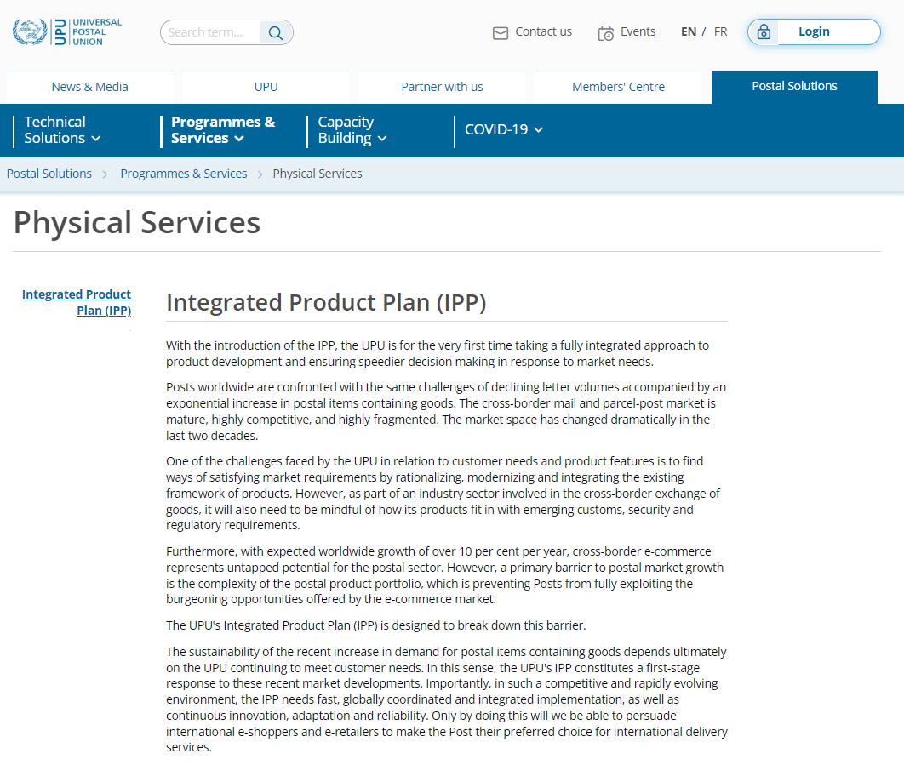
Webinar materials
Guides
User guide
Physical Services Publications
Capacity Building
UPU Forms
Webinars
Presentations
Chat-based questions and answers
Watch the webinar

Slide 12
Tracked delivery service user guide - section themes
POC S6 approved the user guide for the tracked delivery service for letter-post items (POC C 2 2024.2–Doc 2c.Annex 1)
Background
Key operational requirements
Labelling and identification
Technical requirements
Accounting and statistics
Performance and remuneration
7 Using the performance report
The guide provides an overall description of the operational and technical requirements for the tracked delivery service
Link to the guide

Slide 13
Definition, weight and operation
Definition | Member countries shall ensure the provision of the tracked delivery service for letter-post items containing goods and may offer the service as an optional supplementary service in relations between those designated operators for letter-post items containing letters. (Convention articles 17 and 18) Items shall be delivered in the domestic priority service. (Regulations article 18-102)
Weight | Member countries shall ensure that their designated operators accept, handle, convey and deliver tracked items up to 2 kg. (Convention article 17.2)
Notification | Designated operators shall notify the International Bureau if, in addition to offering the mandatory inbound tracked delivery service for letter-post items containing goods, they offer the outbound tracked delivery service for letter-post items containing goods and/or the inbound/outbound tracked delivery service for letter-post items containing documents. Relevant information will be presented in the Letter Post Compendium.

Slide 14
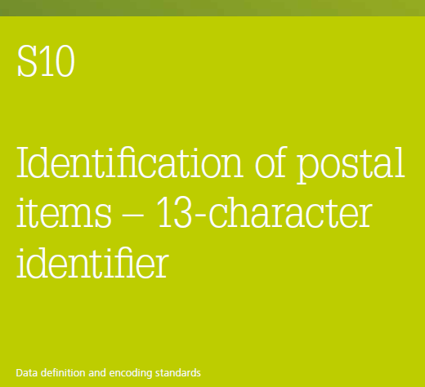
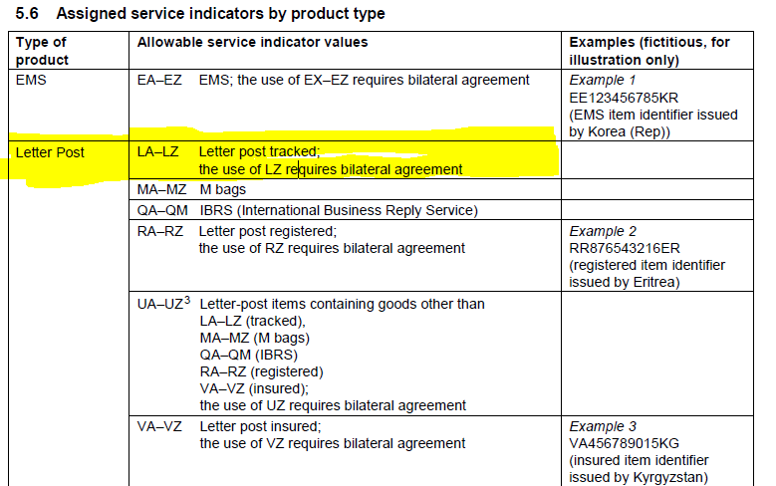
Identification of tracked items
Tracked delivery items shall use the specific service indicator values LA–LZ; the use of LZ requires bilateral agreement. This service indicator makes up the first two characters of the barcode identifier as defined in UPU EDI Messaging Standard S10 (Identification of postal items – 13-character identifier).
Designated operators shall apply a single barcode identifier conforming to UPU Technical Standard S10 to small packets containing goods to enable the provision of cross-border customs electronic advance data in compliance with UPU EDI Messaging Standard M33 (ITMATT V1).
The presence of such an identifier shall not imply the provision of a delivery confirmation service.
The identifier should appear on the front of the item and should not obscure the other service markings, indicia or address information
(Regulations article 17-107.6.4)

Slide 15


Marking of tracked items
Tracked delivery items may be provided with a logo which shall if possible be bright red and of the shape reproduced below. A black and white version may, however, be used for system-generated labels. The “Tracked” logo shall be placed on the address side, in so far as possible in the top left-hand corner, beneath the sender’s name and address where these are given. (Regulations article 18-102.2.1.1)
The “Tracked” logo may be included in the CN 05bis label.
Items for tracked delivery shall bear a CN 05bis label, barcoded with a barcode conforming to UPU Technical Standard S10. The CN 05bis label shall have a single, unique item identifier that conforms to the provisions of article 17-130. (Regulations article 18-102.2.1.2). Alternatively, e.g. in case of a system-generated label, an equivalent of the CN 05bis label (including the barcode) may be integrated into the label, provided that the information is clearly recognizable.

Slide 16
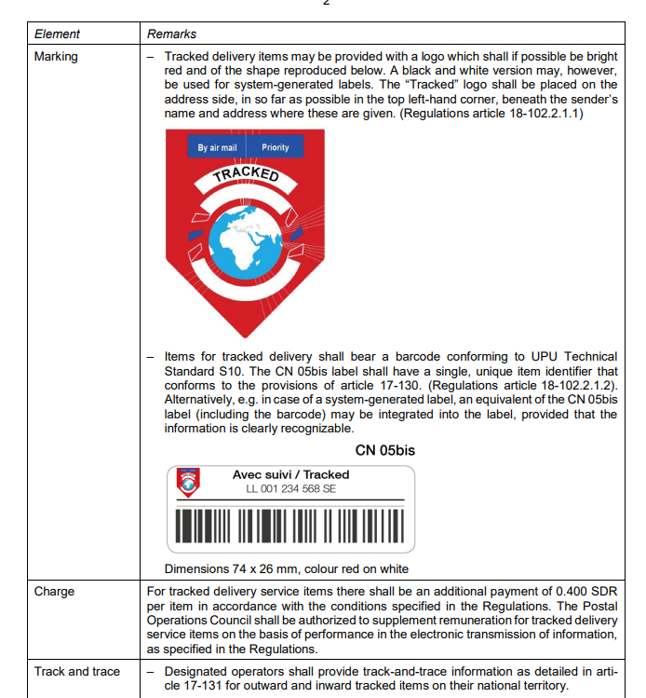
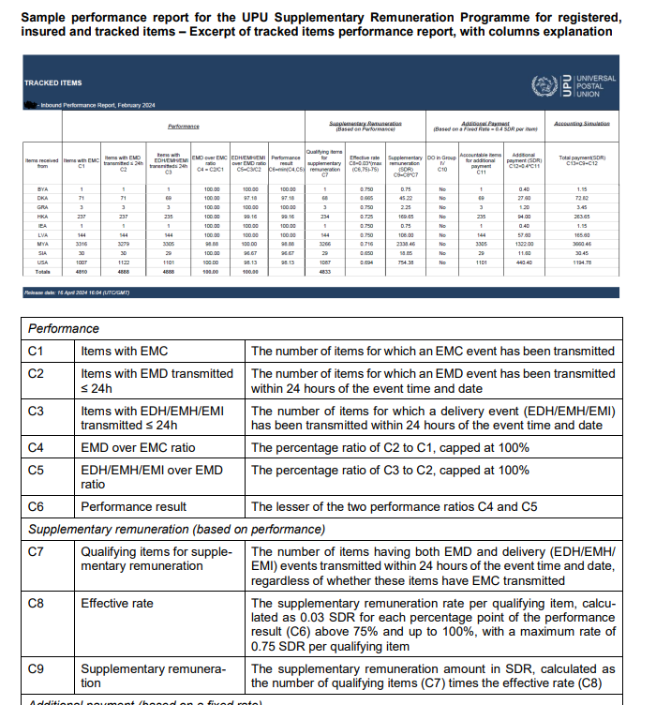
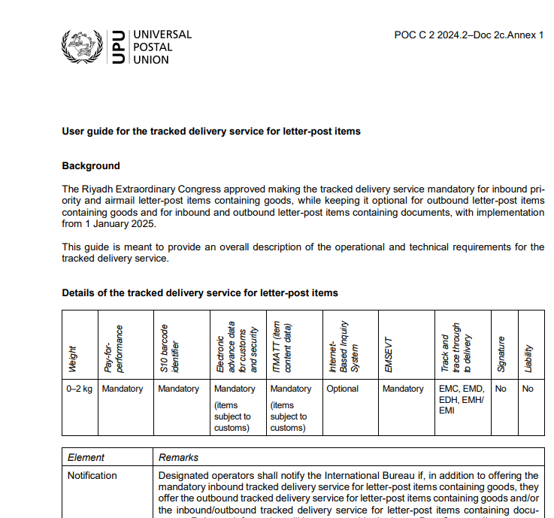
Tracked delivery service guide
APPROVED

Slide 17
3 Registered and insured services effective 1 January 2026

Slide 18

Pivoting towards customers and their needs Product-related changes effective 1 January 2026
Registration service limited to documents only – Convention article 18.1.1
Exchange of EMSEVT V3 mandatory for registered, insured and tracked items – Regulations articles 17-130 and 17-131

Slide 19


Registration service (RA–RZ) – Changes effective 1 January 2026
Originally, the registration service was a mandatory supplementary service for letter-post items containing documents and goods, with end-to-end liability and visibility only at delivery, without end-to-end tracking. The original purpose of the registration service was to provide proof of posting and a signature on delivery from the recipient, mostly for legal documents (max. 2 kg).
What will change: The registration service will be limited to documents only from 1 January 2026, with mandatory electronic tracking for registered and insured items. Therefore, the registration service will no longer apply to postal items containing goods, including those containing admissible dangerous goods or infectious substances.
Convention changes:
Article 18 – Supplementary services
1 Member countries shall ensure the provision of the following mandatory supplementary services:
1.2 registration service for outbound and inbound priority and airmail letter-post items containing documents only.

Slide 20
Registration service (RA–RZ) – Changes effective 1 January 2026 (cont.)
Convention Regulations changes:
Article 19-003
Admissible radioactive materials, infectious substances, and lithium cells and lithium batteries
1.2 When they are sent in letter-post items, they shall be subject to the tariff for priority items or the tariff for letters and registration small packets under the tracked delivery service.
2.2 Category B infectious substances (UN 3373) must be handled, packed and labelled in accordance with the provisions listed in the Regulations. These items shall be subject to the tariff for priority items or the tariff for registered letters small packets under the tracked delivery service. An additional charge for the handling of these items shall be allowed.
2.4 Exempt patient specimens (human or animal) must be handled, packed and labelled in accordance with the provisions listed in the Letter Post Regulations. These items shall be subject to the tariff for priority items or to the tariff for registered letters small packets under the tracked delivery service. An additional charge for the handling of these items is allowed.

Slide 21
Mandatory track-and-trace information via EMSEVT 3 for registered, insured and tracked items
Convention Regulations changes:
Article 17-130
Electronic exchanges to support mail processes
2.1 For tracked, registered and insured items, the exchange of EMSEVT shall be mandatory with all partners. Supplementary remuneration for the provision of track-and-trace information shall be paid in accordance with the provisions set out in articles 31-104 and 31-105.
2.2 For registered and insured items, the exchange of EMSEVT shall be mandatory only within the supplementary remuneration programme, for those designated operators that participate fully in the pro-gramme according to articles 31-104 and 31-105. Data exchange with other participants shall be optional
Note. ‒ Mandatory EMSEVT events: EMC, EMD, EMH and EMI (Regs art. 17-130.3.1)*
* EDH was added to Regs art. 17-131.7.8 as one of the delivery events.

Slide 22
4 Technical requirements for registered and insured services

Slide 23
Overview of features: registered, insured and tracked delivery services
Postal service | Goods or documents | Weight range | Non-priority, priority or premium | S10 barcode identifier | EMSEVT | Electronic tracking through delivery | ITMATT (item content data) and EAD | IBIS | Signature at delivery | Liability between DOs
Registration | Documents | 0–2kg | Priority | Mandatory (RA–RZ) | Mandatory | EMC, EMD, EDH, EMH/ EMI | N/A | Optional | Yes | Yes
Insured | Documents (effective from 1 January 2026) | 0–2kg | Priority | Mandatory (VA–VZ) | Mandatory | EMC, EMD, EDH, EMH/ EMI | N/A | Optional | Yes | Yes
Tracked delivery service | Documents and goods | 0–2kg | Priority | Mandatory (LA–LZ) | Mandatory | EMC, EMD, EDH, EMH/ EMI | Mandatory (items subject to customs control) | Optional | No | No

Slide 24
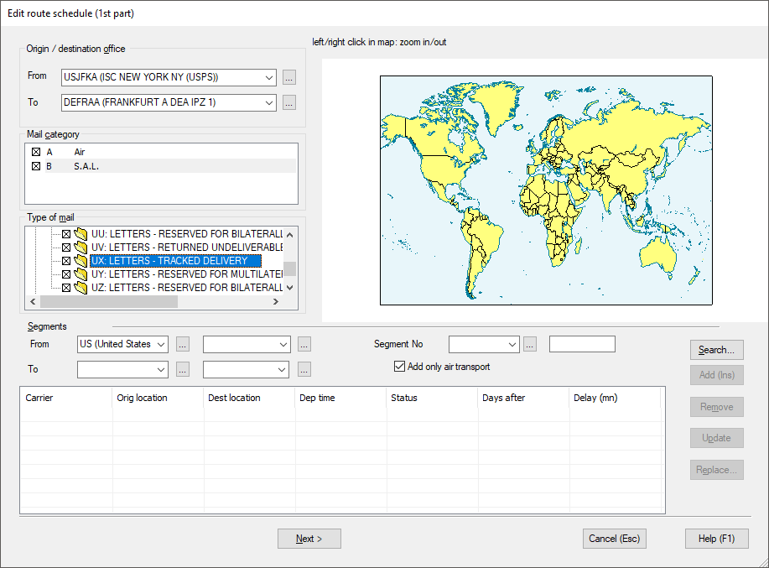
Route management
IPS allows the configuration of routes for sending of dispatches and receptacles with UX mail subclass for tracked items, and UR mail subclass for registered items
1 Run the function National management > Routing plan > International > Air and S.A.L. routes.
2 Create or update existing routes. Select the mail dispatch/ receptacle subclasses allowed for the given route:
UX: LETTERS – TRACKED DELIVERY
UR: LETTERS – REGISTERED
For letter mail sent to the US
USPS accepts only:
UA receptacles for letters containing goods
UL receptacles for letters containing documents

Slide 25
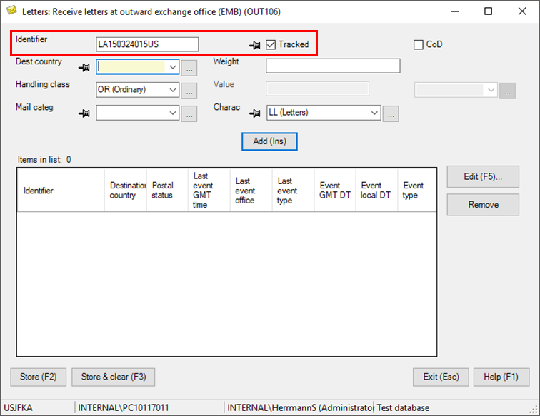
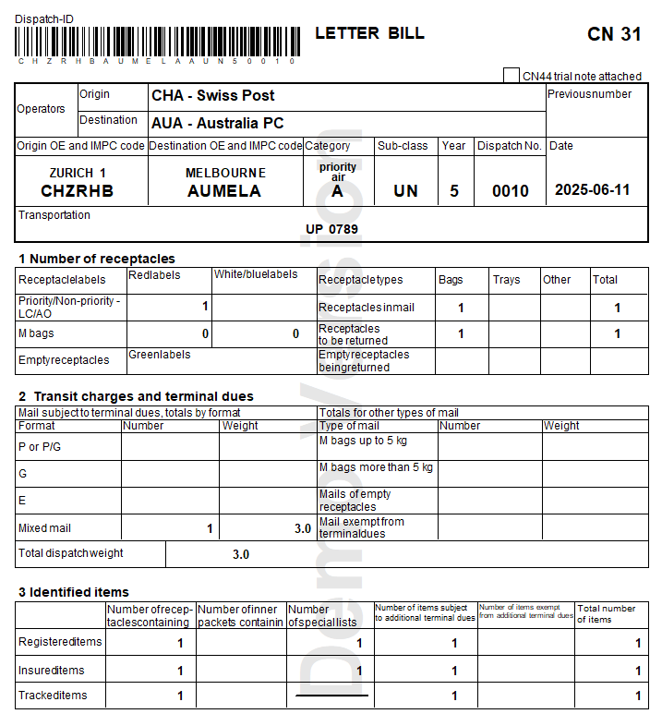
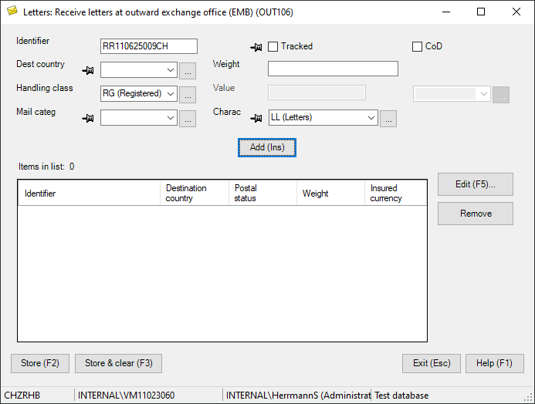
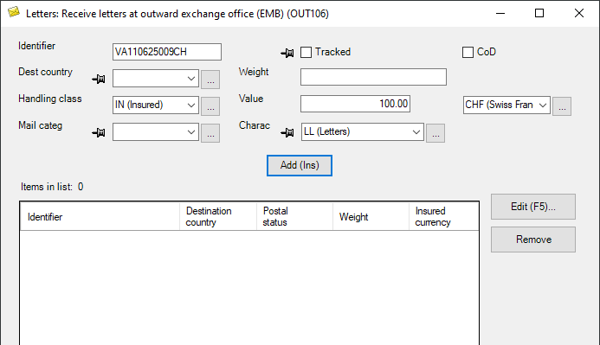
Dispatch creation
Mail management – outbound operations
Mail items with a service indicator within the LA–LZ, RA–RZ or VA–VZ range are automatically stored as tracked, registered or insured items, respectively.
IPS function:
Letters > Outbound > Letters > Receive letters at outward exchange office (EMB)

Slide 26
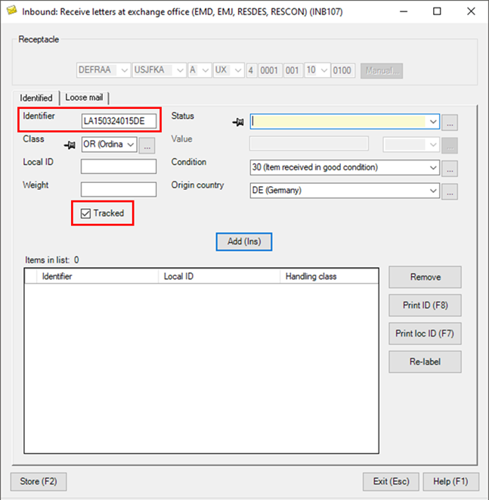
Inbound mail
Mail management – inbound operations
Mail items with a service indicator within the LA–LZ, RA–RZ or VA–VZ range are automatically stored as tracked, registered or insured items, respectively.
IPS function:
Letters > Inbound > Receive letters at exchange office

Slide 27
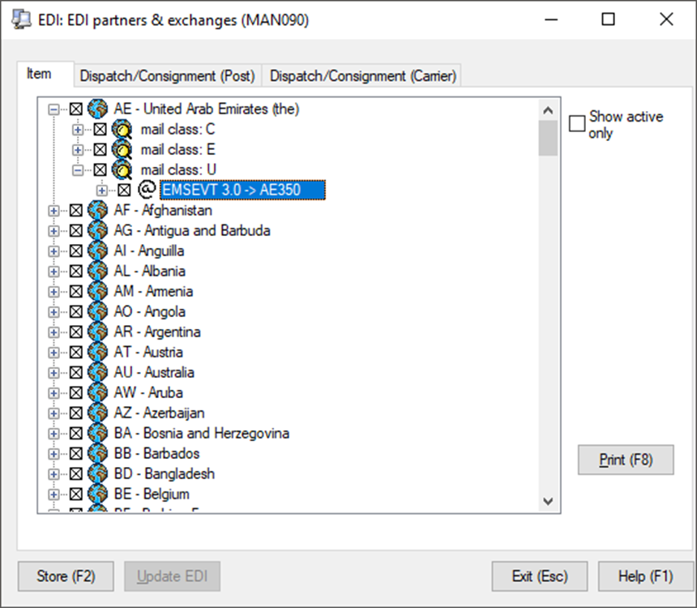
EDI configuration
Configuration of electronic data interchange (EDI)
The EDI configuration for all letter products/ services is the same.
In National management > EDI > EDI partners and exchanges, tick the “Mail class: U – EMSEVT 3.0” checkbox for all your partners.

Slide 28


IPS 2025
Changes can be made to IPS 2025 to facilitate the processing of tracked, registered and insured letters
One requirement has already been identified:
Registered items not allowed in UA receptacles
Please share any ideas or suggestions you have with the PTC

Slide 29
5 Remuneration

Slide 30
Remuneration of registered and insured documents effective 1 January 2026
Registered items and insured items (documents)
Additional payment for registered items in 2026: 1.745 SDR/item (+4.5% compared to 2025)
Additional payment for insured items (documents) in 2026: 2.045 SDR/item
Supplementary remuneration for mandatory tracking:
0.250 SDR for each item where the destination DO provides the timely transmission of EMD and EDH or EMH or EMI
Increased to 0.500 SDR if the destination DO achieves a performance target of EDH/EMH/EMI over EMD at 80% in 2026, 85% in 2027, 90% in 2028 and 95% in 2029 and 2030
Total remuneration = base remuneration (E format) + additional payment (surcharge) + supplementary remuneration (tracking, mandatory)

Slide 31
Remuneration of registered and insured documents effective 1 January 2027
Registered and insured items (documents)
Base remuneration: P/G format (change)
Additional payment for registered (surcharge): 2.500 SDR/item (to compensate for shift E > PG format base remuneration) (+4.5% annually for subsequent years)
Additional payment for insured (surcharge): 0.300 SDR/item on top of the registered surcharge (2.800 SDR in 2027)
Supplementary remuneration for mandatory tracking (same as in 2026 – see previous slide)
Total remuneration = base remuneration (P/G format) + additional payment (surcharge) + supplementary remuneration (tracking, mandatory)

Slide 32
Remuneration of insured parcels effective 1 January 2027
Insured parcels
Insured surcharge similar to the one applied for letters: 0.300 SDR on top of the charge for items with POD (1.200 SDR or equivalent internal POD surcharge)
* Proposed amendment by Germany adopted by Congress
Total remuneration = parcels base remuneration + additional payment (surcharge POD + 0.300 SDR) + supplementary remuneration, max. 0.500 SDR/item (tracking, mandatory)

Slide 33
Remuneration of registered and insured items
Summary table
Year | Registered items |  | Insured letter-post items (documents only) |  | Insured parcels
 | (a) Surcharge | (b) Tracking (maximum) | (a) Surcharge | (b) Tracking (maximum) | (a) Surcharge | (b) Tracking (maximum)
2026 | 1.745 | 0.500 | 2.045 | 0.500 | – | –
2027 | 2.500 | 0.500 | 2.800 | 0.500 | 1.500 | 0.500
2028 | 2.613 | 0.500 | 2.913 | 0.500 | 1.500 | 0.500
2029 | 2.731 | 0.500 | 3.031 | 0.500 | 1.500 | 0.500
2030 | 2.854 | 0.500 | 3.154 | 0.500 | 1.500 | 0.500

Slide 34
6 Quality measurement and reporting

Slide 35
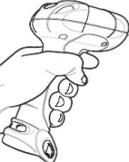


I. Data capture and exchange
Relevant EDI data captured:
Last outbound event/departure from outbound OE/AMU (EMC)
First inbound event/arrival at inbound OE/AMU (EMD)
Delivery event(s)
Attempted delivery (EMH) or
Arrival at collection point for pick-up (EDH) or
Final delivery (EMI)
Registered: RA–RZ
Insured: VA–VZ
Sorting centre (origin)
Airmail unit/ office of exchange (origin)
Airmail unit/ office of exchange (destination)
Sorting centre (destination)
Last mile/ recipient/ delivery
First mile
Post (origin)
Customs
*
*
Customs
*
*
*
*
*
Border
*
*
*
*
*
*
*
EMC
EMD
EMH/EDH/EMI

Slide 36

I. Data capture and exchange (cont.)
Transmission of EDI data:
Transmitted through established EDI messaging networks:
UPU system (POST*Net via IPS)
IPC system
EDI data is stored at the UPU
Current transmission targets:
EMD < 24 hours, for items with EMC
EMH or EDH or EMI < 24 hours, for items with EMD
For each DO, the number of items with events meeting the above targets are counted
Registered: RA–RZ
Insured: VA–VZ
II. Measurement: deadlines for data transmission

Slide 37
III. Measurement: performance calculation
For each flow, minimum targets:
56% of items with EMC event MUST also have EMD events
and
56% of items with EMD event MUST also have delivery event (EMH or EDH or EMI)
…cascade calculation mechanism: different from calculation for tracked measurement
When the minimum targets are fulfilled and DO participates in pay for performance (prior to 2026), all items transmitted within 24 hours qualify for remuneration.
Remuneration = number of qualifying items x 0.5 SDR

Slide 38
Reporting schedule (see IB circular 51/2025)
Reporting follows guidelines as contained in article 31-105
LAS – letter accounting simulation
Q – quarter
Y – reporting year
Reports will be published in QCS Mail application (qcsmail.ptc.post) between 15th and 25th of each month
Final reports for remuneration: February (Q4), May (Q1), August (Q2), November (Q3)

Slide 39
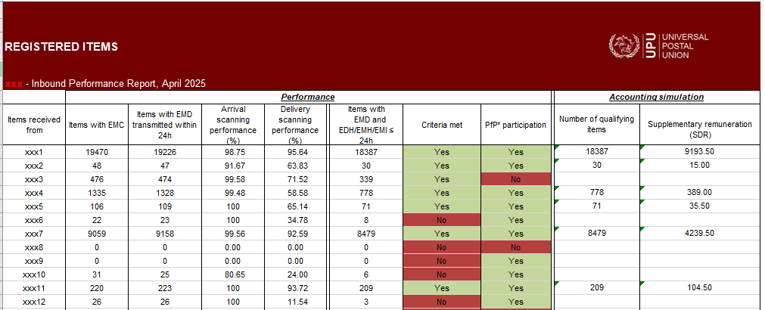
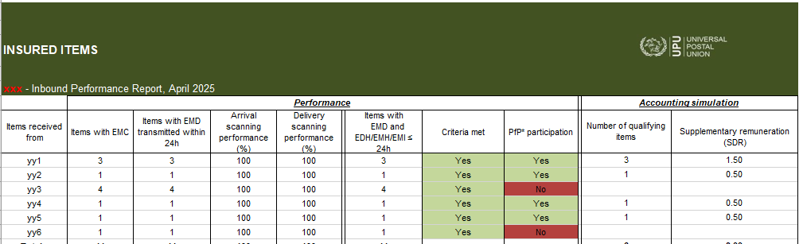
Sample report

Slide 40
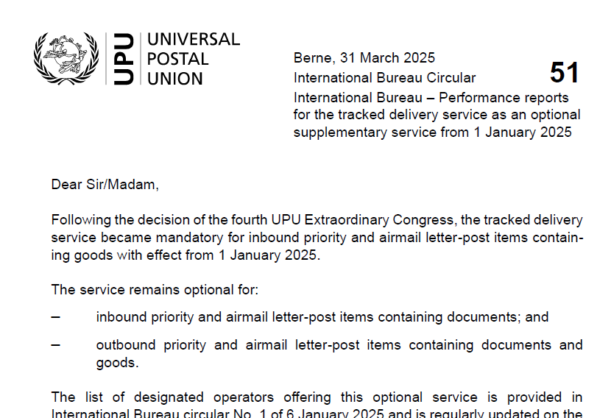
Experiences and operations reports
Experiences
EDI data to be copied
Accessing QCS reporting system
Operations reports
Only flat file can be generated and made available on demand
UPU Global Reporting System will contain more operational reports

Slide 41
Electronic handling of international inquiries effective 1 January 2026
Convention Regulations article 21-003 (Inquiries when using IBIS)
The preparation of requests for designated operators using IBIS is mandatory for parcels and optional for letter-post items
When IBIS is used for letter-post items, all operational and technical procedures applicable to IBIS for parcels also apply to letter-post items
Scope:
International inquiries for registered, tracked and insured items will be handled using the Internet-based inquiry system – already in use for parcels
Key changes:
Unified system using IBIS–GCSS to ensure consistency across inquiries
The relevant module is being enhanced by the GCSS provider to allow for access by existing and new call centres/users
Call centres and users already experienced with handling Internet-based inquiries will be instrumental in this rollout; training can be organized when needed
Next steps:
Detailed guidance and implementation support will be communicated shortly to all members

Slide 42
7 Accounting

Slide 43
Accounting today
UPU supplementary remuneration programme (SRP) optional participation
-> “Closed” subgroup of operators that have supplementary remuneration based on performance
Product | Additional remuneration | Supplementary remuneration
Registered | Applies to all registered items received Account: CN 55, 56, 61 | Only among UPU SRP participants Based on UPU reports Account: CN 60
Insured | Applies to all insured items received Account: CN 55, 56, 61 | Only among UPU SRP participants Based on UPU reports Account: CN 60
Tracked | Based on UPU reports Account: CN 60 | Based on UPU reports Account: CN 60

Slide 44
Accounting from 2026
Product | Additional remuneration | Supplementary remuneration
Registered | Applies to all registered items received Account: CN 55, 56, 61 | Only among UPU SRP participants Based on UPU reports Account: CN 60
Insured | Applies to all insured items received Account: CN 55, 56, 61 | Only among UPU SRP participants Based on UPU reports Account: CN 60
Tracked | Based on UPU reports Account: CN 60 | Based on UPU reports Account: CN 60

Slide 45
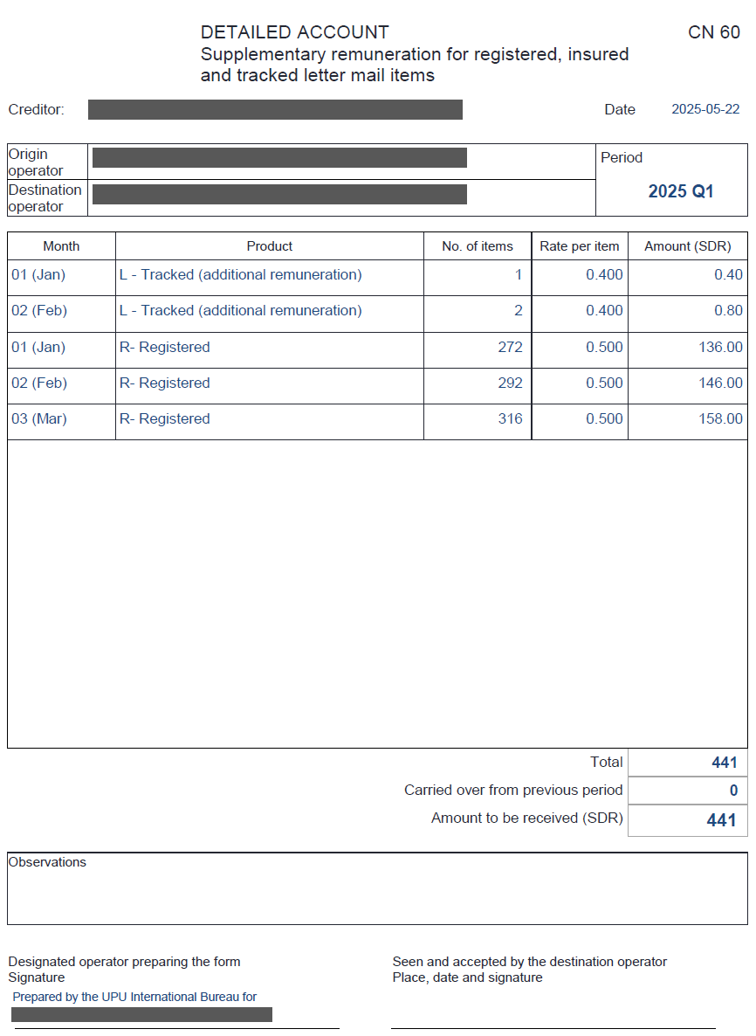
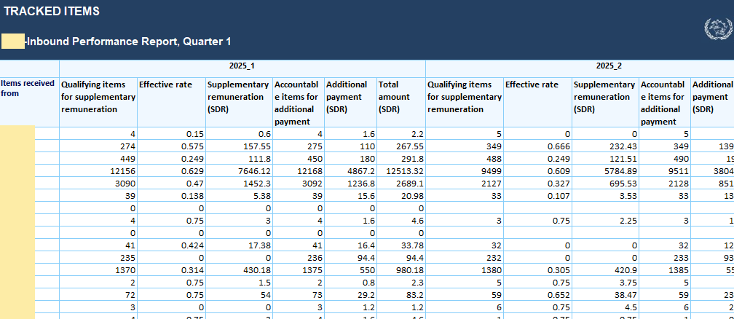
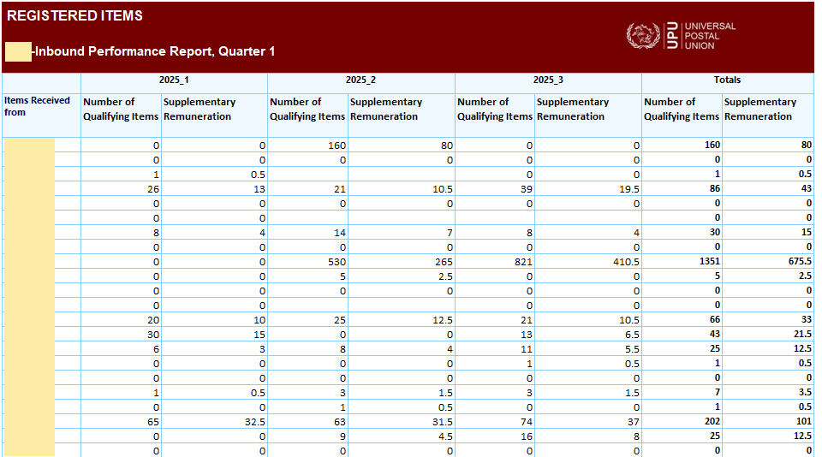
CN 60
Quarterly account
Content: exclusively from UPU report (based on EMSEVT exchanges)

Slide 46
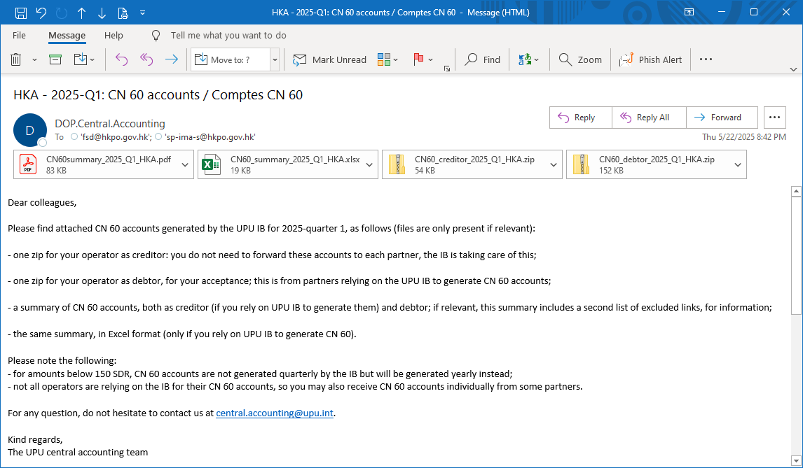
Centralized CN 60
Content of CN 60: “copy and paste” from central IB report
New optional IB service as of 2025: the IB can generate and distribute CN 60 accounts on behalf of interested DOs
Avoids manual copy-paste
No challenge with verification notes
IB handles payment thresholds (payment carried over to next period, etc.)
More pleasant and easier for debtors to receive centrally generated accounts

Slide 47
Centralized CN 60 (cont.)
Central CN 60: solution described in Convention Regulations article 31-106 (Preparation and transmission of charges for supplementary remuneration accounts and additional payments based on central reports)
Starting in 2026, CN 60 will be used more -> increased benefits with centralized CN 60
Note. ‒ Central approach covers bilateral/multilateral agreements with accounting outside UPU

Slide 48
8 Compliance

Slide 49
EDI compliance measurements
EDI compliance measurements available in the compliance platform published in QCS (qcsmailbd.ptc.post)
Part of data quality measurements
Platform designed to show issues and help resolve them
Compliance measurements regularly refreshed to match new rules/needs
Intention to adjust at the beginning of 2026 to:
take account of the mandatory exchange of EMSEVT for all letter mail -> All EDI links should be opened for xx350 EDI addresses -> EMSEVT messages should be sent with all partners
show anomalies such as registered mail present in dispatches containing goods only (UA dispatches)

Slide 50
IBIS: electronic handling of inquiries for letter-post items
Shaping the future of postal services: UPU regulatory updates and IT innovations with delivered duty paid solution
UPU – Postal Operations Directorate (DOP.EPSI)

Slide 51
Objectives
Introduce electronic exchanges (PREDES/RESDES, EMSEVT) for tracked/registered/insured items
Define IBIS and general inquiry principles
Explain the two-level IBIS workflow and messages
Clarify reply times and performance indicators
Ensure standardized inquiry handling and transparent tracking through IBIS and EMSEVT

Slide 52
EMSEVT messaging and IBIS integration
Tracked, registered and insured items: EMSEVT exchange mandatory with all partners
Provides outward and inward tracking on national territory
PREDES: item-level data where identified items exist; format of contents where relevant
RESDES: receptacle type and format of contents where relevant
S10 identifiers included for all items containing goods (UPU EDI M41)

Slide 53
Internet-based inquiry system
UPU-certified IBIS
Mandatory for parcels; optional for letter-post but recommended
Used for preparation, submission, transmission, receipt and processing of inquiries

Slide 54
Internet-based inquiry system
General principles: article 21-001 of Convention Regulations
CN 08: inform anticipated transmission time
IBIS inquiry submitted after transmission time expires unless RESDES/EMSEVT inbound
Reservations on handling periods only via bilateral agreements
Inquiries accepted once problem is reported by sender or addressee

Slide 55
Internet-based inquiry system
Evidence of delivery:
Provide written proof when delivery disputed: CN 07 advice of delivery, signature copy or other evidence
Comply with related UPU articles
Origin
operator (requesting partner)
Destination operator (replying partner)
Customer
L1Q
Close workflow
Yes
L1R
No
L2Q
Yes
L2R
IBIS – two-level inquiry workflow

Slide 56
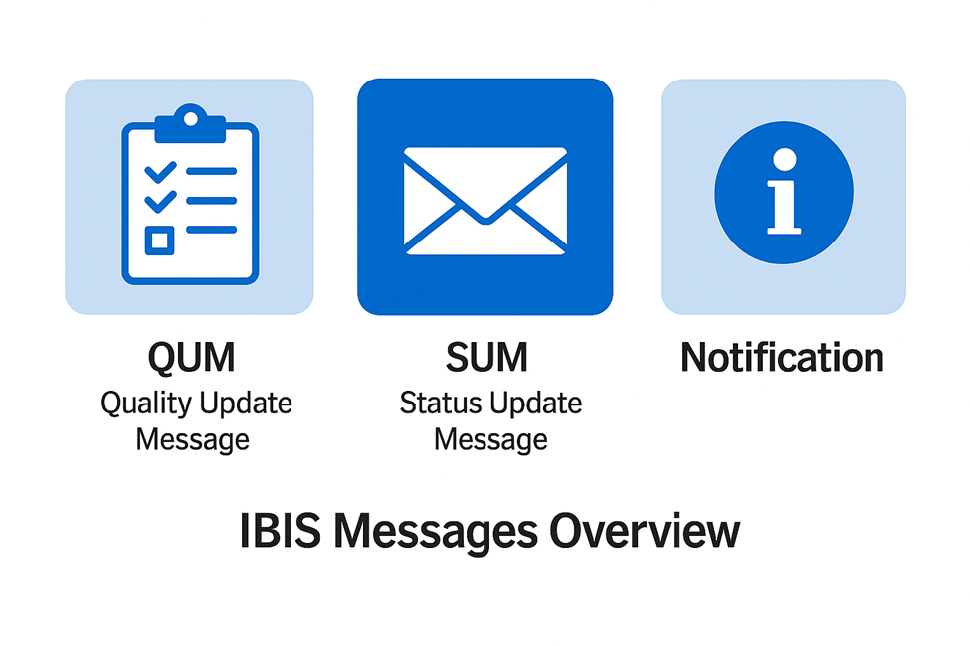
Internet-based inquiry system
QUM: request clarifications or missing information
SUM: interim status before final reply
Notification: proactive item-level info without opening official inquiry

Slide 57
Internet-based inquiry system
Type of request | Reply time L1 | Reply time L2
Update/confirmation item status | 3 days | 15 days
Written proof of delivery (WPOD) | 10 days | –
Damage/missing contents | 7 days | 15 days
Misdirected/redirected/transit | 7 days | 15 days
Customs investigation | 7 days | 15 days
Advice of delivery (AR) | 7 days | 15 days
Reply
times
(working
days)

Slide 58
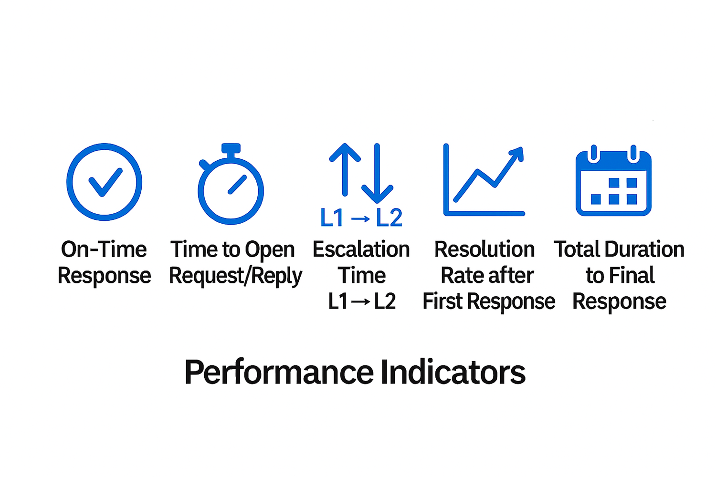
Internet-based inquiry system
Performance targets:
Letter post: ≥80% on-time responses
Parcel post: ≥90% on-time responses and ≤8 working hours to open requests and replies

Slide 59
Key points on IBIS and inquiry handling
IBIS and EMSEVT ensure standardized inquiry handling and transparent tracking
Align local processes with timelines and mandatory data
Consequential proposal on the mandatory use of IBIS for letter-post items to be discussed at the Product Development and Integration Group meeting on 9 February 2026
UPU-certified Internet-based inquiry system to support electronic handling of inquiries for letter-post items

Slide 60

Thank you
Chokri Ellili, Physical Services Implementation and Capacity Building Programme Manager
ellilic@upu.int

Slide 61
Latest innovations: UPU IT systems and delivered duty paid solution
Shaping the future of postal services: UPU regulatory updates and IT innovations with delivered duty paid solution
UPU Postal Technology Centre

Slide 62

UPU products and solutions

Slide 63


UPU products and solutions
LEG 1
LEG 2
LEG 3
Individuals
Domestic processing
International processing
Transport
International processing
Domestic processing
Individuals
EAD Customs Declarations
Data capture
DPS Mobile
Mail collection at home
DPS 2025
Domestic dispatching
PO boxes
Point of sale
CDS 2025
Customs declarations (data capture, verification, DDP)
IPS 2025
International dispatching
Accounting
EDI
CDS 2025
Customs decisions for outbound mail
EAD Transport
CARDIT/ RESDIT exchanges
EAD compliance
IPS 2025
International dispatching
Accounting
EDI
CDS 2025
Customs decisions for inbound mail
DPS 2025
Domestic dispatching
PO boxes
Point of sale
DPS Mobile
Mail delivery
POST*Net

Slide 64
UPU products and solutions
EAD check
Assess whether mail processed in outbound, transit or inbound complies
with electronic advance data requirements
Lookup services
HS codes, prohibitions and restrictions, denied parties from several providers
UPU DDP
Generic DDP solution embedded in CDS and available on the UPU API Gateway
DGST
Detection of dangerous mail items in domestic and international processing

Slide 65
Integration
E-commerce companies/ marketplaces
Track and trace
Customs declarations
Designated
operator
Customs
ASYCUDA
Customs declarations
Customs decisions
IPS
CDS
API
Solution providers
Lookup services
Landed cost calculator
DPS
UPU
UPU SAVE
EAD check
DGST

Slide 66
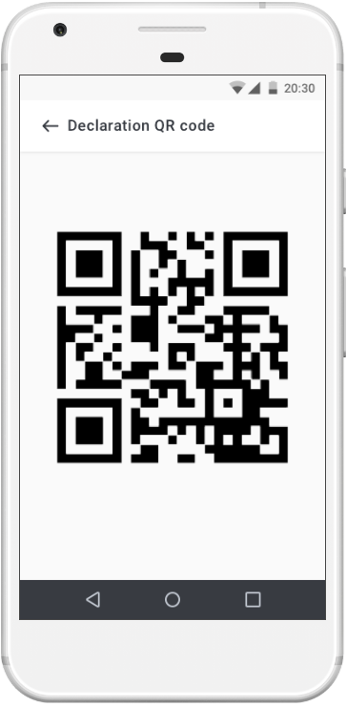
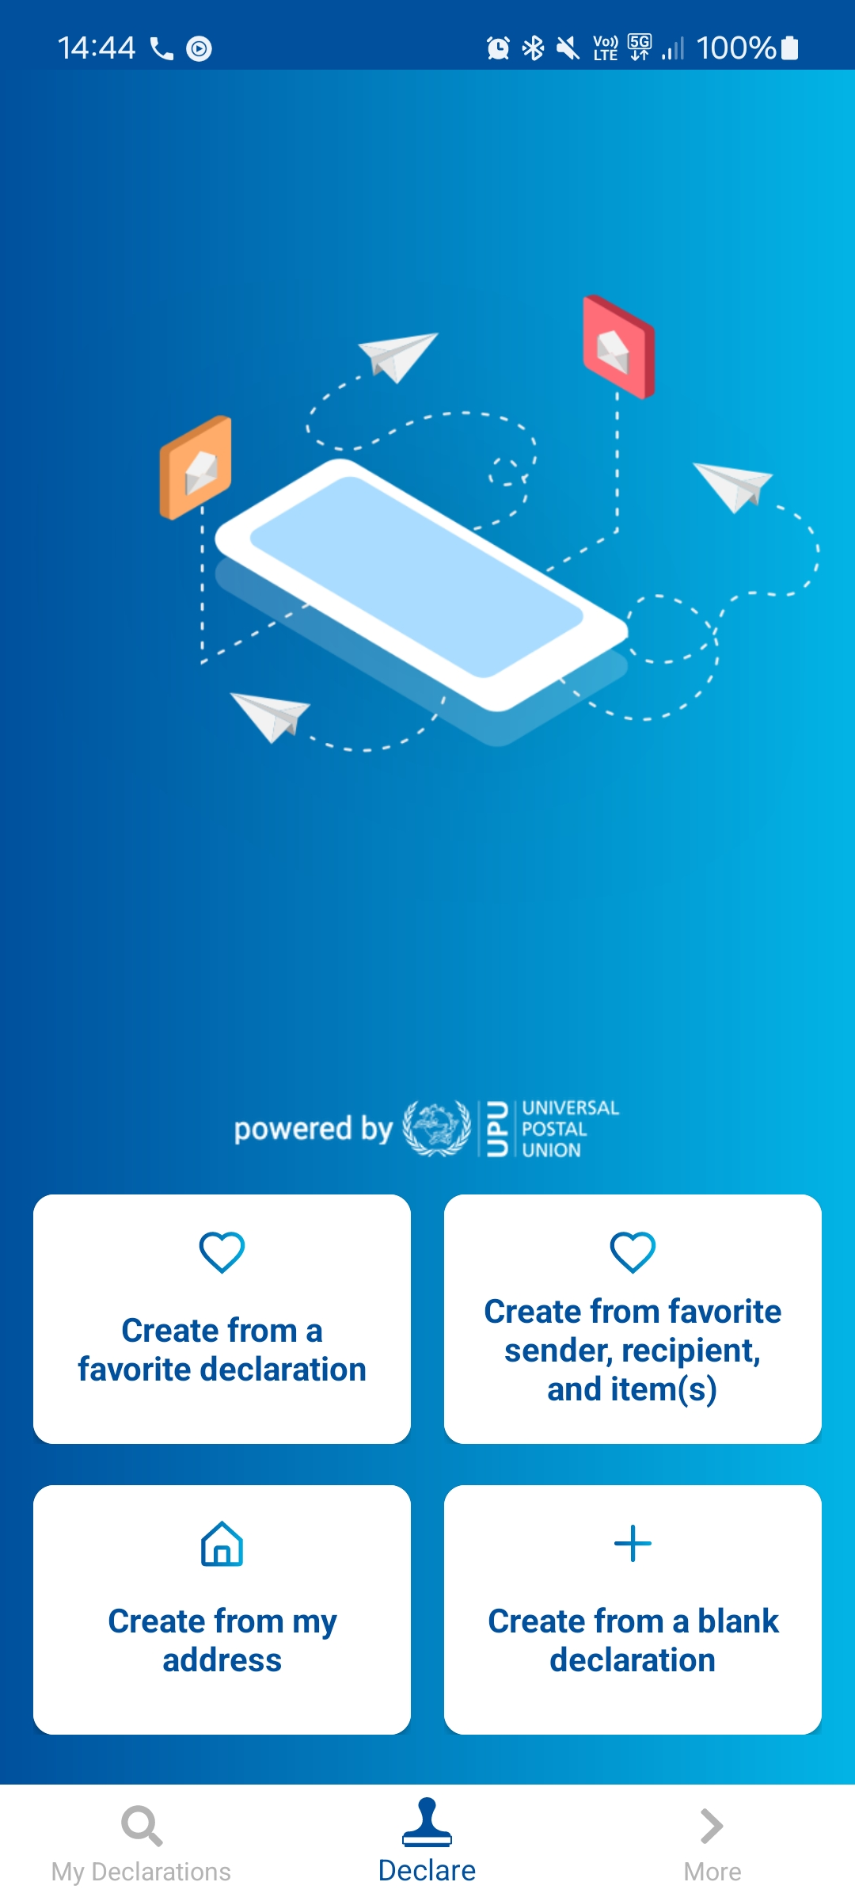
Technology
Web
Mobile
Windows
client
API
UPU API Gateway
Cloud
Local installation

Slide 67

UPU DDP solution

Slide 68

UPU DDP solution
UPU DDP solution
Shipping of goods by all Posts
A global solution for all 192 UPU member countries and their designated postal operators
Collecting duties and taxes at origin
Retail, counter, online and app payment channels
UPU Customs Declaration System (CDS) and APIs
facilitating DDP and EAD
Transport and delivery to recipient
Electronic advance data compliance and customer visibility
Settlement with customs authority at destination
Bilateral or multilateral settlement channels (Customs, Posts, supplier)

Slide 69


UPU DDP solution – customer journey and process
Hand
over
mail
Customs
declaration
capture
Accept
costs?
At
Post
On
invoice
At third
party
EAD compliance checks
LC calculations
Check
payment
status
Not paid
Prepare
shipment
Prepare
dispatch
Remit
(if pay at Post)
Sending Post
Paid
At home (CDS kiosk, app)
At Post (CDS UI)
At business (CDS API)
If declaration not present,
use DeclarationID to pull it from third party
Prepare DDP-enriched ITMATT
POST*Net
data copies
Reports
Dashboards
Associate
S10–DeclarationID–ShipperID
PTC IT
Prepay
Invoice
Draft declaration
Payment status
Shipment reference
Manifest
Invoice Post
or shipper
QP
Final
assessment
Invoice QP
US CBP

Slide 70
UPU DDP solution offering
Flexible IT deployment options
Turn-key with CDS.post
Built-in process in CDS, or externalize part (or the full) process (CDS APIs)
DDP APIs on the PTC Gateway
86 Posts using CDS.post are technically ready!
Integrated payment options: postal customers can
Pay at Post
Pay directly at the third party (→ outsource, where regulations don’t allow the origin Post to collect duties on behalf of a foreign country)
Modular
Option to subscribe to only part of the solution (e.g. automatic manifests from POST*Net)
Choice of third party
All third-party providers integrated the same way
Easy transition from one to another if required

Slide 71
UPU DDP solution – readiness
CDS 2024 SP2 (current version, live on CDS.post)
CDS 2025 (planned for 5 December 2025)
QP services
Zonos
(Terms and conditions embedded in the CDS license – option)
BoxC
SafePackage
Others at various stages of integration
Qualified party with no direct contract with UPU
(UPU-TechCert certification)
Duties
payment options
Duties collected by Post
Duties collected by Post
Shipper prepays QP
QP invoices shipper
Data copies from POST*Net to the QP
Manifest
preparation
Single QP
Selected QP
By default, configured at the level of the Post of origin
Optionally, can be configured to file according to the QP indicated in the ITMATT (for Posts using different QP in parallel)

Slide 72

UPU DDP solution – roadmap
Flows to the United States
Integrate additional qualified party (on demand)
Anticipate future changes (March 2026, later?)
Global
Adapt – when required – the solution to other market needs (e.g. direct integrations with Customs)
Financial settlements and reports
UPU*Clearing integration (its value to increase when DDP becomes widespread in multiple destinations)
Dashboard and reports (duties reassessed, returns, third-party performance, etc.)
Standardization and interoperability
Customs clearance models (postal, commercial) and impacts on UPU standards and regulations (→ UPU RMIG)
Interoperability with the IPC solution

Slide 73
Launching the service – 4 + 1 steps
1 Contact the PTC to begin upgrade procedures for CDS software
support.upu.int (not required if the postal operator is a user of CDS Cloud or CDS.post)
2 Visit www.upu.int/DDP
Updates on the release plan for the technology
User guides and documentation on the service
Customer awareness and marketing campaigns
To retain your current customers
To offer the service to new customers/guide them through the duties payment options
3 Legal and admin
Update UPU licence agreement. Select the CDS DDP option and the qualified party (if Zonos: sign the embedded terms and conditions)
Sign the data copy authorization form
4 Internal procedures
Decide on the duties payment options (pay at Post, shipper prepays QP, QP invoices shipper) and roll out corresponding procedures
Reconciliation of accounts, payments, settlement procedures (bilateral or multilateral)

Slide 74





















Technology strategy 2026–2029
PARTNERS
Wider postal sector players
DESIGNATED
OPERATORS
UPU postal operators access the global UPU technology platform for postal and non-postal operations
CUSTOMS
AUTHORITIES
CARRIERS
POSTAL BUSINESS
PARTNERS
Volume
providers
Solution providers
UPU COUNTER OPERATIONS
DPS
POST*Net, PosTransfer
UPU POSTAL IT NETWORK
GLOBAL
UPU
TECHNOLOGY
PLATFORM
DOMESTIC
PROCESSING
INTERNATIONAL PROCESSING
CUSTOMS PROCESSING
POSTAL
PAYMENTS
QUALITY
CONTROL
SUPPLY CHAIN INTEGRATION SYSTEMS
POST
ONLINE TRUST AND SECURITY
EAD Transport, UPU SAVE
DPS
IPS
CDS
UPU-IP
QCS
trust.post
API
API
API
API
API
API
CERTIFIED INTEROPERABILITY UPU-TechCert

Slide 75
Thank you
Stéphane Herrmann, Mail Products and Services Lead Technical Account Manager
herrmanns@upu.int

Slide 76
Worldwide volume statistics
January to November 2025 – 2024 – 2023
Shaping the future of postal services: UPU regulatory updates and IT innovations with delivered duty paid solution
UPU – Postal Operations Directorate (DOP.EPSI)

Slide 77
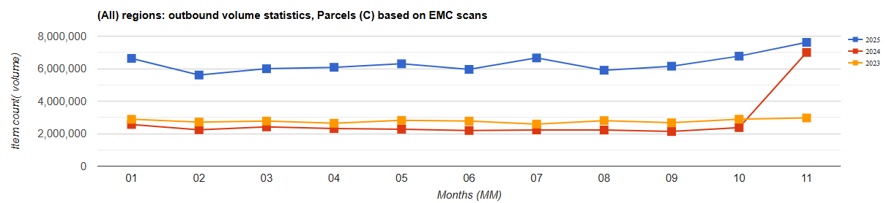
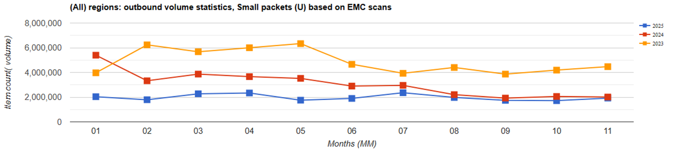
Worldwide volume statistics

Slide 78
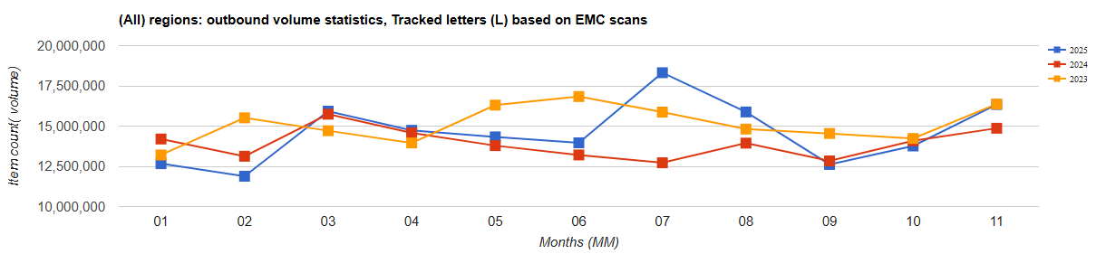
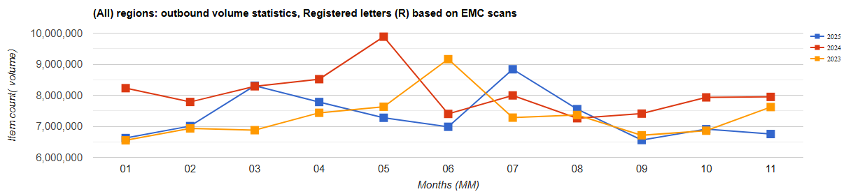
Worldwide volume statistics

Slide 79
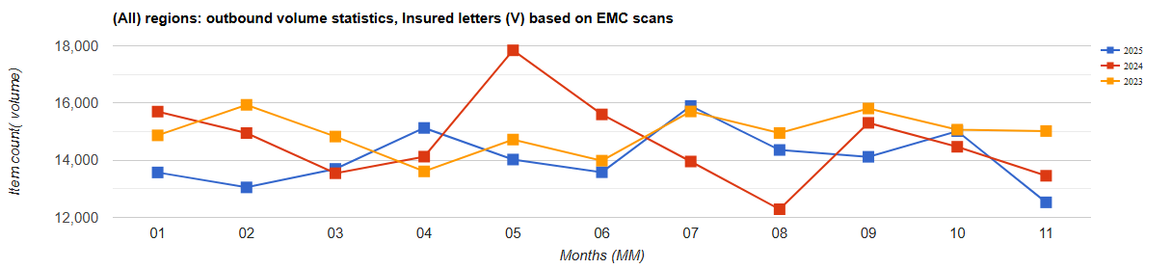
Worldwide volume statistics

Slide 80
Thank you
Chokri Ellili, Physical Services Implementation and Capacity Building Programme Manager
ellilic@upu.int

Slide 81
Questions and answers
Shaping the future of postal services: UPU regulatory updates and IT innovations with delivered duty paid solution
UPU – Postal Operations Directorate (DOP.EPSI)

Slide 82
Support and guidance

Slide 83
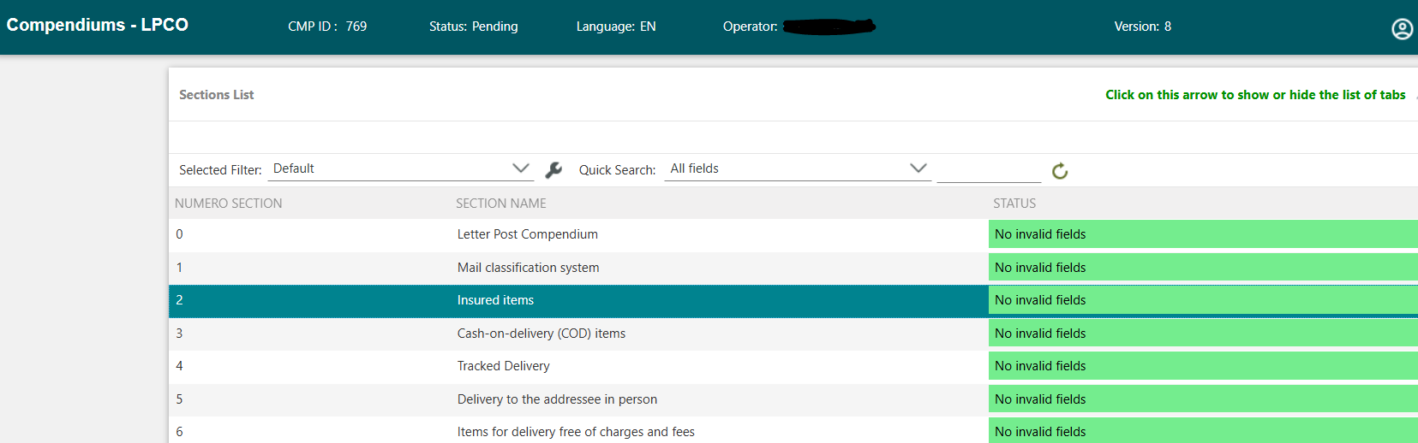
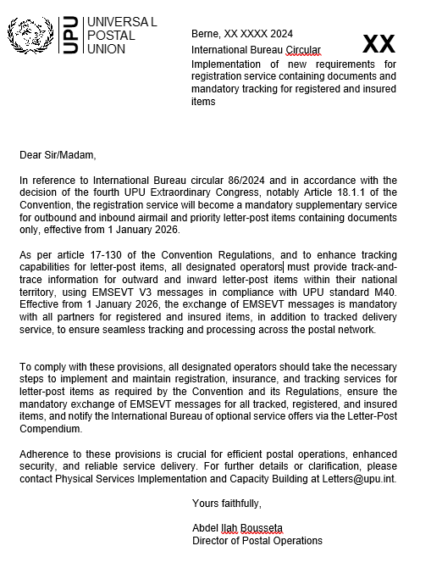
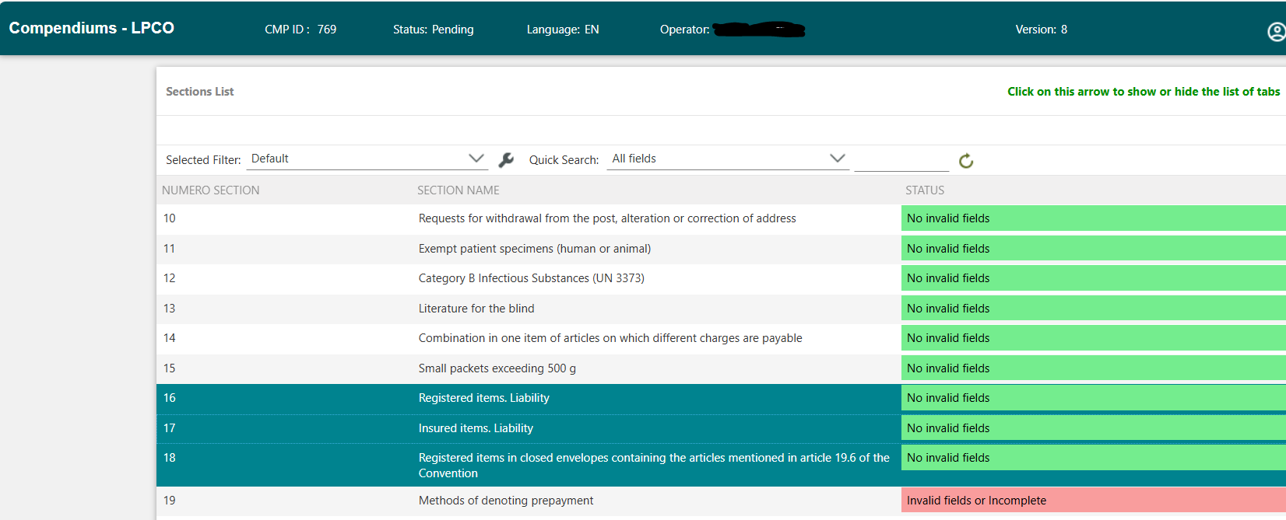
Draft IB circular and updating of Letter Post Compendium Online
D R A F T

Slide 84
For any additional questions or further information, feel free to reach out to us:
Capacity building:
letters@upu.int
Physical services:
poc.psdeig.secretariat@upu.int
Quality of service:
information.qs@upu.int
Remuneration:
dprm-ppre-rem@upu.int
Accounting:
central.accounting@upu.int
EDI compliance:
compliance.standards@upu.int
Technical support:
support.upu.int

Slide 85
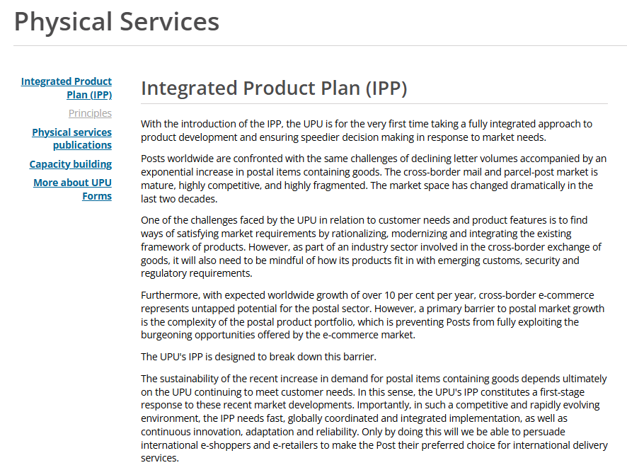
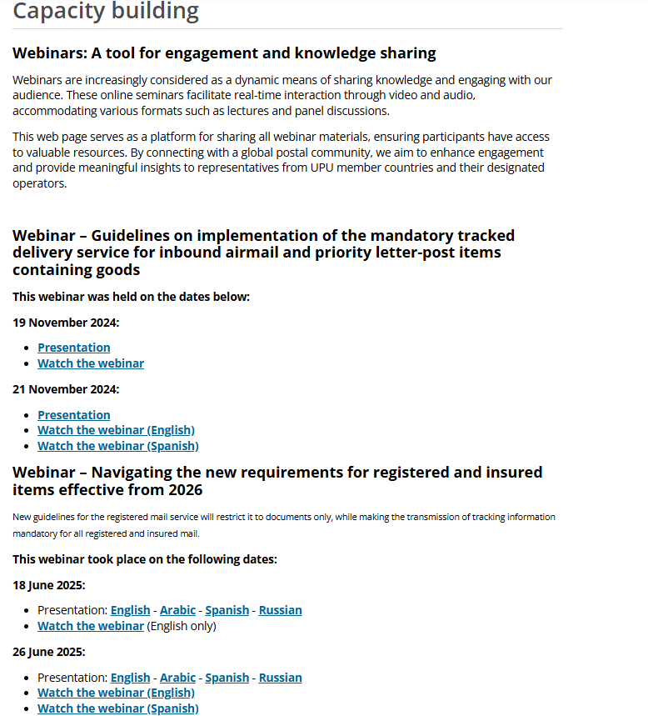
Webinar materials….
www.upu.int/en/postal-solutions/programmes-services/physical-services#capacity-building

Slide 86
Thank you
David Pilkington, Physical Services Development and POC Matters Coordinator
pilkingtond@upu.int

Slide 87
THANK YOU! We appreciate your attention! If you have any additional questions or need further information, feel free to reach out to us at POC.PSDEIG.secretariat@upu.int

