Slide 1
Navigating the new requirements for registered, tracked and insured services effective 1 January 2026
Webinar
E-Commerce, Physical Services Integration and POC Matters Directorate
Postal Operations Directorate, International Bureau

Slide 2
Agenda item | Topic | Speaker
1 | Introduction | Wendy Eitan Regional Coordinators
2 | Physical services and regulatory provisions | David Pilkington/Fredrick Omamo
3 | Technical requirements | Stéphane Herrmann/Laurent Muller
4 | Remuneration | Paul Schoorl/Siham Houhou/Vytis Staskevicius
5 | Quality measurement and reporting | Julius Tsuwi
6 | Accounting | Jean-Marc Coeffic
7 | Compliance | Jean-Marc Coeffic
8 | Chat-based Q&A session | All
9 | Support and guidance | Chokri Ellili

Slide 3
1 Introduction

Slide 4
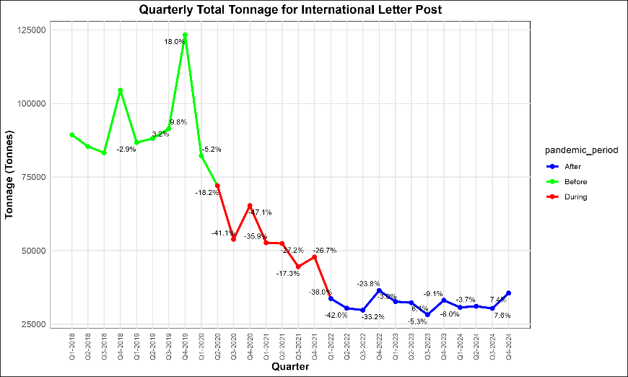

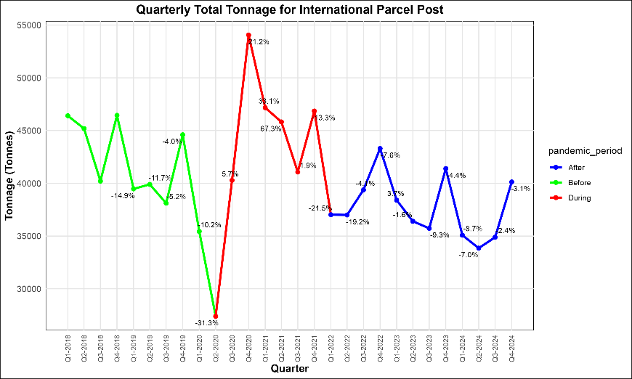
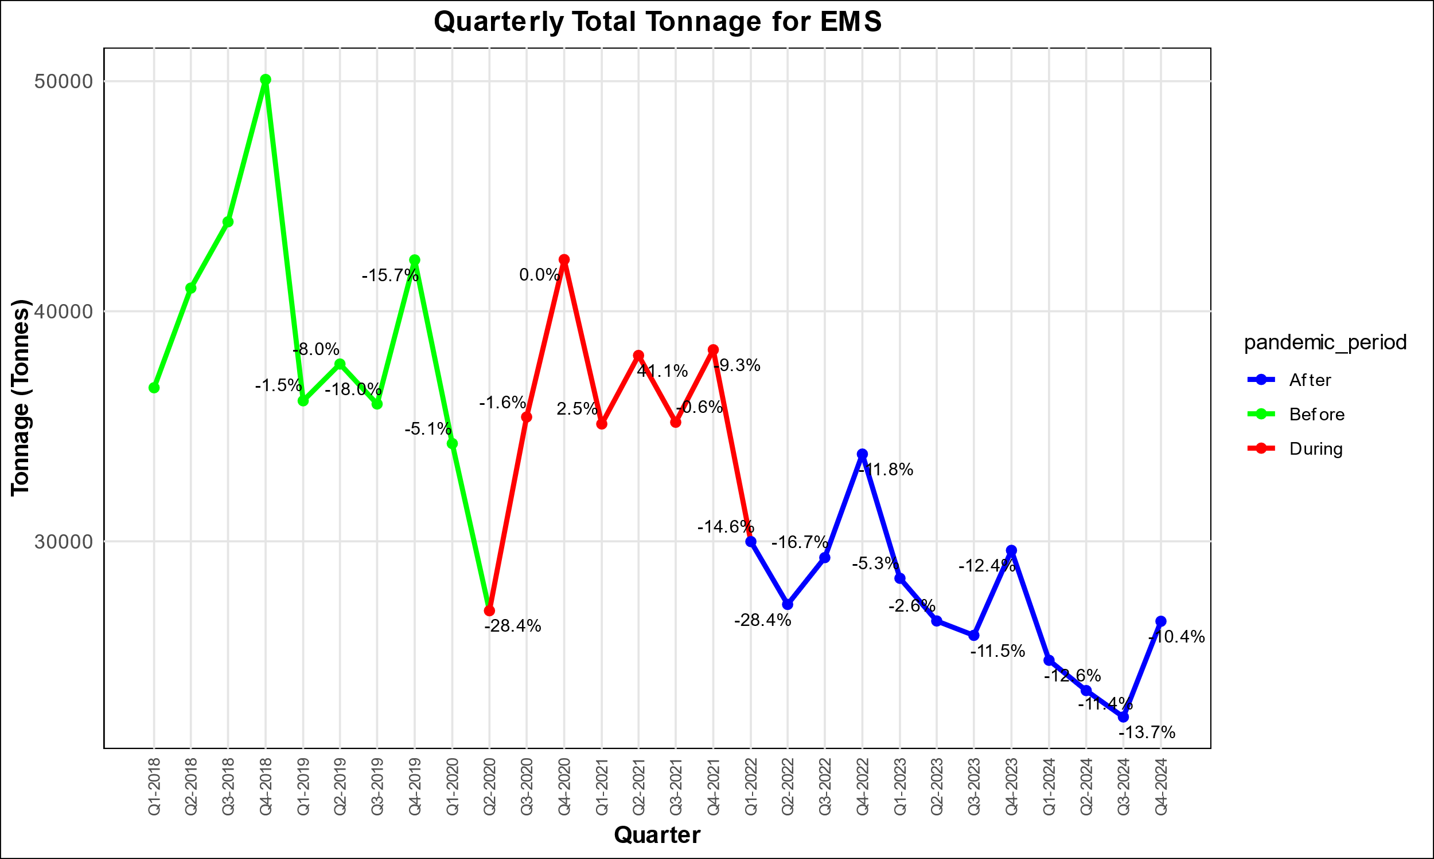
Introduction: What is driving product changes? Internal factors and rapidly changing global landscape
Complexity of postal product offering
Overlap between letter-post, parcel-post and EMS items
Changing customer expectations
Growing e-commerce boom
Emerging trade policy, supply chain, and mail security requirements
Increasing digitalization
Environmental concerns

Slide 5






UPU response and support framework Adapting postal services to market dynamics
Simplifying the service portfolio, enhancing features
Customer-focused, market-driven review and development of services and product features
Service features
Market
Capacity building, knowledge empowerment and development cooperation
Customer at the centre
Aligning regulations to support and facilitate services
Capacity development
Regulatory framework
Developing new models and solutions
New models

Slide 6

Pivoting towards customers and their needs Product-related changes effective 1 January 2026
Registration service limited to documents only – Convention article 18.1.1
Exchange of EMSEVT V3 is mandatory for registered, insured and tracked items – Regulations articles 17-130 and 17-131

Slide 7
2 Physical services and regulatory provisions

Slide 8


Registration service (RA–RZ) – Changes effective 1 January 2026
Originally, the registration service was a mandatory supplementary service for letter-post items containing documents and goods, with end-to-end liability and visibility only at delivery, without end-to-end tracking. The original purpose of the registration service was to provide proof of posting and a signature on delivery from the recipient, mostly for legal documents (max. 2 kg).
What will change: The registration service will be limited to documents only from 1 January 2026, with mandatory electronic tracking for registered and insured items. Therefore, the registration service will no longer apply to postal items containing goods, including those containing admissible dangerous goods or infectious substances.
Convention changes:
Article 18 – Supplementary services
1 Member countries shall ensure the provision of the following mandatory supplementary services:
1.2 registration service for outbound and inbound priority and airmail letter-post items containing documents only.

Slide 9
Registration service (RA–RZ) – Changes effective 1 January 2026 (cont.)
Convention Regulations changes:
Article 19-003
Admissible radioactive materials, infectious substances, and lithium cells and lithium batteries
1.2 When they are sent in letter-post items, they shall be subject to the tariff for priority items or the tariff for letters and registration small packets under the tracked delivery service.
2.2 Category B infectious substances (UN 3373) must be handled, packed and labelled in accordance with the provisions listed in the Regulations. These items shall be subject to the tariff for priority items or the tariff for registered letters small packets under the tracked delivery service. An additional charge for the handling of these items shall be allowed.
2.4 Exempt patient specimens (human or animal) must be handled, packed and labelled in accordance with the provisions listed in the Letter Post Regulations. These items shall be subject to the tariff for priority items or to the tariff for registered letters small packets under the tracked delivery service. An additional charge for the handling of these items is allowed.

Slide 10
Mandatory track-and-trace information via EMSEVT 3 for registered, insured and tracked items
Convention Regulations changes:
Article 17-130
Electronic exchanges to support mail processes
2.1 For tracked, registered and insured items, the exchange of EMSEVT shall be mandatory with all partners. Supplementary remuneration for the provision of track-and-trace information shall be paid in accordance with the provisions set out in articles 31-104 and 31-105.
2.2 For registered and insured items, the exchange of EMSEVT shall be mandatory only within the supplementary remuneration programme, for those designated operators that participate fully in the pro-gramme according to articles 31-104 and 31-105. Data exchange with other participants shall be optional
Note. ‒ Mandatory EMSEVT events: EMC, EMD, EMH and EMI (Regs. art. 17-130 § 3.1)*
* EDH was added to Regs. art. 17-131 § 7.8 as one of the delivery events.

Slide 11
Summary of features: registered, insured and tracked delivery services
Postal service | Goods or documents | Weight range | Non-priority, priority or premium | S10 barcode identifier | EMSEVT | Electronic tracking through delivery | ITMATT (item content data) and EAD | Internet-Based Inquiry System (IBIS) | Signature at delivery | Liability between DOs
Registration | Documents | 0–2kg | Priority | Mandatory (RA–RZ) | Mandatory | EMC, EMD, EDH, EMH/ EMI | N/A | Optional | Yes | Yes
Insured | Documents and goods | 0–2kg | Priority | Mandatory (VA–VZ) | Mandatory | EMC, EMD, EDH, EMH/ EMI | Mandatory (items subject to customs control) | Optional | Yes | Yes
Tracked delivery service | Documents and goods | 0–2kg | Priority | Mandatory (LA–LZ) | Mandatory | EMC, EMD, EDH, EMH/ EMI | Mandatory (items subject to customs control) | Optional | No | No

Slide 12
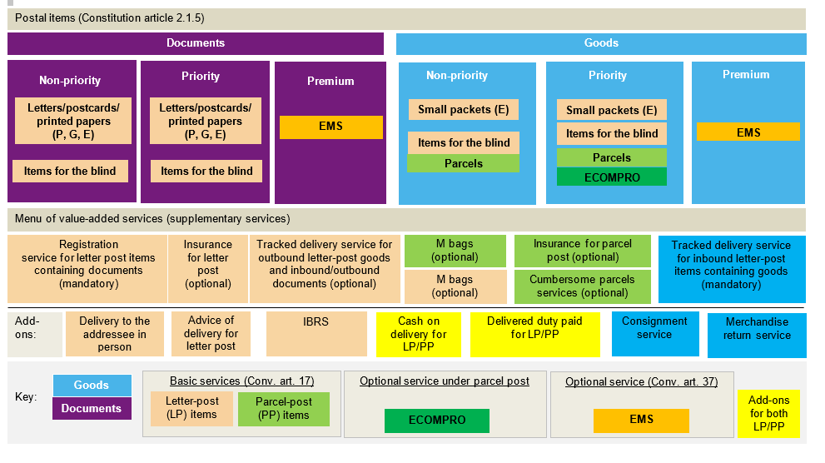
Portfolio matrix of international physical postal services – as at 1 January 2026
As approved by the fourth Extraordinary Congress in 2023

Slide 13
3 Technical requirements

Slide 14
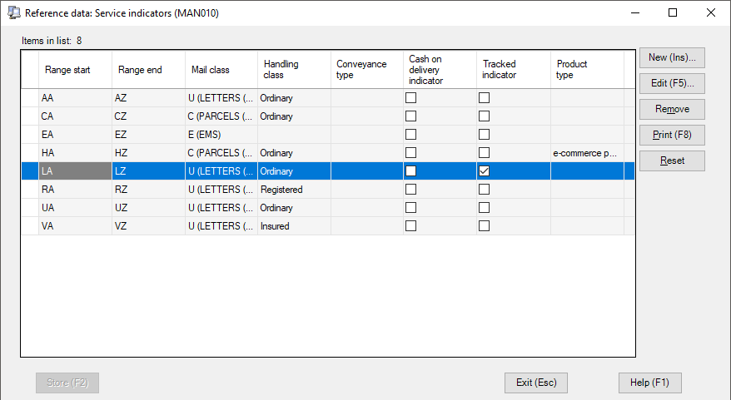
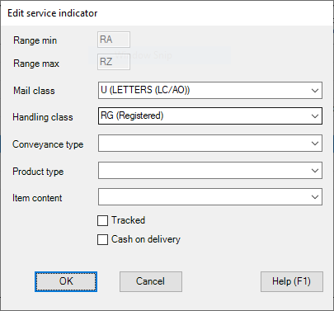
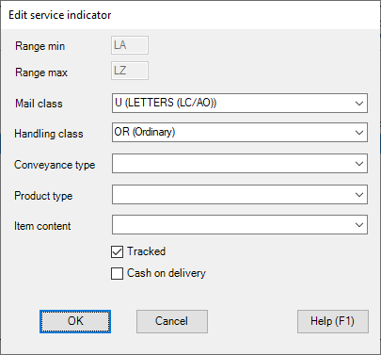
Service indicators
Service indicator and mail item identification
IPS is preconfigured with the ranges of service indicators assigned to mail types:
LA–LZ → Tracked
RA–RZ → Registered
VA–VZ → Insured
IPS function: National management > Reference data > Service indicators

Slide 15
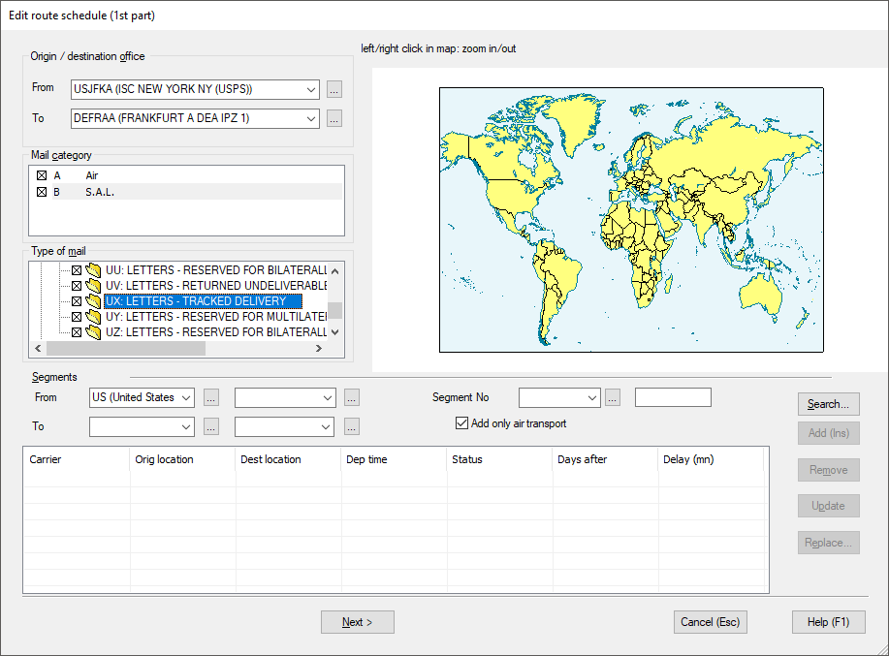
Route management
IPS allows the configuration of routes to send dispatches and receptacles with UX mail subclass for tracked items, and UR mail subclass for registered items
1 Run the function National management > Routing plan > International > Air and S.A.L. routes.
2 Create or update existing routes. Select the mail dispatch/ receptacle subclasses allowed for the given route:
UX: LETTERS – TRACKED DELIVERY
UR: LETTERS – REGISTERED
For letter mail sent to the US
USPS accepts only:
UA receptacles for letters containing goods
UL receptacles for letters containing documents

Slide 16
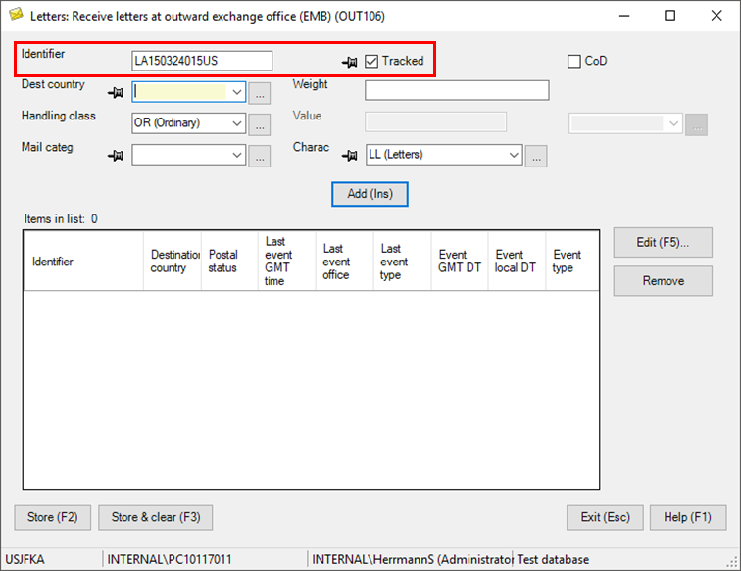
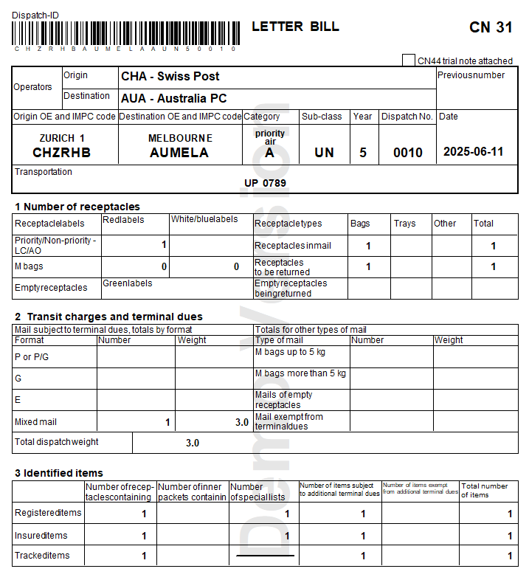
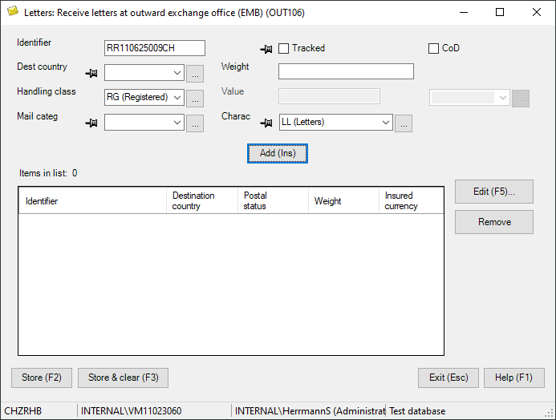
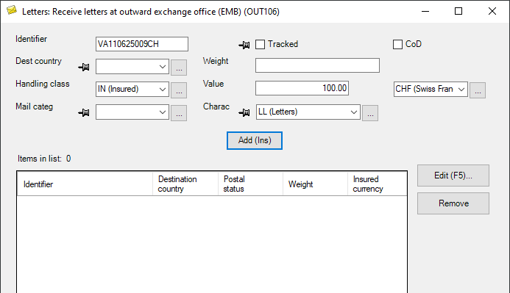
Dispatch creation
Mail management – Outbound operations
Mail items with a service indicator within the LA–LZ, RA–RZ or VA–VZ range are automatically stored as tracked, registered or insured items, respectively.
IPS function:
Letters > Outbound > Letters > Receive letters at outward exchange office (EMB)

Slide 17
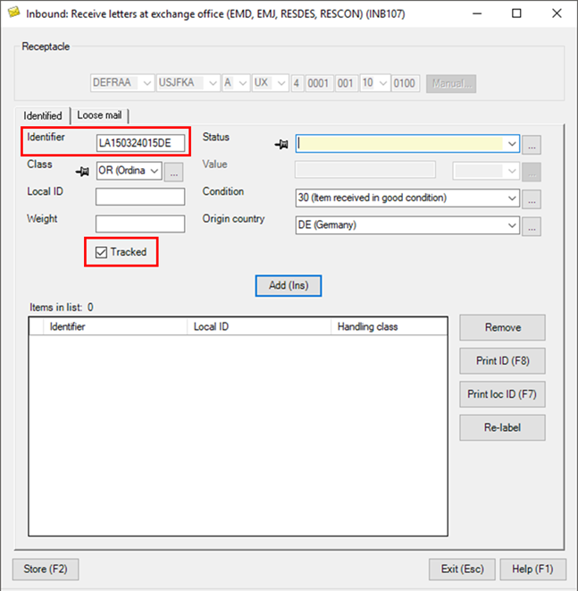
Inbound mail
Mail management – Inbound operations
Mail items with a service indicator within the LA–LZ, RA–RZ or VA–VZ range are automatically stored as tracked, registered or insured items, respectively.
IPS function:
Letters > Inbound > Receive letters at exchange office

Slide 18
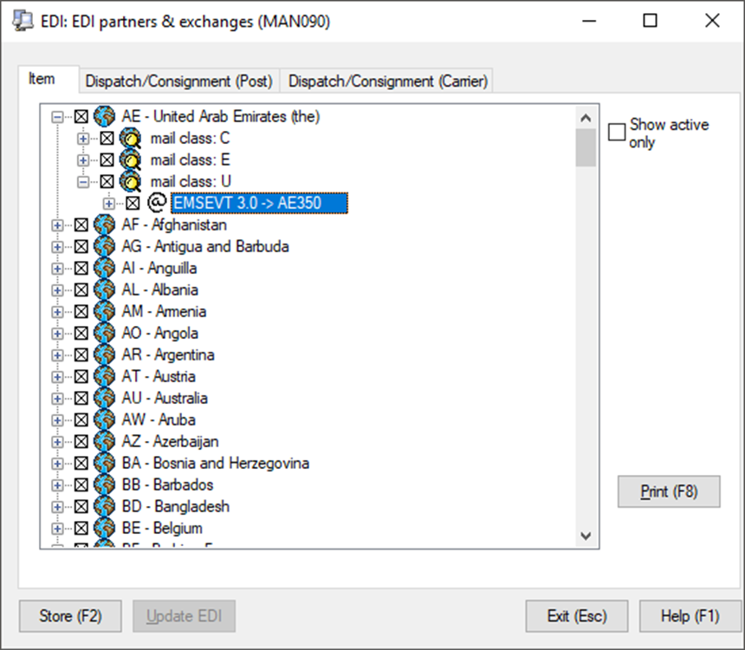
EDI configuration
Configuration of the electronic data interchange (EDI)
The EDI configuration for all letter products/ services is the same.
In National management > EDI > EDI partners and exchanges, tick the “Mail class: U – EMSEVT 3.0” checkbox for all your partners.

Slide 19
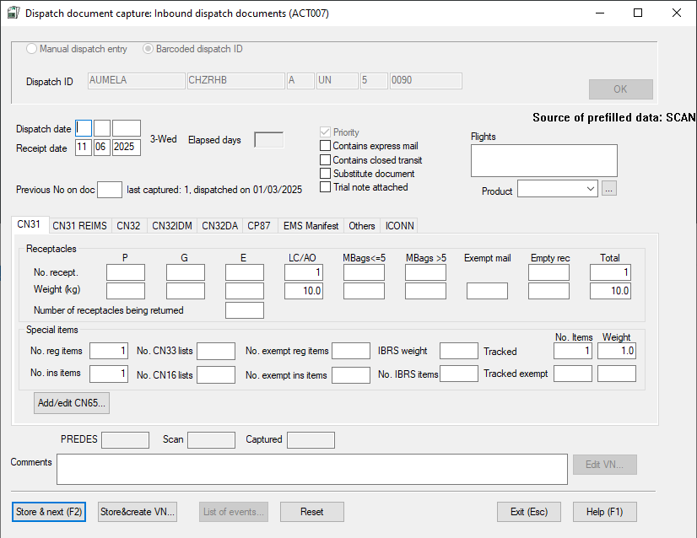
Accounting
Accounting
The number and weight of tracked items received can be checked with the functions:
Accounting data entry > Dispatch document capture and search > Modify dispatch documents

Slide 20
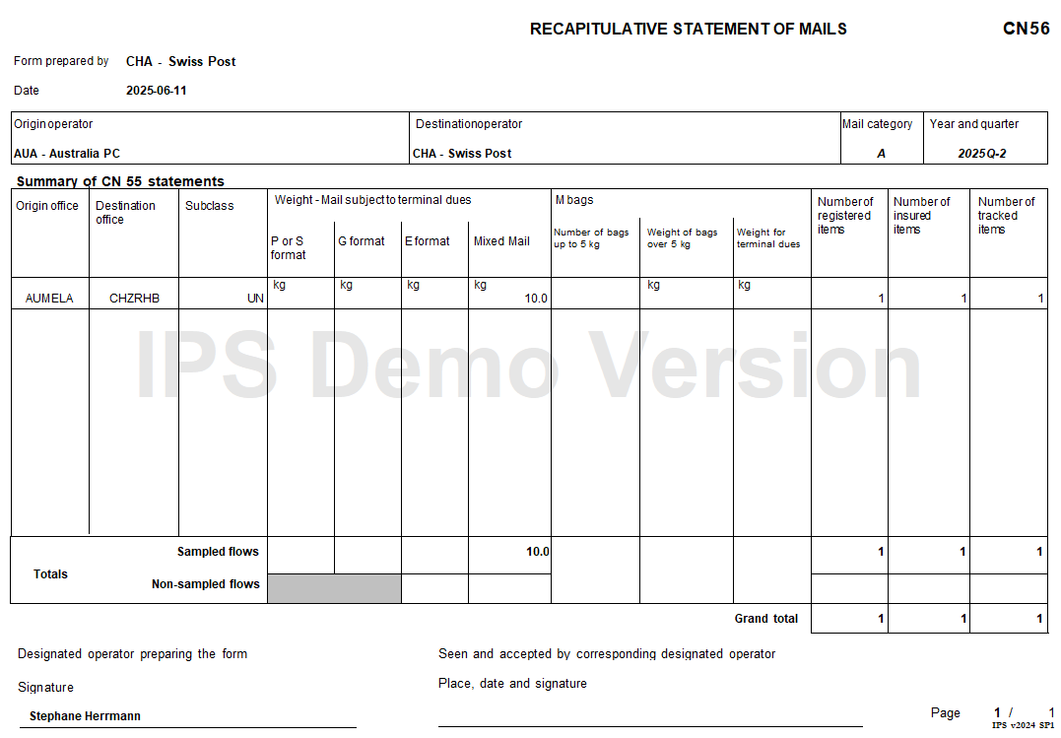
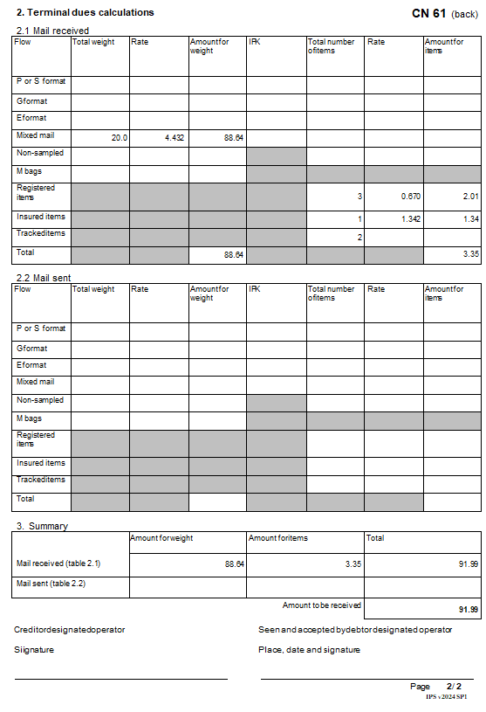
Accounting (cont.)

Slide 21
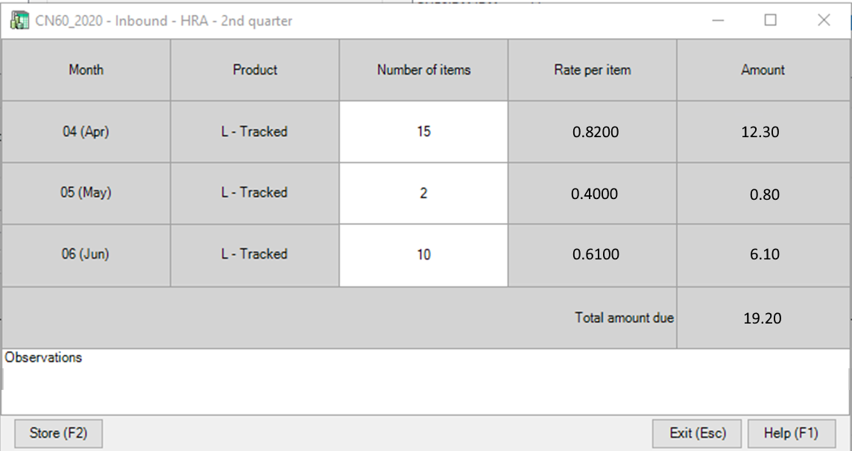
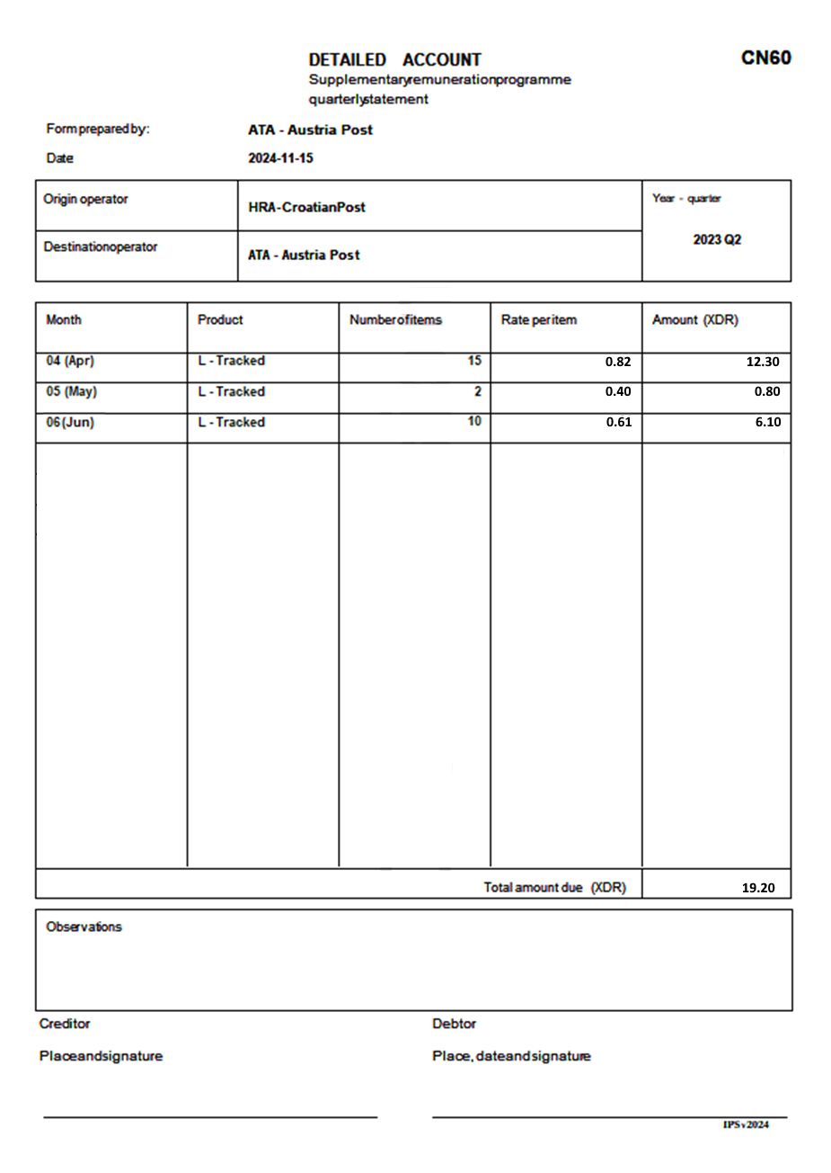
Accounting (cont.)
Generation of the CN 60 (available from IPS 2024 onwards):
There is no import of reports provided by the UPU IB. The “number of items” and “rate per item” must be captured by the operator to feed the calculation of the CN 60.
The above intermediary screen gets pre-filled based on items (tracked, registered, insured) recorded in the accounting dispatch document.
Corresponding new accounting streams:
Letters: registered – supplementary remuneration
Letters: insured – supplementary remuneration
Letters: tracked – supplementary remuneration
For “tracked” mail, IPS does not have the capability to capture “supplementary remuneration” separately from the “additional payment”. Therefore, a weighted average has to be calculated before data capture.

Slide 22


IPS 2025
Changes can be made to IPS 2025 to facilitate the processing of tracked, registered and insured letters.
One requirement has already been identified:
Registered items not allowed in UA receptacles
Please share any ideas or suggestions you have with the PTC

Slide 23
4 Remuneration

Slide 24
Remuneration of registered and insured items Current cycle (2025)
Registered items and insured items
Additional payment (article 28.8 of the Convention):
Additional payment (surcharge) for registered items in 2025: 1.670 SDR/item
Additional payment (surcharge) for insured items in 2025: 2.028 SDR/item
Supplementary remuneration (article 31-104 of the Regulations):
Where DOs opt to collect the supplementary remuneration for the feature of tracking in relation to registered and/or insured items:
→ For an item to qualify, the DO of destination must transmit the scanning event information for tracking and meet the targets set in article 31-104.3. For qualifying items, the payment is 0.5 SDR per item to be paid by the origin DO to the destination DO.
Total remuneration = Base remuneration (E format – regardless of actual content or shape) + additional payment (surcharge) + supplementary remuneration (tracking optional)

Slide 25
Remuneration of registered and insured items effective 1 January 2026 (proposal 20.28.1)
Registered items and insured items (documents)
28th Congress to decide on CA/POC proposals for an Integrated Remuneration System (IRS) for the 2026–2030 period
Additional payment for registered items in 2026: 1.745 SDR/item (+4.5% compared to 2025)
Additional payment for insured items (documents) in 2026: 2.045 SDR/item (0.300 SDR higher than for registered items)
Supplementary remuneration for mandatory tracking:
0.250 SDR for each item where the destination DO provides the timely transmission of EMD and EDH or EMH or EMI
Increased to 0.500 SDR if the destination DO achieves a performance target of EDH/EMH/EMI over EMD at 80% in 2026, 85% in 2027, 90% in 2028 and 95% in 2029 and 2030
Total remuneration = Base remuneration (E format – regardless of actual content or shape) + additional payment (surcharge) + supplementary remuneration (tracking mandatory)

Slide 26
Remuneration of registered and insured items effective 1 January 2026 (proposal 20.28.1) (cont.)
Insured items (parcels)
28th Congress to decide on CA/POC proposals for an Integrated Remuneration System for the 2026–2030 period
Additional payment for insured items: 1.500 SDR per item
Total remuneration = 2026 ILRs (including bonus payment) + additional payment (surcharge) of 1.500 SDR

Slide 27
Remuneration of registered and insured items effective 1 January 2027 (proposal 20.28.1)
Registered and insured items (documents)
28th Congress to decide on CA/POC proposals for an Integrated Remuneration System for the 2026–2030 period
Base remuneration: P/G format (change)
Additional payment for registered (surcharge): 2.500 SDR/item (to compensate for shift E > P/G format base remuneration) (+4.5% annually for subsequent years)
Additional payment for insured (surcharge): 0.300 SDR higher than for registered
Supplementary remuneration for mandatory tracking (same as in 2026 – see previous slide)
Insured (parcels)
No change compared to 2026 regarding the surcharge
Total remuneration = Base remuneration (P/G format) + additional payment (surcharge) + supplementary remuneration (tracking mandatory)
Total remuneration = Parcels base remuneration + additional payment (surcharge) of 1.500 SDR + supplementary remuneration max 0.500 SDR/item (tracking mandatory)

Slide 28
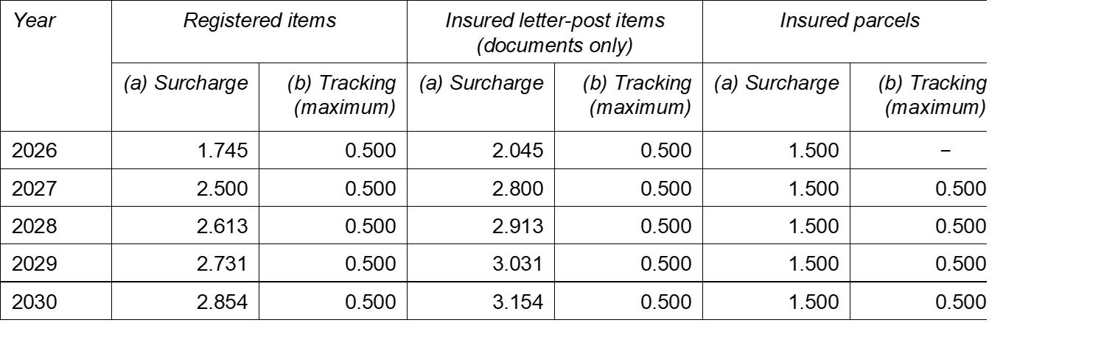
Remuneration of registered and insured items IRS 2026–2030 proposals (proposal 20.28.1)
Summary table
28th Congress (Dubai, September 2025) to decide on CA/POC proposals for an IRS for the 2026–2030 period – the following are proposals (20.28.1):
(Letter post) base remuneration: E format in 2026 and P/G format from 2027
(Letter post) additional payment (surcharge) and supplementary remuneration for tracking as in table below
(Parcels) payment of 1.500 SDR/item and remuneration for tracking as in table below

Slide 29
5 Quality measurement and reporting

Slide 30
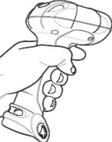



I. Data capture and exchange
Relevant EDI data captured:
Last outbound event/departure from outbound OE/AMU (EMC)
First inbound event/arrival at inbound OE/AMU (EMD)
Delivery event(s)
Attempted delivery (EMH) or
Arrival at collection point for pick-up (EDH) or
Final delivery (EMI)
Registered: RA–RZ
Insured: VA–VZ
Sorting centre (origin)
Airmail unit/ office of exchange (origin)
Airmail unit/ office of exchange (destination)
Sorting centre (destination)
Last mile/ recipient/ delivery
First mile
Post (origin)
Customs
*
*
Customs
*
*
*
*
*
Border
*
*
*
*
*
*
*
EMC
EMD
EMH/EDH/EMI

Slide 31
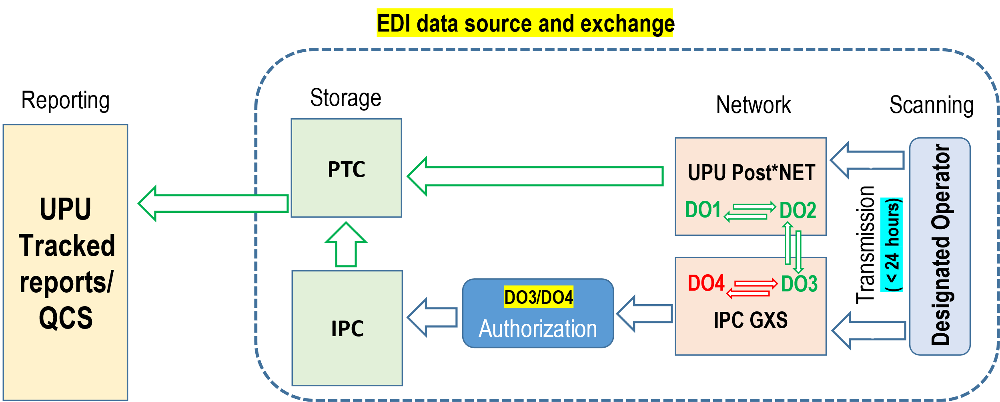
I. Data capture and exchange (cont.)
Transmission of EDI data:
Transmitted through established EDI messaging networks:
UPU system (POST*Net via IPS)
IPC system
EDI data is stored at the UPU
Registered: RA–RZ
Insured: VA–VZ

Slide 32

I. Data capture and exchange (cont.)
Transmission of EDI data:
Transmitted through established EDI messaging networks:
UPU system (POST*Net via IPS)
IPC system
EDI data is stored at the UPU
Current transmission targets:
EMD < 24 hours, for items with EMC
EMH or EDH or EMI < 24 hours, for items with EMD
For each DO, the number of items with events meeting the above targets are counted
Registered: RA–RZ
Insured: VA–VZ
II. Measurement: deadlines for data transmission

Slide 33
III. Measurement: performance calculation
For each flow, minimum targets:
56% of items with EMC event MUST also have EMD events
and
56% of items with EMD event MUST also have delivery event (EMH or EDH or EMI)
…cascade calculation mechanism: different from calculation for tracked measurement
When the minimum targets are fulfilled and DO participates in pay-for-performance (prior to 2026), all items transmitted within 24 hours qualify for remuneration.
Remuneration = number of qualifying items x 0.5 SDR

Slide 34
Reporting schedule (Refer to IB circular No. 51/2025)
Reporting follows guidelines as contained in article 31-105
LAS – letter accounting simulation
Q – quarter
Y – reporting year
Reports will be published in QCS Mail application (qcsmail.ptc.post) between 15th and 25th of each month
Final reports for remuneration: February (Q4), May (Q1), August (Q2), November (Q3)

Slide 35
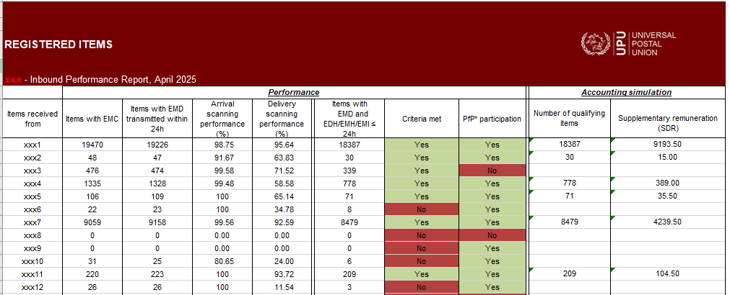
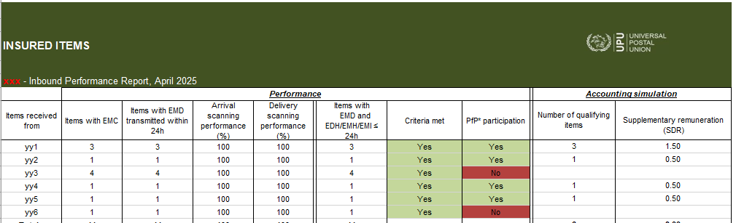
Sample report

Slide 36
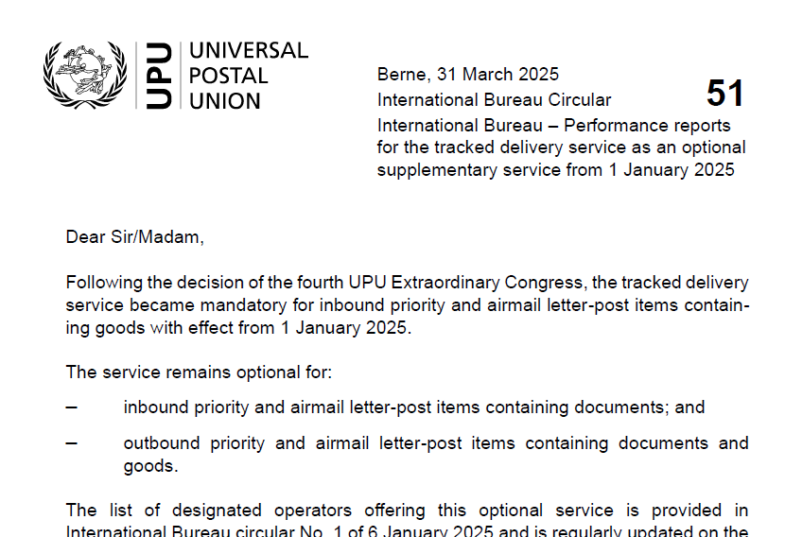
Experiences and operations reports
Experiences
EDI data to be copied
Accessing QCS reporting system
Operations reports
Only flat file can be generated and made available on demand
UPU Global Reporting System will contain more operational reports

Slide 37
Electronic handling of international inquiries effective 1 January 2026
Convention Regulations Article 21-003 (Inquiries when using IBIS)
The preparation of requests for designated operators using IBIS is mandatory for parcels and optional for letter-post items.
When IBIS is used for letter-post items, all operational and technical procedures applicable to IBIS for parcels shall apply as well for letter-post items.
Scope:
International inquiries for Registered, Tracked, and Insured items will be handled using the IBIS system—already in use for parcels.
Key changes:
Unified system using IBIS-GCSS to ensure consistency across inquiries
The relevant module is being enhanced by the GCSS provider allowing for access by existing and new call centers/users
Call centers and users already experienced with handling Internet-based inquiries will be instrumental in this rollout. Training can be organized when needed.
Next steps:
Detailed guidance and implementation support will be communicated shortly to all members

Slide 38
6 Accounting

Slide 39
Accounting today
UPU Supplementary Remuneration Programme (SRP) optional participation
-> “Closed” subgroup of operators that have supplementary remuneration based on performance
Product | Additional remuneration | Supplementary remuneration
Registered | Applies to all registered items received Account: CN 55, 56, 61 | Only among UPU SRP participants Based on UPU reports Account: CN 60
Insured | Applies to all insured items received Account: CN 55, 56, 61 | Only among UPU SRP participants Based on UPU reports Account: CN 60
Tracked | Based on UPU reports Account: CN 60 | Based on UPU reports Account: CN 60

Slide 40
Accounting from 2026
Product | Additional remuneration | Supplementary remuneration
Registered | Applies to all registered items received. Account: CN 55, 56, 61 | Only among UPU SRP participants Based on UPU reports Account: CN 60
Insured | Applies to all insured items received. Account: CN 55, 56, 61 | Only among UPU SRP participants Based on UPU reports Account: CN 60
Tracked | Based on UPU reports Account: CN 60 | Based on UPU reports Account: CN 60

Slide 41
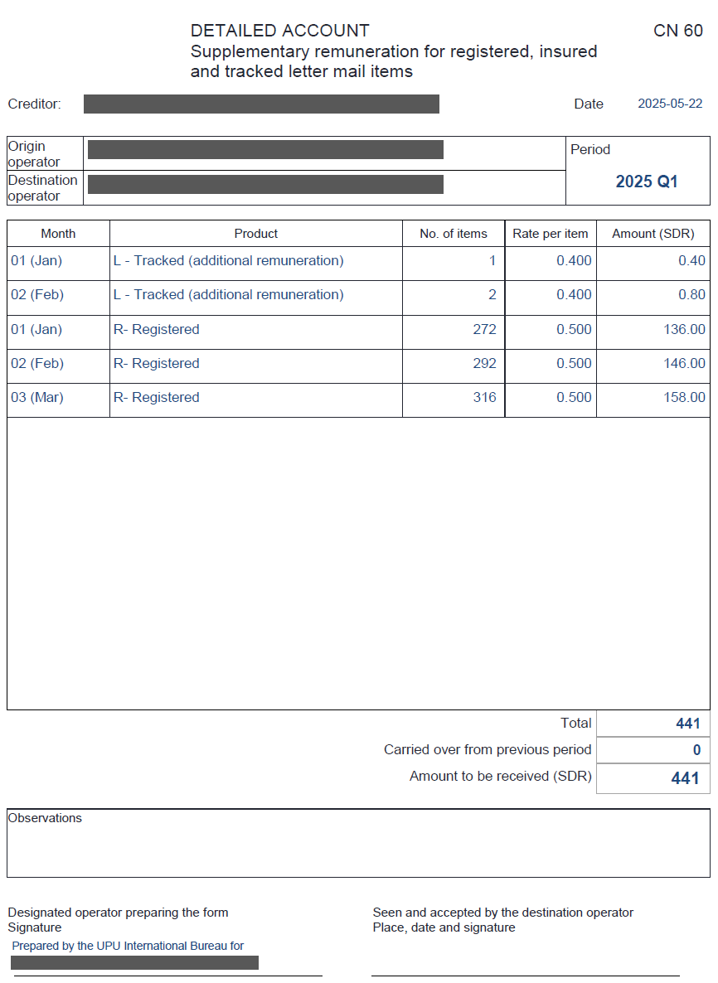
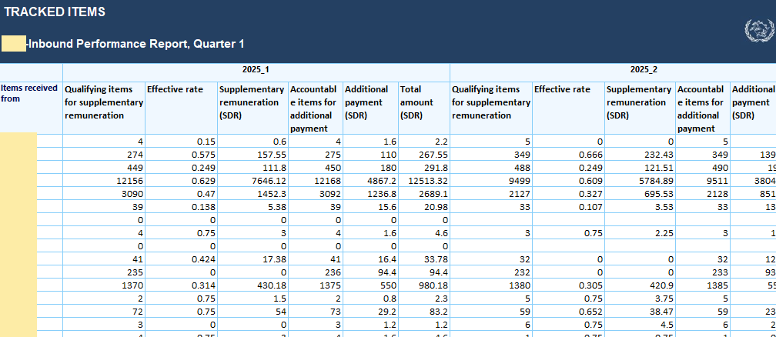
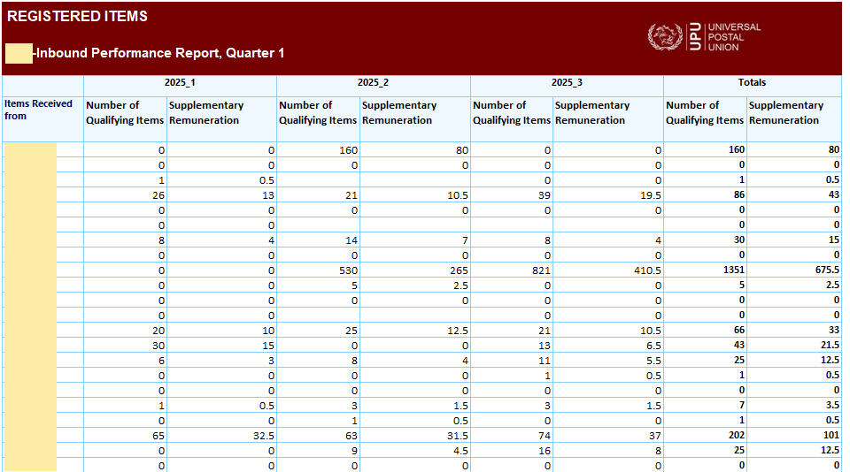
CN 60
Quarterly account
Content: exclusively from UPU report (based on EMSEVT exchanges)

Slide 42
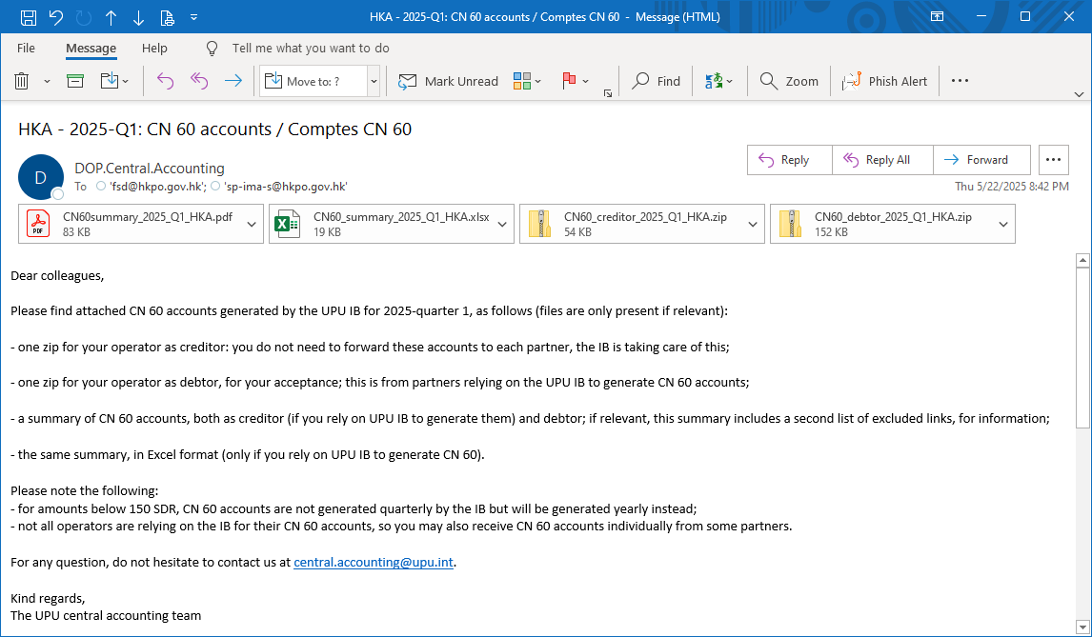
Centralized CN 60
Content of CN 60: “copy and paste” from central IB report
New optional IB service as of 2025: the IB can generate and distribute CN 60 accounts on behalf of interested DOs
Avoids manual copy-paste
No challenge with VNs
The IB handles payment thresholds (payment carried over to next period, etc.)
Nicer and easier for debtors to receive centrally generated accounts

Slide 43
Centralized CN 60 (cont.)
Central CN 60: solution described in UPU Convention Regulations article 31-106 (Preparation and transmission of charges for supplementary remuneration accounts and additional payments based on central reports)
Starting in 2026, CN 60 will be used more -> increased benefits with centralized CN 60
Note. ‒ central approach covers bilateral/multilateral agreements with accounting outside UPU

Slide 44
7 Compliance

Slide 45
EDI compliance measurements
EDI compliance measurements available in the compliance platform published in QCS (qcsmailbd.ptc.post)
Part of data quality measurements
Platform designed to show issues and help resolve them
Compliance measurements are regularly refreshed to match new rules/needs
Intention to adjust at the beginning of 2026 to:
take into account the mandatory exchange of EMSEVT for all letter mail -> All EDI links should be opened for xx350 EDI addresses -> EMSEVT messages should be sent with all partners
show anomalies such as registered mail present in dispatches containing goods only (UA dispatches)

Slide 46
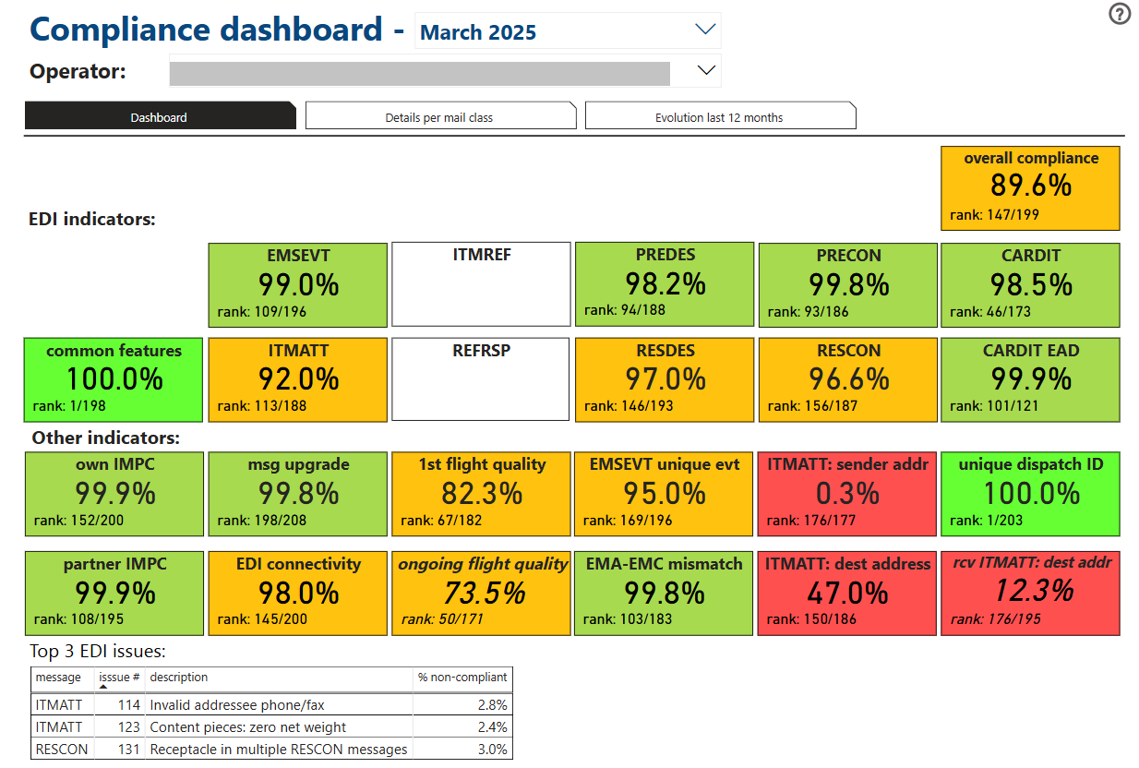
Compliance dashboard
New in 2026:
Issue raised when registered items are in dispatch for goods only
New in 2026:
Pending/refused links for xx350 addresses raised as errors
Active exchanges of EMSEVT letters with all partners

Slide 47
8 Chat-based Q&A
session

Slide 48


Slide 49
9 Support and guidance

Slide 50
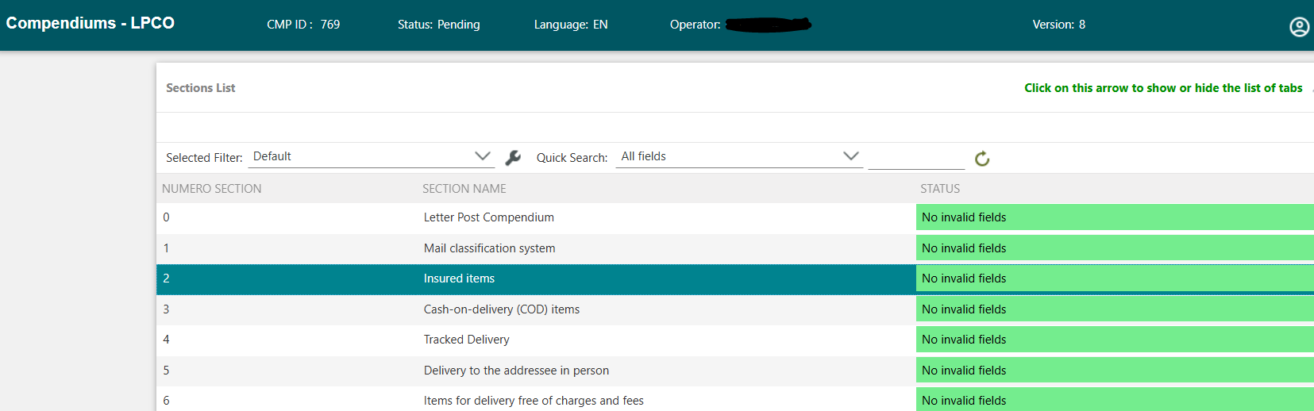
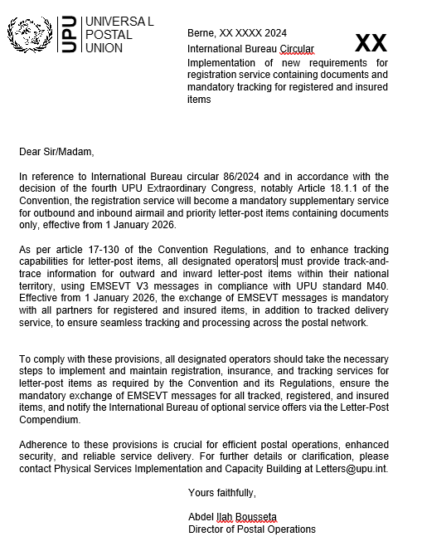
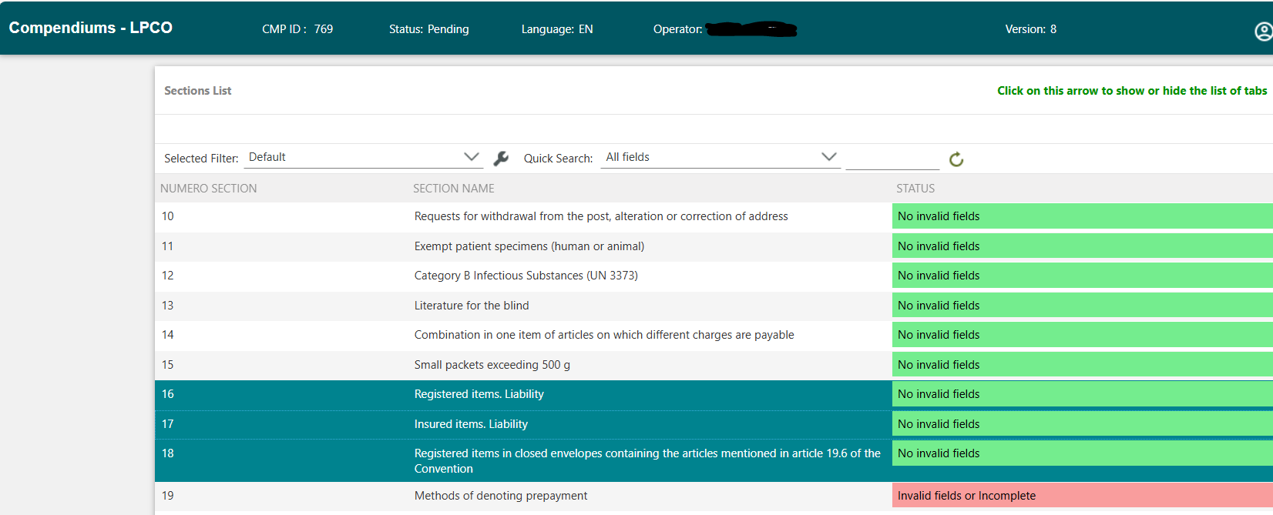
Draft IB circular and updating of Letter Post Compendium Online
D R A F T

Slide 51
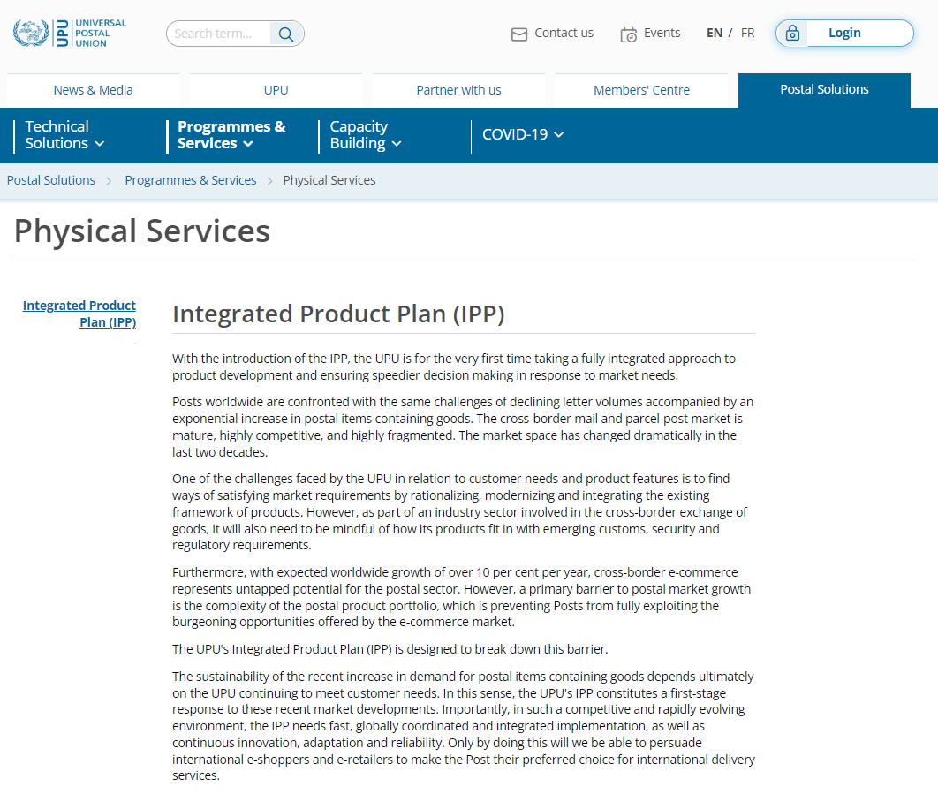
Webinar materials
Guides
User Guide
Physical Services Publications
Capacity Building
UPU Forms
Webinars
Presentations
Chat-based questions and answers
Watch the webinar

Slide 52
Update on tracked delivery service and M bags
Designated operators offering outbound tracked delivery service for letter-post items containing goods
Designated operators offering tracked delivery service for letter-post items containing documents
Designated operators offering M bags as optional supplementary service
114
79
77

Slide 53
For any additional questions or further information, feel free to reach out to us:
Capacity building:
letters@upu.int
Physical services:
poc.psdeig.secretariat@upu.int
Quality of service:
information.qs@upu.int
Remuneration:
dprm-ppre-rem@upu.int
Accounting:
central.accounting@upu.int
EDI compliance:
compliance.standards@upu.int
Technical support:
support.upu.int

Slide 54
Thank you for your attention

