Slide 1

International Mailing of Dangerous Goods by Air

Slide 2
Training Course for Mail Acceptance Staff
Modules:
General Philosophy
Identifying & Classifying Dangerous Goods
Limitations
Requirements for Mailers
  Packing, Labeling & Marking
  Transportation Documents
Acceptance of Permitted Dangerous Goods
Recognition of Undeclared Dangerous Goods
Mail Processing and Handling Procedures
Passenger & Crew Provisions
Emergency Procedures
© UPU 2013 – All rights reserved
Notes:
This course is designed for staff who accept mail, which may contain dangerous goods, at designated postal operators. The course is broken down into modules based on subject matter outlined in Part 1, Chapter 4, Table 1-6, of the ICAO Technical Instructions.

Slide 3
Learning Objectives:
Be capable of identifying and classifying dangerous goods
Be familiar with the shippers requirements, such as, transport documents
Recognize proper vs improper packaging, labeling and marking
Understand acceptance and handling procedures for dangerous goods allowed in the Posts and air mail
Know your role in preventing prohibited dangerous goods from entering the mail
Know what to do in the event of an emergency
Notes:
As acceptance staff you play an important role in controlling the introduction of dangerous goods into the mail and onto air transportation. At the conclusion of this training, you will be able to meet all the specified learning objectives.

Slide 4


General Philosophy
-- Excerpt from the UPU “Keep Me Safe” Campaign Message
Notes:
In this module, we’ll cover regulations, the definition of dangerous goods, risks associated with mailing dangerous goods by air (including an example of a dangerous goods incident) and steps that can be taken to reduce the hazards of dangerous goods. ***Can we can get this message recorded and show a video.

Slide 5

Keep Me Safe Campaign Video

Slide 6
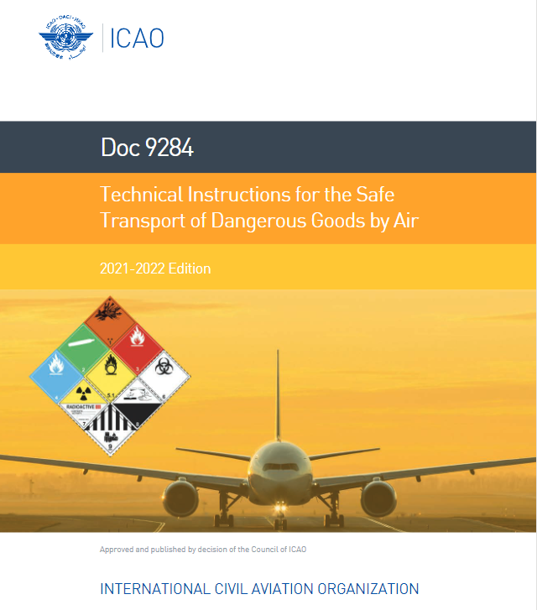
Definition of Dangerous Goods:
The International Civil Aviation Organization (ICAO) defines dangerous goods as “articles or substances which are capable of posing a risk to health, safety, property or the environment, and which are shown in the list of dangerous goods in the technical instructions, or which are classified according to those instructions.”

Slide 7

UNESC Committee of Experts
“Recommendations on the Transport of Dangerous Goods – Model Regulations”
Commonly referred to as the ‘Orange Book’
Provides recommendations for the labeling, packaging, limits, etc., of dangerous goods during transport

Slide 8

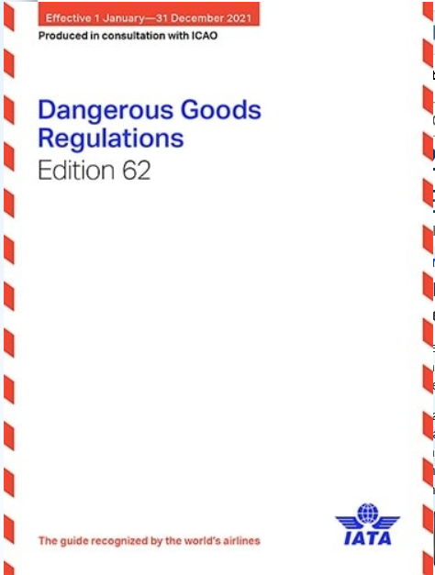
Dangerous Goods Regulations
Air Transportation
ICAO Technical Instructions
IATA Dangerous Goods Regulations
Notes:
Both of these books cover international shipping regulations with respect to the movement of dangerous goods through the air. Their foundation is based on the ICAO Technical Instructions. The IATA regulations, however, contain additional restrictions that go beyond the ICAO regulations.
The IATA Dangerous Goods Regulations presents the requirements for shipping dangerous goods by air in a user friendly, easy to interpret format. It also specifies more precisely how to prepare a shipment. It is the “field manual” version of the ICAO Technical Instructions.
These regulations are intended to facilitate the transport of dangerous goods, while providing safety for aircraft and their occupants.

Slide 9

Universal Postal Union Regulations
The regulations regarding dangerous goods which are restricted in international mail are contained in the Letter Post and Parcel Post Manuals.
Specifically, articles RC 119 and RL 131 list the dangerous goods admitted.

Slide 10
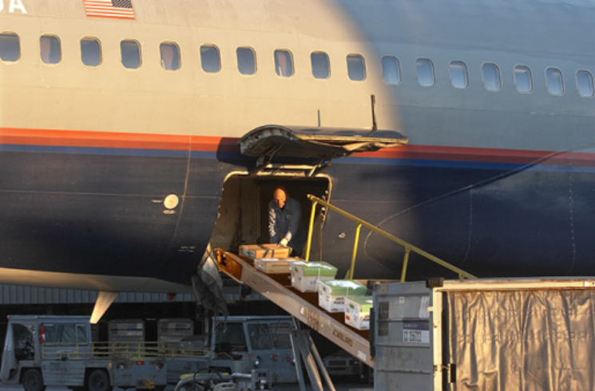


Special Considerations for Dangerous Goods in
Air Transportation
When transported by air, dangerous goods can be exposed to:
  Improper handling
  Extremes in temperature
  Extremes in pressure
  Vibration
These conditions could potentially cause dangerous goods that are relatively safe in everyday use to exhibit threatening characteristics.
Notes:
Dangerous goods are regularly carried as cargo on passenger and cargo aircraft. There are some unique risks posed when dangerous goods are transported by air as compared to surface transportation. Many dangerous goods that are relatively safe in everyday use may exhibit potentially dangerous characteristics when exposed to air transport conditions.

Slide 11
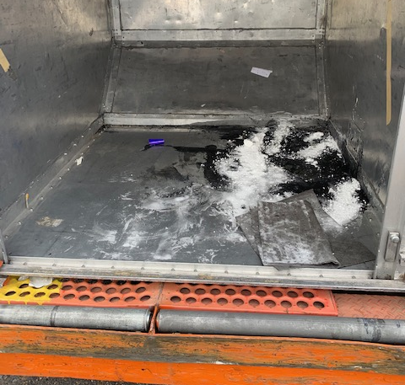
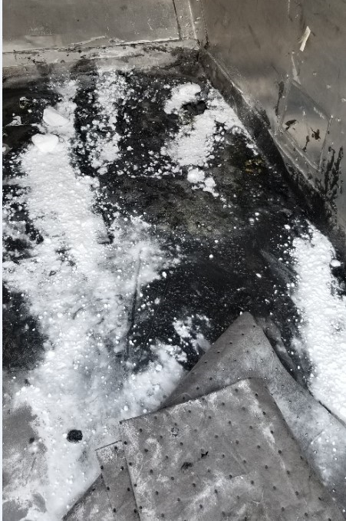
An Example of What Can Happen When Dangerous Goods are Transported by Air
Notes:
This image shows damage to a unit load device (ULD) that was caused by sodium hydroxide spilling out of a package. Several other parcels were damaged as well. Sodium hydroxide is corrosive and reacts vigorously with aluminum. This could have potentially caused damage to the aircraft.
Here are some more severe examples of what can happen when dangerous goods are transported by air:
In 1988, an American Airlines passenger flight made an emergency landing due to a fire caused by undeclared chemicals in the cargo hold. Nine passengers and crew were injured, and the plane was destroyed.
In 1996, 110 passengers and crew on a ValuJet flight perished in a crash caused by oxygen generators placed in the cargo hold.
In 2010, a cargo plane crashed in Saudi Arabia, killing the 2 pilots. The crash was the result of a fire caused by a large shipment of undeclared lithium batteries.
Although none of these incidents occurred due to mail, these are examples of what can happen if we are not vigilant about accepting dangerous goods into the mail stream.

Slide 12
Reducing the Hazards of Dangerous Goods
Higher Risk
STEP 1:
Limit the number of hazard classes allowed
As each additional step is implemented, the risk decreases
STEP 2:
Limit the quantity allowed
STEP 3:
Require packing, labeling and marking restrictions
STEP 4:
Follow proper handling procedures
Lower Risk
Notes:
Implementing these four basic steps lowers the risk involved in transporting dangerous goods by air:
Step 1 – Limit the number of types (hazard classes) of dangerous goods for mailing.
Step 2 – Limit the quantity of dangerous goods that are allowed, so they present only a minimal hazard to life, health, property, or the environment.
Step 3 – Ensure proper packing, labeling and marking, so that dangerous goods are identified and contained.
Step 4 – Follow safe procedures for processing, handling, storage and loading of dangerous goods to limit risk.

Slide 13
Knowledge Check
Question #1
Dangerous goods mailed by air can be exposed to which of the following?
A Improper handling B Extremes in temperature C Extremes in pressure D Vibration E All of the above
Notes:
The correct answer is E.

Slide 14
Knowledge Check
Question #2
Dangerous goods are defined by ICAO as articles or substances which are capable of posing a risk to:
A Health
B Safety
C Property
D Environment
E All of the above
Notes:
The correct answer is E.

Slide 15
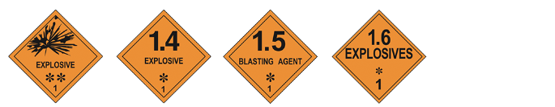






Identifying & Classifying Dangerous Goods
Notes:
In this module, Identifying & Classifying Dangerous Goods, you will learn that dangerous goods are identified by unique numbers and are assigned to one of nine classes based on the hazard presented. Some classes are further divided into divisions to better define the hazard. Each class or division is identified by a specific hazard label. This section will look at each class and division with the corresponding hazard label. There will also be examples of dangerous goods from each class or division.

Slide 16
The ICAO List of Dangerous Goods, provides the following information about specific materials:
  Shipping name
  Hazard Class/Division
  United Nations (UN) identification number
  Allowable quantities
  Packaging Specifications
UN No. | Name and Description | Class or division | Subsidiary risk | UN packing group | Special Provisions
(1) | (2) | (3) | (4) | (5) | (6)
1549 | ANTIMONY COMPOUND, INORGANIC, SOLID, N.O.S. | 6.1 |  | III | 45 274
This is a sample of some of the information you can find in the ICAO List of Dangerous Goods.
Notes:
There are over 3,000 entries in the list of dangerous goods.

Slide 17


UN Numbers
More UN Number Examples:
UN 0334 – Fireworks
UN 1013 – Carbon dioxide
UN 2024 – Mercury compounds, liquid, n.o.s
UN 3093 – Corrosive liquid, oxidizing, n.o.s
Notes:
A UN (United Nations) number is a four digit number that identifies dangerous goods. Some substances or materials have their own unique number, while other numbers belong to a group of chemicals or products with similar properties. UN numbers range from UN 0004 to about UN 3548. These numbers are recognized globally for the international transport of dangerous goods.

Slide 18
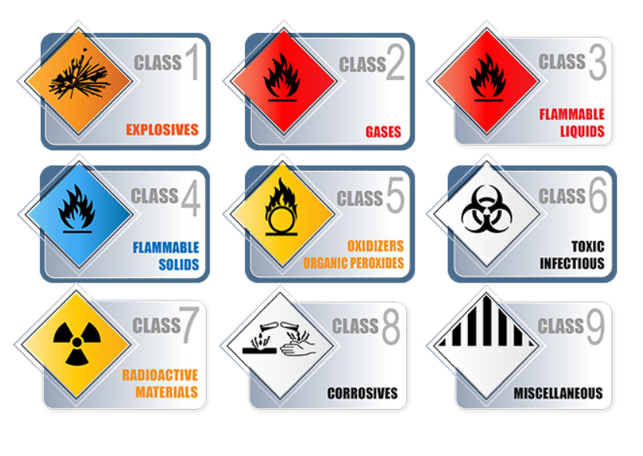
The 9 Classes of Dangerous Goods
Notes:
These are the nine classes of dangerous goods. The five classes outlined in blue are further broken down into divisions. Now, let’s look closer at each class.

Slide 19

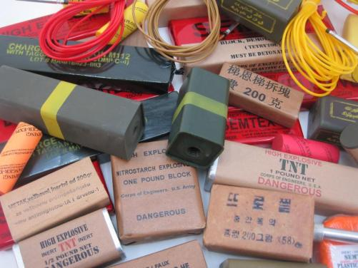

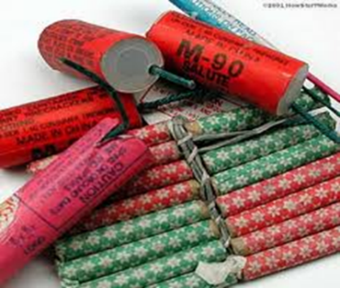
Hazard Class 1 - Explosives
Examples of Hazard Class 1 Materials:
Notes:
Hazard Class 1 is explosives. This class has six divisions, 1.1 through 1.6. The division number is the number after the decimal point on a placard. The division describes the potential hazard posed by the explosive, for example, division 1.1 explosives have a mass explosion hazard.
Hazard Class 1 includes materials such as, fireworks, live ammunition, dynamite, black powder, and model rocket engines.
Hazard Class 1 materials are prohibited from mailing.

Slide 20



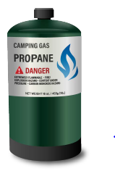



Hazard Class 2 - Gases
Examples of Hazard Class 2 Materials:
Notes:
Hazard Class 2 is gases. This class has three divisions:
1. Division 2.1 – Flammable gases (propane tanks, aerosol sprays like hairspray)
2. Division 2.2 – Non-flammable, non-toxic gases (helium tanks)
3. Division 2.3 – Toxic (poisonous) gases (chlorine gas)
Some additional materials in this class include, aerosol spray cans and fire extinguishers.
Class 2 gases are prohibited in international mail.

Slide 21





Hazard Class 3 – Flammable &
Combustible Liquids
Examples of Hazard Class 3 Materials:
Notes:
Hazard Class 3 is flammable and combustible liquids. A flammable liquid is a liquid having a flash point of not more than 60 °C (140 °F), or any material in a liquid phase with a flash point at or above 37.8 °C (100 °F) that is intentionally heated and offered for transportation or transported at or above its flash point in a bulk packaging. A combustible liquid is any liquid that has a flash point above 60 °C (140 °F) and below 93°C (200 °F). This class includes materials/substances such as, fuels, items that formerly contained fuel (i.e. used gasoline/petrol tanks), some oil based paints and inks, varnishes, and perfumes.
Flash point means the minimum temperature at which a liquid gives off vapor within a test vessel in sufficient concentration to form an ignitable mixture with air near the surface of the liquid.
Flammable liquids are prohibited in international mail.

Slide 22


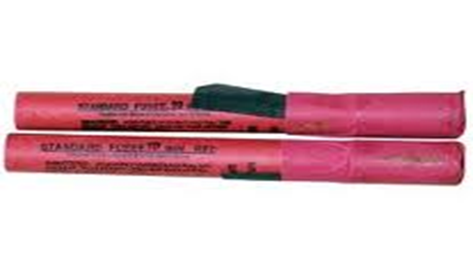

Hazard Class 4 – Flammable Solids
Examples of Hazard Class 4 Materials:
Notes:
Hazard Class 4 is flammable solids. A flammable solid is any solid other than those classified as an explosive, that is likely to cause fire through friction or retained heat from manufacturing or processing, or that can be ignited readily and, when ignited, burns so vigorously and persistently that it creates a serious transportation hazard.
Class 4 has three divisions:
1. Division 4.1 - Flammable Solids, like matches and signal flares.
2. Division 4.2 – Spontaneously Combustible, these materials are capable of erupting into flames upon exposure to atmospheric oxygen, for example, white phosphorous.
3. Division 4.3 – Dangerous When Wet, these materials, by contact with water, are liable to become spontaneously flammable or to give off flammable or toxic gas at a given rate. Examples include sodium, potassium, rubidium, and cesium metals and aluminum or magnesium powders.
Class 4 materials are prohibited in the mail for transport by air.

Slide 23





Hazard Class 5 – Oxidizing Substances & Organic Peroxide
Examples of Hazard Class 5 Materials/Substances:
Notes:
Hazard Class 5 has two divisions:
1. Division 5.1 - Oxidizing Substances, a material that may cause or enhance the combustion of other materials by yielding oxygen, for example, hydrogen peroxide and swimming pool chemicals.
2. Division 5.2 - Organic Peroxides, examples include, benzoyle peroxide (common in acne medicine), ammonium nitrate fertilizers and hair colourants.
Class 5 materials are prohibited in international mail.

Slide 24


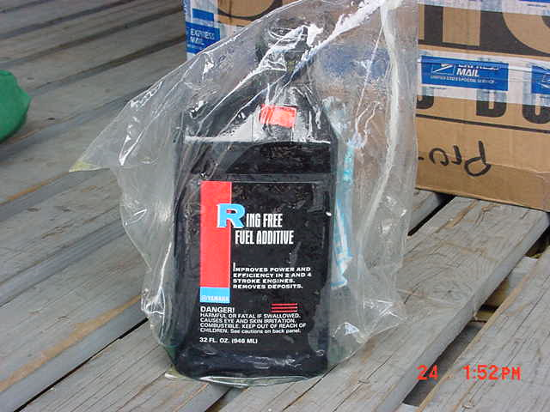
Division 6.1 – Toxic/Poisonous Material
HAZARD CLASS 6
Examples of Division 6.1 Materials/Substances:
Notes:
Class 6 is toxic and infectious substances. Class 6 has two divisions:
Division 6.1 - Toxic Substances, Poisons, and Irritating Material: Examples include cyanide, pure nicotine, arsenic and non-oleoresin capsicum based mace and tear gas. Some important terms with respect to Division 6.1 materials include the following:
Toxic Substance - A poisonous material, other than a gas, that is known to be so toxic to humans as to cause death, injury, or harm if swallowed, inhaled, or brought into contact with skin.
Irritating Material - Any liquid or solid substance that gives off intense fumes and causes extreme but reversible localized irritant effects on the eyes, nose, and throat, temporarily impairing a person’s ability to function.
Division 6.1 Toxic Substances, Poisons, and Irritating Materials are always prohibited in international mail.

Slide 25




HAZARD CLASS 6
Division 6.2 – Infectious Substances
Examples of Division 6.2 Materials/Substances:
Notes:
Division 6.2 - Infectious Substances- These are materials that are known or reasonably expected to contain a pathogen (a microorganism-including bacteria, viruses, parasites, fungi) or other agent, that can cause disease in humans or animals.
Division 6.2 Infectious substances is further split into two categories as follows:
Category A Infectious Substances - These are substances that are found a form that is capable of causing permanent disability or life-threatening or fatal disease in otherwise healthy humans or animals when exposure to it occurs.
Category A substances are prohibited in the mail.
Category B Infectious Substances- These are substances that are not in a form generally capable of causing permanent disability or life-threatening
or fatal disease in otherwise healthy humans or animals when exposure to it occurs. Examples of this category of substances include infectious
materials transported for diagnostic or investigational purposes.
Infectious substances assigned to Division 6.2, Category B (UN 3373), when packed in accordance with the requirements of Packing Instruction
650, are the only Class 6 materials allowed for international airmail transport.

Slide 26
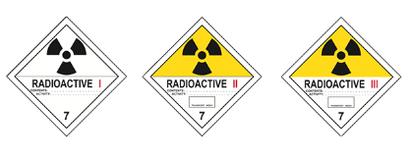



Hazard Class 7 – Radioactive Material
Examples of Hazard Class 7 Materials:
Notes:
Class 7 is radioactive materials. This class includes materials such as, scientific instruments that have radiation sources, luminous dials (aircraft instruments) and ionization chamber smoke detectors.
Radioactive materials, the activity of which does not exceed one-tenth of that listed in Table 2-15, Activity Limits for Excepted Packages, in the ICAO Technical Instructions, may be allowed in international mail. These items must be prepared and packed in accordance with the respective provisions of the regulations.
Radioactive materials are prohibited in the mail if they are required to bear one of the following labels:
Class 7 Radioactive White-I
Class 7 Radioactive Yellow-II
Class 7 Radioactive Yellow-III
Fissile Label

Slide 27



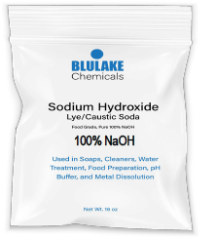

Hazard Class 8 – Corrosive Substances
Examples of Hazard Class 8 Substances:
Notes:
Hazard Class 8 is corrosive materials. A corrosive is a liquid or solid that causes visible destruction or irreversible alteration in human skin tissue at the site of contact, or a liquid that has a severe corrosion rate on steel. This class includes materials/substances such as, acids (hydrochloric, sulfuric, muriatic), sodium hydroxide (lye), wet batteries, mercury or instruments containing mercury.
Class 8 materials are prohibited in international mail.

Slide 28




Hazard Class 9 – Miscellaneous Dangerous Substances and Articles, including Environmentally Hazardous Substances
Examples of Hazard Class 9 Materials/Substances:
Notes:
Hazard Class 9 is used to capture other materials that present a hazard during transportation, but do not fit neatly into any of the other 8 classes.
Hazard Class 9 materials include but are not limited to dry ice (solid carbon dioxide), magnetized materials, environmentally hazardous substances, and lithium batteries.

Slide 29
Knowledge Check
Question #3
What is hazard class 3?
A Radioactive Materials
B Corrosive Substances
C Toxic & Infectious Substances
D Flammable Liquids
Notes:
The correct answer is D.

Slide 30
Knowledge Check
Question #4
How many classes of dangerous goods are there?
A 6
B 7
C 8
D 9
E 10
Notes:
The correct answer is D.

Slide 31

Knowledge Check
Question #5
Matches are an example of which class of dangerous goods?
A Explosives
B Flammable Solids
C Corrosives
D Flammable Gas
E Toxic Substance
Notes:
The correct answer is B.

Slide 32

Limitations
What dangerous goods are allowed in international mail?
Notes:
In this Module, we’ll cover the limitations on transport of dangerous goods by air. You will learn:
- what dangerous goods can never be shipped by air and
- the few specific dangerous goods that are accepted for international mail.

Slide 33
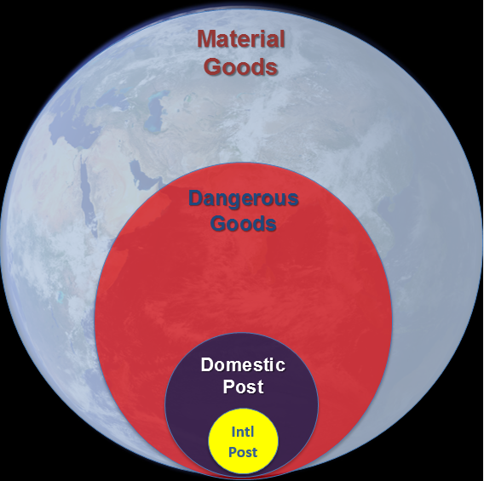
In the world of commerce, the transportation of dangerous goods in international mail makes up just a small fraction.
Notes:
In accordance with the Universal Postal Convention and regulations, dangerous goods are generally forbidden in international mail with very few exceptions. The dangerous goods permitted in mail are limited in type and specific packaging requirements apply, so they pose a minimal danger to the general public, aviation, and employees.

Slide 34

Dangerous Goods Prohibited in International Mail:
Class 1 | Explosives
Class 2 | Flammable or Toxic Gases
Class 3 | Flammable Liquids
Class 4 | Flammable Solids
Class 5 | Oxidizers & Organic Peroxides
Class 8 | Corrosives
Notes:
Because of the risk involved, these items are never accepted for transport by air:
-Explosives, this includes fireworks, ammunition, and dynamite.
-Flammable or toxic gases, such as aerosols.
-Flammable liquids, this includes fuels, perfumes, and some paints and varnishes.
-Flammable solids, like matches or charcoals.
Additionally, anything susceptible to damage due to changes in temperature or atmospheric pressure, unless protected against the effects of such changes, cannot be shipped via airmail.

Slide 35



Dangerous Goods that May Be Shipped in International Mail:
Class 6 | Some infectious substances only
Class 7 | Some radioactive materials
Class 9 | Lithium batteries contained in equipment only
Class 9 | Dry ice when used as a refrigerant for UN 3373
Notes:
UPU regulations permit three types of dangerous goods in international mail:
- Some infectious substances;
- Some radioactive materials; and
- Lithium batteries contained in equipment
For radioactive materials, the mailer must obtain prior authorization from appropriate regulatory authorities within the mailer’s and addressee’s countries and the materials must be packed in accordance with the respective provisions of the regulations. The mailer must provide accurate documentation of the activity limits of the radioactive material.
If an item of dangerous goods is not included in this list, it cannot be mailed internationally.
* Always refer to the regulations if you are unsure of the mailability of an item.

Slide 36


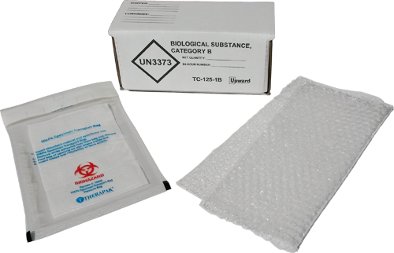
Division 6.2
Category B Infectious Substances &
Patient Specimens
Notes:
Category B infectious substances (UN 3373 only) and exempt patient specimens may be exchanged by mail only between officially recognized senders, as determined by their competent authority. Admission of infectious substances and exempt patient specimens (human or animal) shall be restricted to member countries that have declared their willingness to admit such items, whether reciprocally or in one direction only.
Patient Specimens are those collected directly from humans or animals, including, but not limited to, excreta, secreta, blood and its components, tissue and tissue fluid swabs and body parts being transported for purposes such as research, diagnosis, investigational activities, disease treatment and prevention.
Category B infectious substances (UN 3373) and exempt patient specimens must be packed in accordance with the requirements of Packing Instruction 650.
Solid carbon dioxide (dry ice) may be used as a refrigerant for UN 3373, all applicable requirements of Packing Instruction 954 must be met. Mail containing dry ice as a refrigerant for UN 3373 must be offered separately to the operator by the designated postal operator. Additional packing information will be provided in the Packing module.

Slide 37

Hazard Class 9
UN 1845 - Dry Ice
Carbon dioxide, solid
Can only be shipped in international mail when used as a refrigerant for UN 3373
Requirements in Packing Instruction 954 must be met

Slide 38
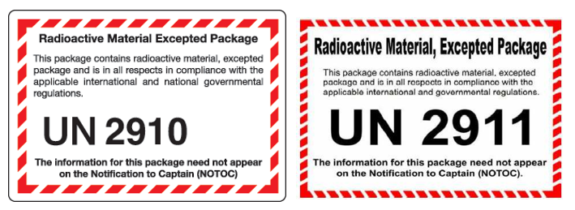
Hazard Class 7
Radioactive Materials Allowed in
International Mail
Limited Quantity
Articles/Instruments
Notes:
Radioactive material, UN Nos. 2910 and 2911 only, provided the activity does not exceed one-tenth of that listed in Part 2, Chapter 7, Table 2-14 and it does not meet the definition and criteria of other classes. The mailer must obtain prior authorization from appropriate regulatory authorities within the mailer’s and addressee’s countries and the materials must be packed in accordance with the respective provisions of the regulations. The mailer must provide accurate documentation of the activity limits of the radioactive material.

Slide 39








Hazard Class 9
Examples of Equipment Containing Lithium Batteries that May Be Allowed in International Mail
GPS Devices
Digital cameras
Walkie
Talkies
Radio controlled toys/cars
Bluetooth Devices
Laptop Computer
Electric Shaver
Power Drill
Notes:
Lithium batteries installed in equipment can be accepted for transport in airmail providing that all regulations are met.
Shown on this slide are a few examples of equipment that generally meet the basic requirements for transport by post.

Slide 40




Hazard Class 9
Additional Requirements for Lithium Batteries in International Mail:
  Must be installed in the equipment they operate
  No more than 4 cells or 2 batteries in a single package
  Before a postal operator can accept equipment containing lithium batteries, they must receive a certification from the Civil Aviation Authority
Notes:
UPU regulations allow for the transport of lithium batteries in airmail, provided they meet the requirements outlined in the ICAO Technical Instructions and UPU regulations. The regulations require that lithium batteries are contained in the equipment they operate and no more than 4 cells or 2 batteries are allowed in a single package.
A lithium cell is defined as a single encased electrochemical unit (one positive and one negative electrode) which exhibits a voltage differential across its two terminals.
The term lithium battery means two or more cells which are electrically connected together and fitted with devices necessary for use, for example, case, terminals, marking and protective devices.
Additionally:
for a lithium metal or lithium alloy cell, the lithium content shall not be more than 1g, and for a lithium ion cell, the Watt-hour rating shall not be more than 20 Wh;
for a lithium metal or lithium alloy battery, the aggregate lithium content shall not be more than 2g, and for a lithium ion battery, the Watt-hour rating shall not be more than 100 Wh;
Before a designated postal operator can begin to accept equipment containing lithium batteries, it must receive specific approval from the civil aviation authority.

Slide 41
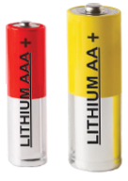


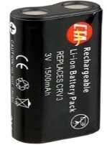

Lithium Cell vs Battery
Lithium Cells
Lithium Batteries
Notes:
A lithium cell is defined as a single encased electrochemical unit (one positive and one negative electrode) which exhibits a voltage differential across its two terminals.
The term lithium battery means two or more cells which are electrically connected together and fitted with devices necessary for use, for example, case, terminals, marking and protective devices.

Slide 42





Lithium Batteries that are NOT Acceptable in International Mail
Spare battery packed with equipment
Batteries packed alone
Batteries that exceed lithium content or power limits
Notes:
The following are some examples of lithium batteries that cannot be mailed internationally.
Equipment packaged with one or more spare batteries cannot be mailed. The mail piece can contain no more batteries than the number required to operate the equipment.
While the limits on Watt-hour and lithium content can be difficult to determine, the size of the battery-powered equipment can be an indicator. Large equipment like wheelchairs, electric bicycles, scooters or some automated external defibrillators cannot be mailed because the batteries exceed the maximum allowable power or lithium content.
Individual batteries packaged without equipment CANNOT be mailed internationally.
**Additionally, an item containing a damaged or defective lithium battery cannot be mailed. For example, a product recall due to batteries catching fire. These items must not be accepted into the mailstream.

Slide 43

Notice: RECALL
Defective or damaged batteries, alone or installed in a device, should never be accepted in the mail.
Notes:
An item containing a damaged or defective lithium battery cannot be mailed. For example, a product recall due to batteries catching fire. These items must not be accepted into the mailstream.

Slide 44
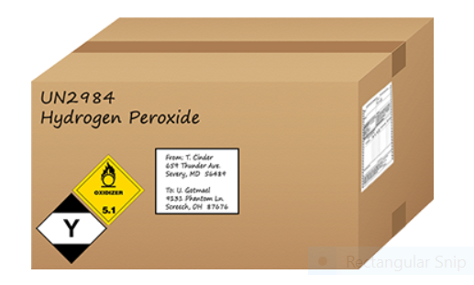
Knowledge Check
Question #6
True or False
UPU regulations permit all types of dangerous
goods in International Mail provided they are
labeled properly.
Notes:
The correct answer is False.

Slide 45

Knowledge Check
Question #7
How many lithium batteries (contained in equipment) can be mailed internationally in a single package?
A 8 cells or 4 batteries
B 4 cells or 2 batteries
C 6 cells or 3 batteries
D There is no limit
Notes:
The correct answer is B.

Slide 46

Requirements for Mailers
Notes:
The mailer has the responsibility to communicate the presence of the dangerous goods in their package and to ensure the addressee’s country has indicated a willingness to accept the respective type of material. Individual country conditions for mailing are published on the Universal Postal Union website.
If a mailer is unsure of the correct classification of an item/substance, he or she should seek advice from the manufacturer or distributor of the item/substance. A package should never be accepted if the mailer is unsure of the contents and/or the hazards they present.
Additionally, the mailer has the responsibility to appropriately package, mark, and label their dangerous good(s). They must complete all required documentation for the dangerous goods according to the national and international governmental regulations.
The acceptance clerk must check that the appropriate international forms have been properly completed and that the sender is aware of the limitations of mailing dangerous goods.

Slide 47
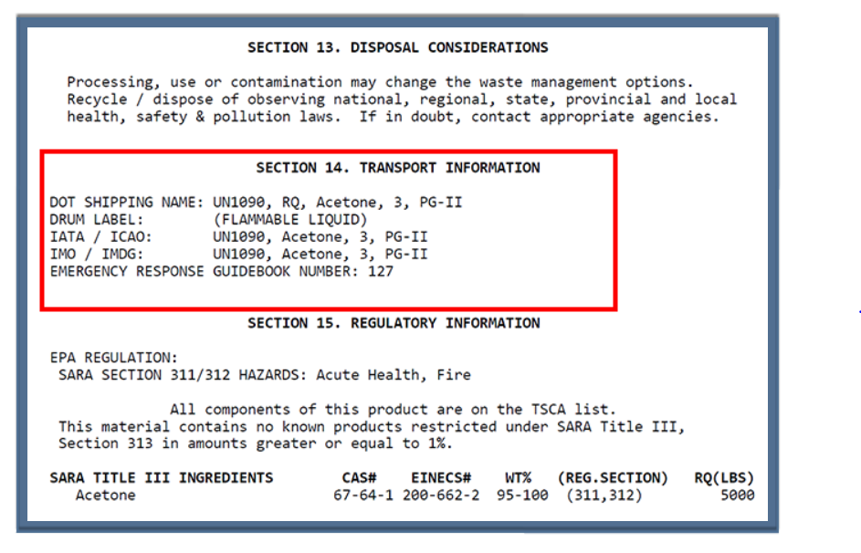
Safety Data Sheet (SDS)
Notes:
Manufacturers of various materials are typically required to provide Safety Data Sheets (SDS’s) for their products. An SDS communicates the physical properties, hazards, protective measures and safety precautions for handling, storing, and transporting of a product. Section 14 of the SDS often contains the transport information.
Customers that have an SDS can use this information to determine whether or not their material is allowed in the Post.

Slide 48
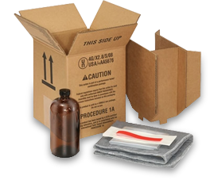
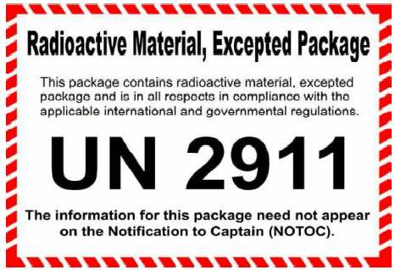
Packing, Labeling & Marking Requirements
Notes:
In this module, you will learn requirements for packing, labeling and marking, all of which are required for the safe handling of dangerous goods permitted in airmail.

Slide 49


General Packing Requirements
  Outer packaging of sufficient strength to protect the contents of the package
  Adequate closure and reinforcement
  Cushioning material
  Absorbent materials and leak-proof packaging for liquids
Notes:
The specific packaging requirements will depend upon the material contained therein. However, there are some general packing requirements:
- There must be cushioning material to protect against breakage
- Packages containing liquids must have absorbent material in case of leakage
- An adequate closure and reinforcement are necessary

Slide 50
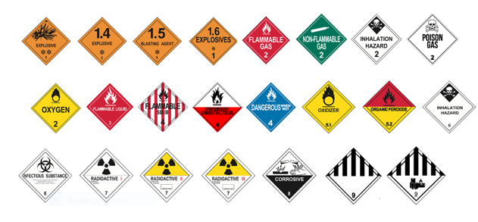
Hazard Labels
Notes:
This slide shows many of the labels that may be seen on dangerous goods. When accepting and handling mail, employees should be aware of UN markings and labels for dangerous substances and articles. Remember, generally dangerous goods and articles are not allowed in international airmail.
If you see any of these hazard labels on a package, it should be removed from the mail stream for further screening.

Slide 51



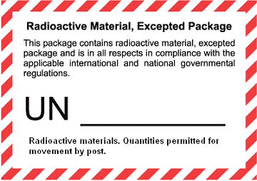
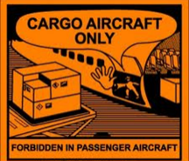
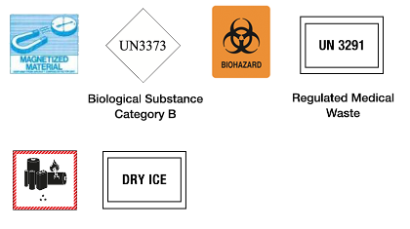



Handling Labels
Notes:
Also check packages for UN handling labels. Packages with these handling labels could contain undeclared dangerous goods.

Slide 52
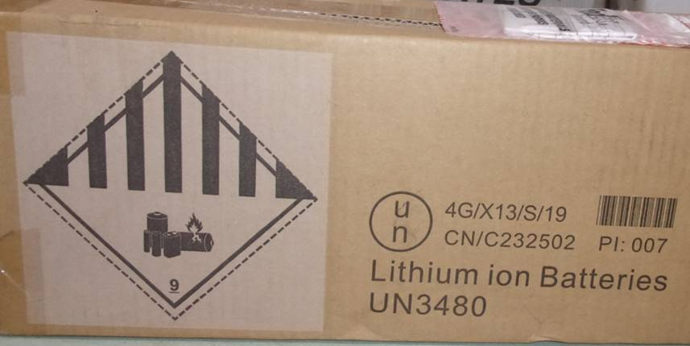
UN Specification Packaging
The UN in the circle indicates the packaging has been UN tested and certified. The symbol can either be a lowercase “u” over a lowercase “n” or as an uppercase “UN.”
The additional series of numbers and letters represent information about the container and what type of goods it can support.
Notes:
UN specification packaging is packaging (container) that has been built, tested and certified to carry liquid or solid dangerous materials. Packages and containers for dangerous goods must pass rigorous performance testing. If you see these markings (see slide) on a package, it can indicate the presence of hazardous materials.

Slide 53
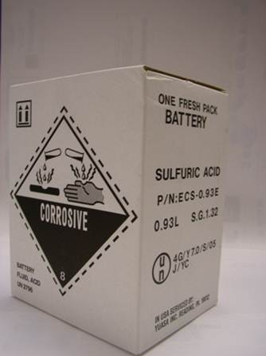
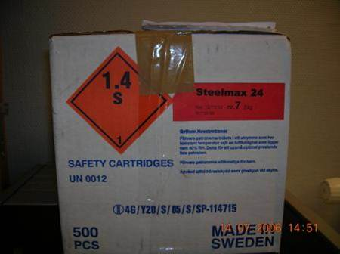

Examples of Unacceptable Reused Packaging
Notes:
It is important to remember that the presence of a UN Number and label on a package may indicate that there are dangerous goods in the package. Those packages should raise your awareness and the sender should be challenged to establish the contents.
Packaging that previously contained dangerous goods is acceptable when all markings and labels are removed or completely obliterated, and there is no risk of contamination. This prevents the package from triggering unnecessary alarms as it moves through the mail.

Slide 54
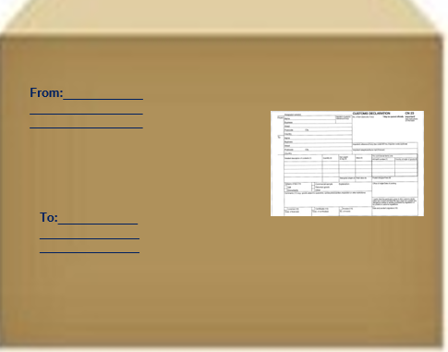
Information Required on a Package Containing Dangerous Goods:
  Complete delivery and return address
  Labels or markings specific to the material contained in the package*
  Customs form (CN 22 or CN 23)
Notes:
Proper marking of parcels containing dangerous goods helps to ensure that the parcels are properly accepted and handled. All parcels containing dangerous goods require a delivery and return address and material specific hazard labels.
* Exception – UN3481 and UN3091 must not display the handling label in international mail.
Customs forms CN 22 or CN 23 are required for all international postal items to be submitted to customs control.
Let’s take a look at the packing, labeling and marking requirements for those dangerous goods that are accepted for international mail.

Slide 55
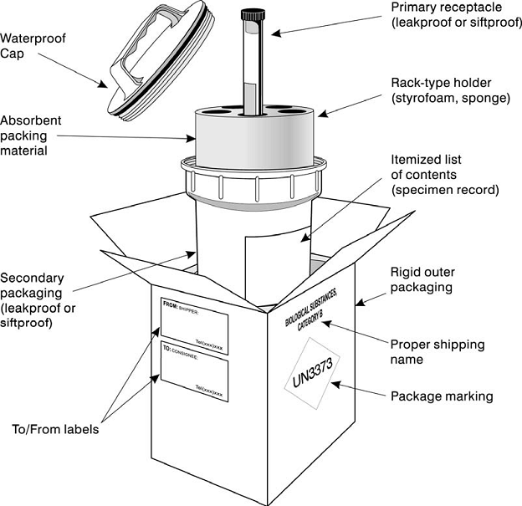
Category B – Infectious Substance (UN 3373)
Proper Packing
Hazard Class 6.2
Notes:
Category B infectious substances must be packed according to Packing Instruction 650, as shown in the Technical Instructions for the Safe Transport of Dangerous Goods by Air.
The outer packaging requires the following information and labelling:
- a delivery and return address
- marked on the address side with the shipping name “Biological Substance,
Category B” and “UN3373”
- the name and telephone number of a person who is knowledgeable about the
Category B infectious substance and has comprehensive emergency response
information must be marked on the outer packaging
- a completed customs form CN 22 or CN 23 is required for all international postal
items to be submitted to customs control
Orientation arrows are not required on packages containing Category B infectious substances, but may be used.
Inside the package, the substance must be packed in a primary receptacle and secondary packaging, which are leakproof or siltproof. In addition, there must be absorbent packing material and cushioning material??.

Slide 56


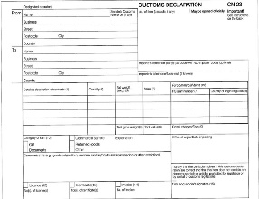

Hazard Class 6.2
Category B – Infectious Substance (UN 3373) with Dry Ice
Proper Labeling & Marking
Sender and delivery address
* This should also include a phone number for the responsible party
Dry Ice mark with “UN 1845” and the total weight of the dry ice
Sender
Address
Recipient
Address
UN 1845
Net Wt. 2 kg.
Hazard Class 9 label (dry ice) and UN 3373 label with text “Biological Substance Category B”
Customs Form
Notes:
UN 3373 substances may require dry ice to keep cold.
When used, dry ice shall be placed outside the secondary packaging or in the outer packaging or an overpack. The overpack is the protective outer packaging, such as a box or crate, that the secondary packaging is placed into.
If dry ice is used, the packing requirements of Packing Instruction 954 of the ICAO Technical Instructions must be met.

Slide 57
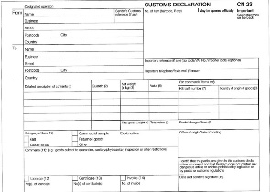
Hazard Class 7
Radioactive Materials
Proper Labeling & Marking
From:____________
_________________
_________________
Sender and
delivery address
Customs Form
To:____________
_______________
_______________
Bold text indicating that the package must be returned to the sender in the event of a nondelivery
Radioactive label with “UN 2910 or UN 2911”
RETURN TO SENDER IN
CASE OF NONDELIVERY
Notes:
The outside packaging of items containing radioactive materials shall be marked by the sender with a label showing the applicable UN number, UN 2910 or UN 2911.
It shall also bear, in addition to the name and address of the sender, a request in bold letters for the return of the items in the event of non-delivery.
A completed CN 22 or CN 23 customs form is required for all international mailings.
The sender shall indicate his name and address and the contents of the item on the inner wrapping.

Slide 58
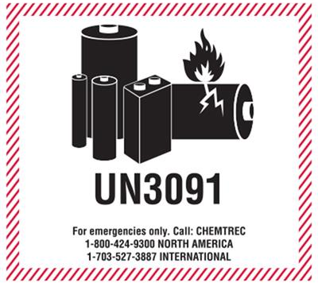
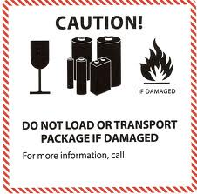
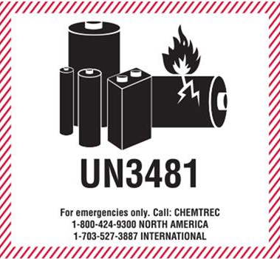
Lithium Battery Handling Label
Lithium Metal Batteries contained in or packed with the equipment they operate
Lithium Ion Batteries contained in or packed with the equipment they operate
Outdated Lithium Battery Mark
** The lithium battery label should not be displayed on packages in International Mail.
Notes:
Lithium batteries have a unique label for their packaging. The label contains the UN number for the specific type of lithium battery. There must also be a phone number listed in order to obtain additional information about the battery contained in the package. This label is not allowed in International Mail.
Please note: the lithium battery label has been updated and the old label is now obsolete.

Slide 59


Additional Lithium Battery
Handling Labels
Individual Lithium
Metal Batteries
Individual Lithium Ion Batteries
Notes:
Lithium batteries mailed separately, with no equipment in the package, have UN’s 3090 and 3480. Examples of their handling labels are shown here.

Slide 60

Lithium Batteries
Proper Labeling & Marking
(International Mail)
Sender and
delivery address
Customs Form
Notes:
Lithium batteries must be installed in equipment and not packed alone or separately with equipment.
The equipment shall be protected from damage and short circuit, and shall be equipped with an effective means of preventing accidental activation.
The equipment must be packed in strong outer packaging constructed of suitable material of adequate strength and design in relation to the packaging's capacity and intended use.
A completed CN 22 or CN 23 customs form is required for all international mailings.
** Please note: When mailed in International Mail, the lithium battery label must NOT be applied to the outside of the mailpiece. Packages bearing this handling label should not be accepted.

Slide 61
Knowledge Check
Question #8
If a customer is unsure of the classification of a material they wish to mail, from which of the following people should they seek advice?
  The window clerk
  The facility manager
  The manufacturer
  None of the above
Notes:
The correct answer is C.
The manufacturer of the product will be most knowledgeable of its classification and hazardous properties.

Slide 62

Knowledge Check
Question #9
True or False
The acceptance clerk should ensure all required
international documents are properly completed
prior to acceptance of a package.
Notes:
The correct answer is True.

Slide 63
Knowledge Check
Question #10
True or False
A lithium battery handling label must be affixed to
a package containing lithium batteries (installed in
equipment) in international mail.
Notes:
The correct answer is False.

Slide 64
Knowledge Check
Question #11
A package observed with a UN Number and hazard label should be:
  Allowed to continue to the destination and then screened
  Removed from the mail stream immediately for further screening
  Allowed to continue to the destination after the labels have been removed
  None of the above
Notes:
The correct answer is B.
The package should be immediately removed from the mail for additional screening.

Slide 65

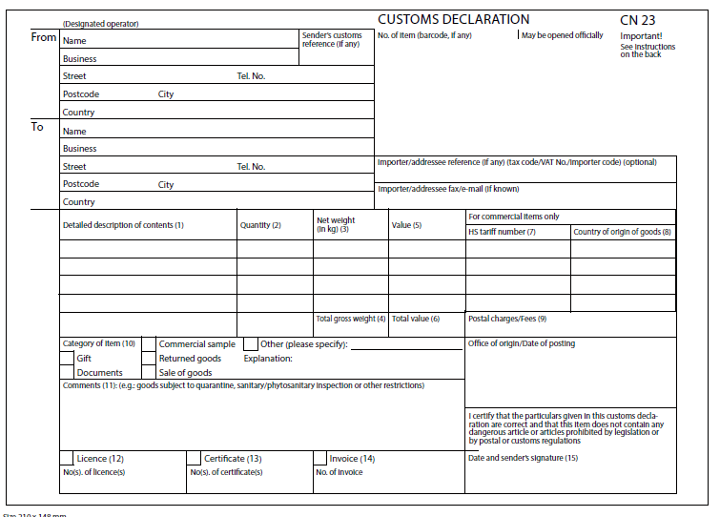
Transportation Documents
Notes:
In this module, you will become familiar with the documents required for international transport of dangerous goods and the important sections on each document.

Slide 66
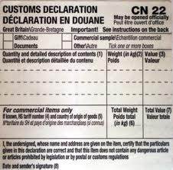
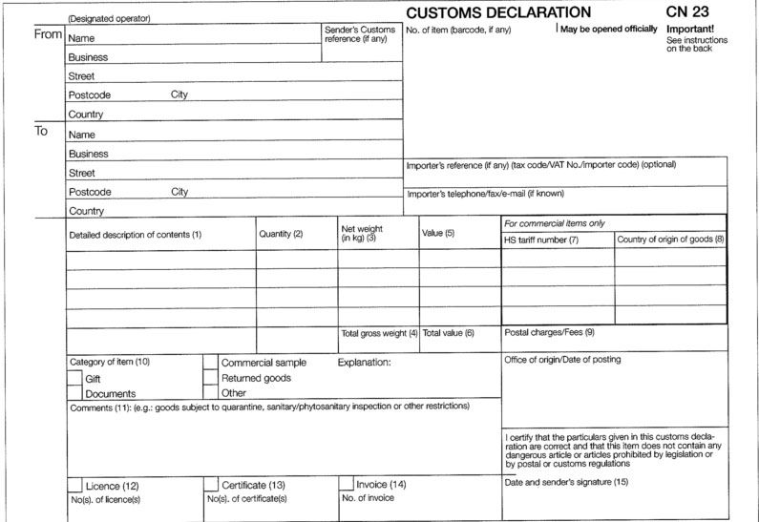
International Mail
Customs Forms
(CN 22 or CN 23)
  Required for all international parcels
  Identifies the sender and receiver
  Describes package content(s)
  Declares value of the content(s)
Notes:
A customs form is required for all international postal items to be submitted to customs control. The customs form documents the sender and receiver, provides a description of the package contents, and the value of the contents.
There are 2 possible customs forms: CN 22 and CN 23.
The value of the items being sent will dictate which form is to be used. In some countries, other factors dictate which customs form must be used.
You should be familiar with your country’s rules and regulations regarding the CN 22 and CN 23 forms.

Slide 67
International Mail
Customs Forms (CN22 & CN23)
Take note of these sections when accepting postal items, business names and content descriptions may indicate dangerous goods
Notes:
The sender information and description may provide indicators that the package could contain dangerous goods. For example, if the sender is a laboratory, there is a chance the contents may be dangerous goods.
Check that the description does not indicate the possibility of dangerous goods.
The sender’s signature (areas circled on the forms) is their assurance that the parcel does not contain dangerous goods.

Slide 68
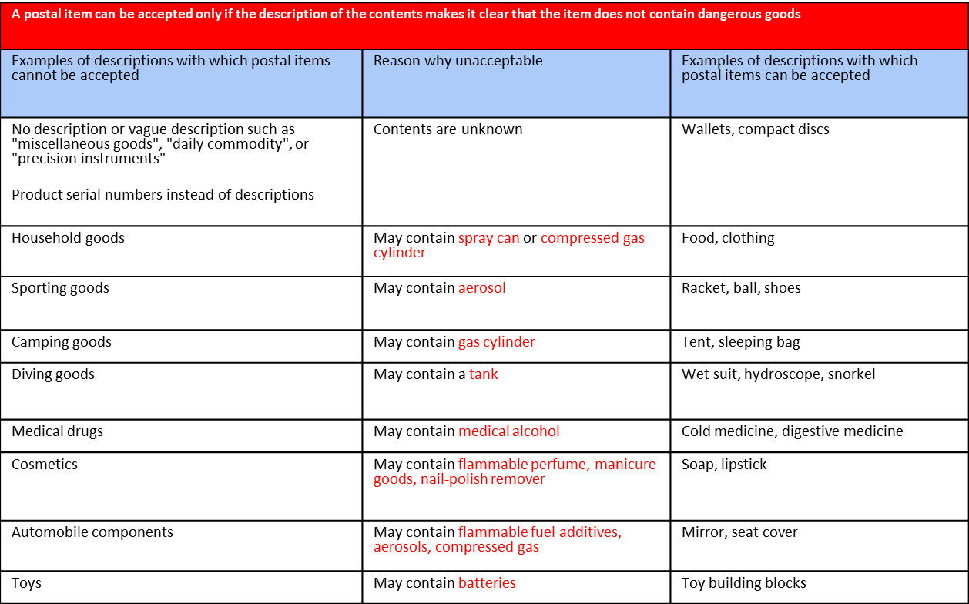
International Mail
Customs Form – Description of Contents
Notes:
The description of contents block on a customs form must be completed and the description must be specific. Vague terms, such as, gift or merchandise are unacceptable. The description must exactly describe what the item is so that a determination can be made regarding its acceptability in the mail.
This chart (column 1) shows some examples of unacceptable descriptions for items on a customs form. With these examples, there is often ambiguity as to whether or not the item is a dangerous good. Column 3 shows acceptable descriptions. With these descriptions, you can clearly make a determination as to whether or not the item is a dangerous good.

Slide 69
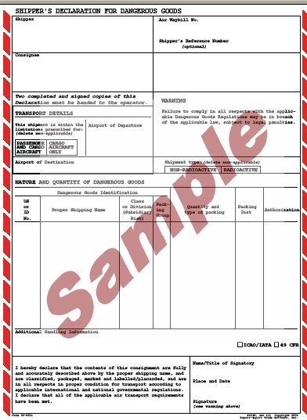
Shippers Declaration
Most dangerous goods require a transport document, known as a ‘Shipper’s Declaration,’ when they are transported as cargo.
If a customer presents an item accompanied by a ‘Shipper’s Declaration,’ this indicates the contents are dangerous goods and must not be accepted in the mail.

Slide 70
Knowledge Check
True or False
Question #12
A customs declaration is only required on international
packages that contain dangerous goods.
Question #13
A customer signature is not required on the CN 22 or
CN 23 customs forms.
Notes:
The correct answers are False.
A customs declaration is required on all international packages.
A customer signature is required on CN 22 and CN 23 customs forms.

Slide 71

Acceptance of Permitted Dangerous Goods
Category B infectious substances
Some radioactive materials
Lithium batteries contained in equipment
Dry ice when used as a refrigerant for UN 3373
Notes:
In this module, we will cover acceptance of dangerous goods. Acceptance personnel may refuse a parcel containing dangerous goods if it is determined that the item does not meet the regulations.
Be familiar with the dangerous goods that may be accepted for international mail.
Acceptance is limited to the few items specified on this slide.

Slide 72

Ask the Mailer Questions:
Does this parcel contain anything liquid, fragile or potentially hazardous, such as lithium batteries or perfume?
OR
Does this parcel contain cell phones, electronic toys or alcoholic beverages?
Notes:
Do NOT be afraid to ask the mailer questions regarding the contents of their parcel.
To help identify undeclared hazardous materials you could ask a question such as, “Does this parcel contain anything liquid or potentially hazardous, such as lithium batteries or perfume?” or “Does this parcel contain cell phones, electronic toys or alcoholic beverages?”

Slide 73


OBSERVE the Package
  See – Visually inspect the package
  Hear – Listen for sounds
  Touch – Feel for moisture or excessive weight
  Smell – Notice unusual odors
Notes:
One easy way to avoid the introduction of prohibited dangerous goods into the mail stream is for employees to use their senses.
If you are unsure, ask your customer to verify the contents and use available job aids to make a determination. Inform the customer that most dangerous goods are non-mailable.

Slide 74



See – Look for UN numbers, hazard labels, stains, leaking powders, product names or descriptions.
Hear – Listen for broken glass, sloshing liquids, or hissing (aerosols).
Feel – Feel for moisture, dampness or excessive weight.
Smell – Make note of any usual odors, such as, perfume, acetone, or petrol (for your safety, do not deliberately smell the package).
When in Doubt, Contact your Supervisor.
Notes:
Visually observe the package and look for indicators of dangerous goods.
Listen for buzzing, ticking, hissing noises which may indicated the presence of aerosols, battery operated devices or live animals.
Feel the package for dampness or moisture which could indicate a leak or spill. It could also indicated the presence of a refrigerant such as dry ice.
Check to see if the package is giving off odors which could indicate a flammable fuel, chemicals, perfumes or colognes.
If you observe anything that makes you suspicious, ask the customer about the contents and inform them that most dangerous goods are not allowed in international mail.
If you are unsure, contact a supervisor.

Slide 75
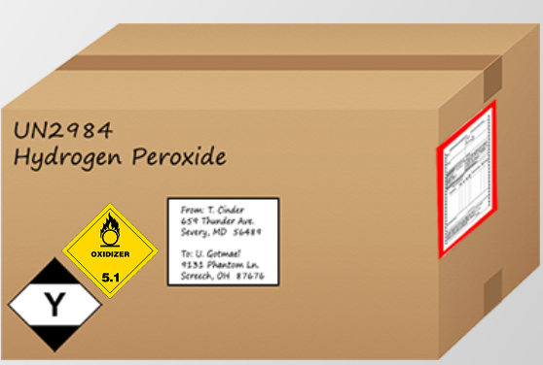
Prior to Accepting a Package Containing Dangerous Goods, Inspect the Following:
Packaging
Labels and markings
Documentation
Damage
This package has labels/markings indicating a dangerous substance that is prohibited in international mail. This package must not be accepted.
Notes:
A declared dangerous good is one that is identified by the mailer and properly packaged, labeled, documented, and accepted. When accepting dangerous goods, personnel should inspect the packaging, labels and markings, and documentation. If the material is allowed in the mail, the package can then be accepted.
- Check that the packaging is strong and sturdy enough to protect the contents
- Check there is sufficient cushioning to prevent breakage or damage
- Check that all required labels and markings are present
- Check that the mailer has completed all required transport documents properly and affixed them to the package
- Check for damage to the packaging (damaged packaging should not be accepted)

Slide 76
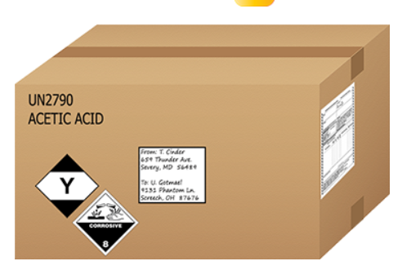
A Package is NOT Mailable When:
It contains prohibited dangerous goods.
It contains permissible dangerous goods, but they are not properly packed, labeled or documented.
Notes:
Any parcel suspected of containing dangerous goods, which is not properly labeled or identified (undeclared), or containing prohibited dangerous goods is non-mailable. If you identify a non-mailable package, do not accept it.

Slide 77
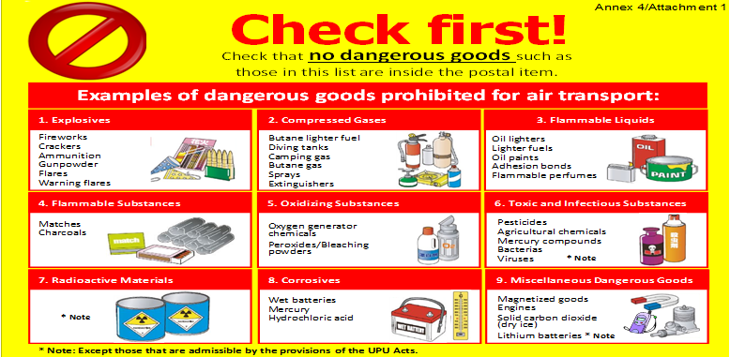
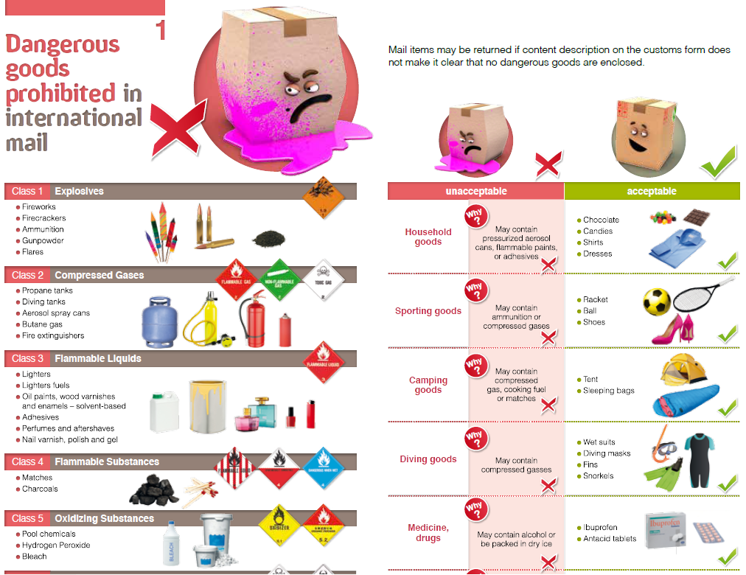
Job aids and brochures, like the ones shown here, can be used to assist customers with mailings.
Notes:
Use posters, brochures, or job aids to explain to the customer why their package is not mailable.

Slide 78
Knowledge Check
Question #14
Which of the following dangerous goods should not be accepted for transport in international mail?
  A cellphone containing a lithium battery
  A Category B infectious substance with dry ice
  A laptop with a spare battery
  None of the above
Notes:
The correct answer is C.
Lithium batteries must be installed in equipment, spares are not allowed in international mail.

Slide 79
Knowledge Check
Question #15
To determine if a package contains dangerous goods, you should do all of the following, EXCEPT:
  Look for hazard labels
  Ask the mailer about the contents
  Check the contents description on the customs form
  Shake the package vigorously
  None of the above
Notes:
The correct answer is D.
For your safety, you should never shake a package with unknown contents, especially if it is suspected to contain dangerous goods.

Slide 80
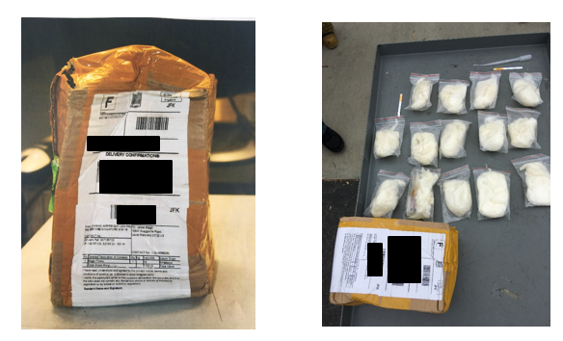
Recognition of Undeclared Dangerous Goods
Notes:
In this module, we will cover recognition of undeclared dangerous goods. While it is the responsibility of acceptance personnel to help prevent undeclared dangerous goods from entering the mail stream, occasionally, non-mailable parcels are discovered in the mail. All employees share the responsibility to look for and remove suspected undeclared dangerous goods from the mail stream.
The photos on this slide show a package that was caught at an International Airport. The customs form identified the contents as “magic tricks”; however, it actually contained several packets of guncotton. Guncotton is basically a raw form of nitrocellulose. This material is categorized as a Class 1 explosive. It is very energetic and can detonate under certain conditions.

Slide 81
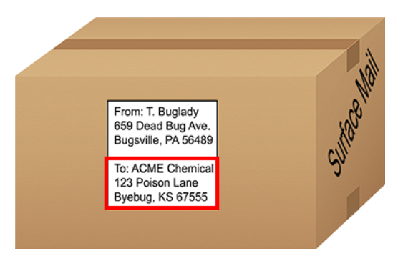
Look Out for these Potential Indicators that a Package Contains Undeclared Dangerous Goods
Preprinted markings on the box (product names or descriptions)
Recipient or sender is a business that handles dangerous goods
UN labels or markings
Stains, leaks, or odors
Sound of broken glass
Lack of or incomplete return address information
Heavily wrapped in plastic or tape
Notes:
An undeclared dangerous good is any parcel containing prohibited dangerous goods or dangerous goods that are not properly labeled or identified. When presented with a parcel or bulky flat, you should examine all sides and check for these potential indicators of a dangerous good.
If you identify a package that you suspect contains undeclared dangerous goods, take the parcel to your facility’s designated hazardous materials (dangerous goods) staging area and notify your supervisor. If the parcel is leaking, follow your facility’s Standard Operating Procedure (SOP) for spills and leaks.

Slide 82

Knowledge Check
True or False
Question #15
If a package displaying an explosive label is discovered
in the mail, it should be returned to the accepting postal
operator.
Notes:
The correct answer is False.
A prohibited dangerous good discovered in the mail, should never be returned to the mail stream.

Slide 83

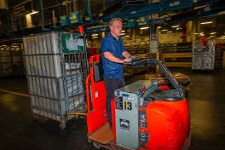
Processing and Handling Procedures for
Mail Containing Dangerous Goods
Notes:
In this module, we will discuss the general processing, staging, storage and handling procedures for dangerous goods. We will also cover the procedures for handling a leaking or prohibited item that is discovered in the mail.

Slide 84
General Handling Procedures
Do not throw, drop or slide mail containing dangerous goods.
Do not process dangerous goods packages on automated or mechanized sorting systems.
Transport mail containing dangerous goods in hard-sided or caged equipment, do not use canvas hampers.
Do not pass undeclared dangerous goods to the next operation or facility. Take the package to the designated staging facility.
Notes:
Packages containing dangerous goods must be handled manually. Any sack, pouch, or container that is identified as dangerous goods must be taken directly to the manual distribution operation.

Slide 85

How to Properly Dispatch Dangerous Goods Packages to Receiving Facilities
Notify the facility of arriving dangerous goods
Dangerous goods should be loaded last and unloaded first
** Never dispatch leaking or suspected undeclared dangerous
goods parcels.

Slide 86
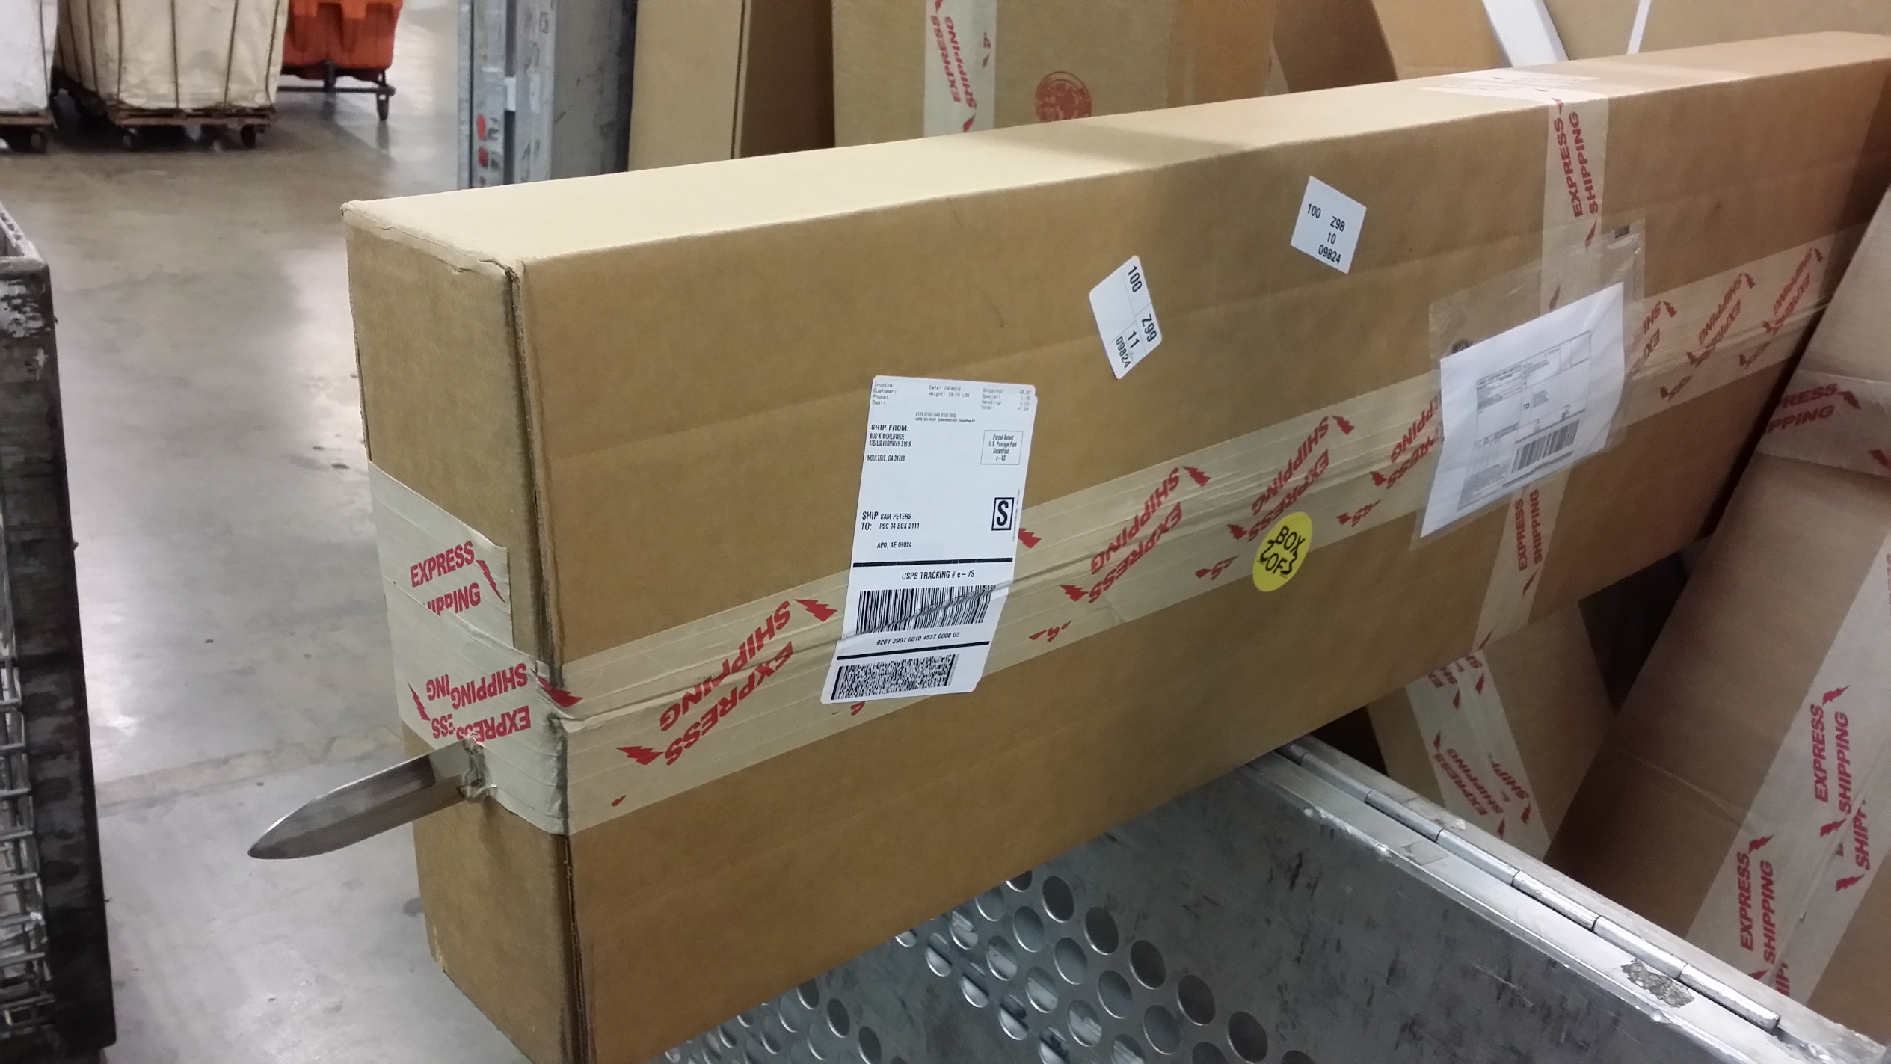

Handling Suspicious Mail or a Dangerous Goods Incident
Incidents involving dangerous goods and suspicious mail must be handled immediately.
Notify your supervisor or another member of management.
Refer to your facilities standard operating procedures (SOP).
Do not leave the items or forward them to another facility.
Notes:
If there is an incident involving dangerous goods, or you suspect something suspicious about a parcel, inform your supervisor and refer to your facilities standard operating procedures for dealing with dangerous goods or suspicious parcels.

Slide 87
Knowledge Check
Question #16
How should packages containing acceptable dangerous goods be processed?
  On mechanized machinery
  In canvas hampers
  Manually sorted (no throwing, dropping)
  None of the above
Notes:
The correct answer is C.

Slide 88
Knowledge Check
Question #17
When should incidents involving dangerous goods be handled?
  When your shift has ended
  Once all the mail is processed
  When you see your supervisor
  Immediately upon discovery
Notes:
The correct answer is D.

Slide 89


Provisions for Passengers and Crew
Notes:
In this module, we will discuss dangerous goods that can be carried by passengers and crew.

Slide 90
Regulations permit passengers and crew to carry very few dangerous goods.
Everyday items that are required for practical reasons and are considered dangerous goods are only allowed in controlled quantities.
Individual airline operators may have separate requirements and an approval process.
Passengers should contact their airline for a list of items that may be carried.
Notes:
Many everyday, necessary items, like toiletries or cosmetics, are considered dangerous goods. For this reason, they are subject to certain controls, in order to be carried by passengers and crew, either on their person, or packed in checked or carry-on baggage.

Slide 91
Emergency Procedures
Notes:
In this module, we will discuss emergency procedures for managing dangerous goods incidents.
Dangerous goods incidents may occur for many reasons. Customers may not have been aware of current regulations regarding dangerous goods that are forbidden in international airmail. Dangerous goods that were allowed in the mail may not have been packaged, or labeled properly.

Slide 92


Response to Dangerous Goods Incidents
If you discover a parcel that is stained, leaking, has an unusual odor, or presents any other suspicious characteristic, follow the appropriate response procedures for your facility.
Notes:
Be observant for stains, leakage, unusual odors, or hot temperature. If you encounter a parcel with any of these characteristics, do not touch or smell the parcel to determine the contents. Apply the appropriate response procedures outlined by your facility. This could include, hazardous materials response, suspicious items response, or emergency response by local authorities.

Slide 93
General Response Protocols
Isolate the package and restrict access to it
Contact a supervisor
Seek emergency assistance if necessary
In order to clear the item, additional screening may be needed
The originating post may be able to assist with clearing the item
Do not dispatch items that have not been cleared
Notes:
In order to resolve an incident, follow the facility standard operating procedure for responding to spills, leaks or suspicious items. In the case of suspicious items, this could include the use of alternate screening methods.
Cognisant of National Civil Aviation Security Program requirements, if the designated operator or screening designee cannot resolve an item after following the procedures outlined above, the mail piece shall not be handed over, loaded or transported to any carrier/aircraft.
The mail piece shall be isolated in a secure location, controlled, and physically guarded to prevent unauthorized access to it.

Slide 94
Reporting the Incident
Proper reporting procedures should be followed when incidents involving dangerous goods cannot be cleared through screening. Report the incident to:
  The local Civil Aviation Authority should be informed
  The host government authorities, police, fire and/or bomb
  squad should be contacted immediately (according to local
  requirements)
  If the item was in transit or at the destination, the
  originating Post should be notified
  Report the incident to the UPU
Notes:
The designated operator or screening designee should report the incident to all appropriate entities.

Slide 95
Knowledge Check
Question #18
Which of the following are general procedures for responding to spills, suspected dangerous goods or suspicious items?
  Isolate the package
  Restrict access to the package
  Contact a supervisor
  If needed, seek emergency help
  All of the above
Notes:
The correct answer is E.

Slide 96
Knowledge Check
Question #19
When there is an incident involving dangerous goods, to whom should it be reported?
  Local Civil Aviation Authority
  Universal Postal Union
  Local governmental authorities
  All of the above
Notes:
The correct answer is D.

Slide 97

The Danger of Dangerous Goods
Prohibited or improperly prepared dangerous goods in the Post can lead to major incidents or worst case scenario, a serious transportation accident.
Notes:
Why is it important to prevent prohibited dangerous goods from entering the mail and ensuring admissible dangerous goods are properly packed and marked?
Regulating hazardous materials and keeping prohibited items out of the mail helps to protect customers, co-workers, transportation networks and infrastructure. In order to do this, it is critical employees have a general awareness of dangerous goods and their proper acceptance and handling.

Slide 98



Lithium Battery Fires
Notes:
The major risk associated with the transport of batteries and battery-powered equipment is short circuit as a result of the battery terminals coming into contact with other batteries, metal objects, or conductive surfaces. Short circuits cause a buildup of heat, which can lead to fire. This is the reason, there are limitations on the mailing of lithium batteries. These pictures show fires that resulted from lithium batteries.

Slide 99

International Mailing of Dangerous Goods by Air
END

