Slide 1
South-South and Triangular Cooperation
DCDEV meeting, 25 February 2022
DCDEV.PAP

Slide 2
What is South-South Cooperation?
South-South Cooperation is a broad framework for collaboration among countries of the South.
It’s a tool used by the states, international organizations, academics, civil society, and the private sector to share knowledge, skills, resources, and successful initiatives in different areas.
It derives from the Buenos Aires Plan of Action for Promoting and Implementing Technical Cooperation among Developing Countries (BAPA) adopted by 138 UN Member States in Argentina, on 12 September 1978.
South-South cooperation “is not a substitute for, but rather a complement to, North–South cooperation”. Involving two or more developing countries, it can take place on a bilateral, regional, sub-regional or interregional basis.

Slide 3
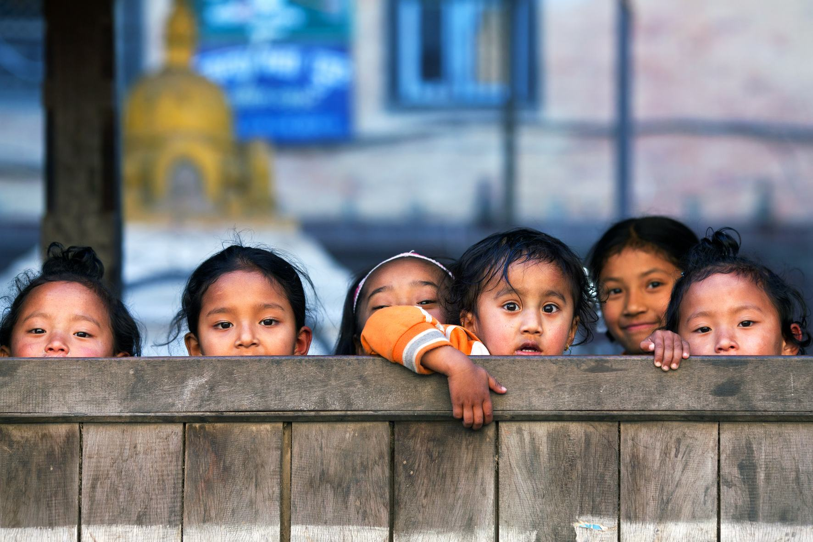
Did you know?
The countries of the South have contributed to more than half of the world's growth in recent years.
Intra-south trade is higher than ever, accounting for more than a quarter of all world trade.
The outflows of foreign direct investment from the South represent a third of the global flows.
Remittances from migrant workers to low and middle-income countries reached 466 billion USD in 2018, which helped lift millions of families out of poverty.

Slide 4
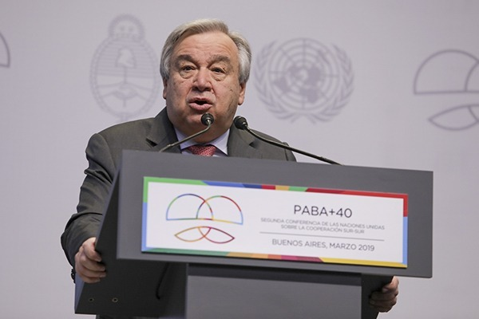
Why is South-South Cooperation important?
“Collaboration among countries of the Global South offers a “unique pathway” that accelerates us towards the 2030 Sustainable Development Goals,” - UN Secretary-General António Guterres, 12 September 2019, International Day for South-South Cooperation.
In his 2017 Report on the State of South-South Cooperation to the GA, the UN Secretary-General mandated the UN Office for South-South Cooperation (UNOSSC) to coordinate, in consultation with the UN agencies, the preparation of the UN system-wide South-South cooperation strategy to “achieve more coherent and coordinated support by the UN system”. The UPU is actively engaged in this process.

Slide 5
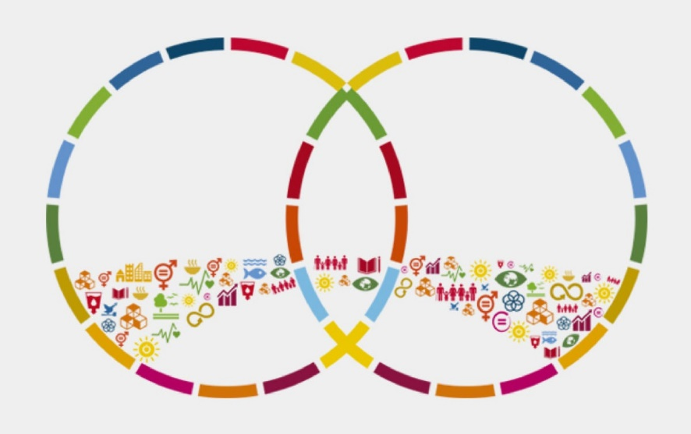
What is South-South and Triangular Cooperation?
In Triangular Cooperation, traditional donor countries and multilateral organizations facilitate South-South initia­tives through the provision of funding, training, management and technological systems, and other forms of support.
Triangular cooperation involves 3 actors: 2 from the South and 1 from the North. The latter (can also be an international organization) provides the financial resources so that the countries of the South can exchange technical assistance on a specific topic.
The division of “North” and “South” is used to refer to the social, economic and political differences between developed countries (North) and developing countries (South), and doesn’t depend on a geographic location.

Slide 6
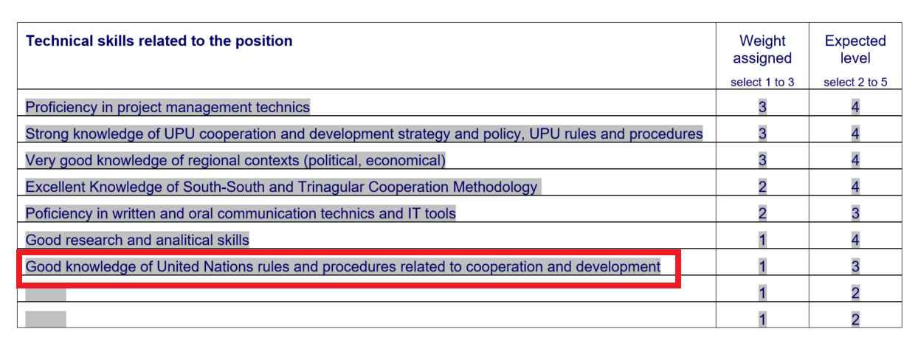
DCDEV Objectives (2021)
Understanding and implementing the United Nations 2030 Agenda for Sustainable Development is our objective at the UPU as international civil servants.

Slide 7
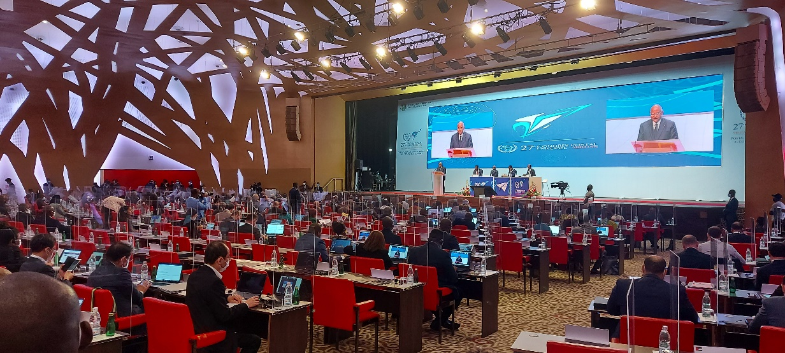
UPU’s commitment to South-South and Triangular Cooperation
Abidjan Postal Strategy (2022–2025) lays down the development cooperation between UPU member states based on the South-South and Triangular Cooperation mechanism.
In order to support the achievement of Postal Vision 2030, the UPU is expected to “…seek to offer postal sector stakeholders quality advice, training and technical cooperation options to support them in navigating the challenges and opportunities of a fast-changing sector.”
The UPU Congress has emphasized on this methodology to raise resources for beneficiary developing UPU member states. The focus is to support their relative initiatives and to align them with their national priorities by applying a “bottom-up” development approach.

Slide 8
UPU’s commitment to South-South and Triangular Cooperation

Slide 9
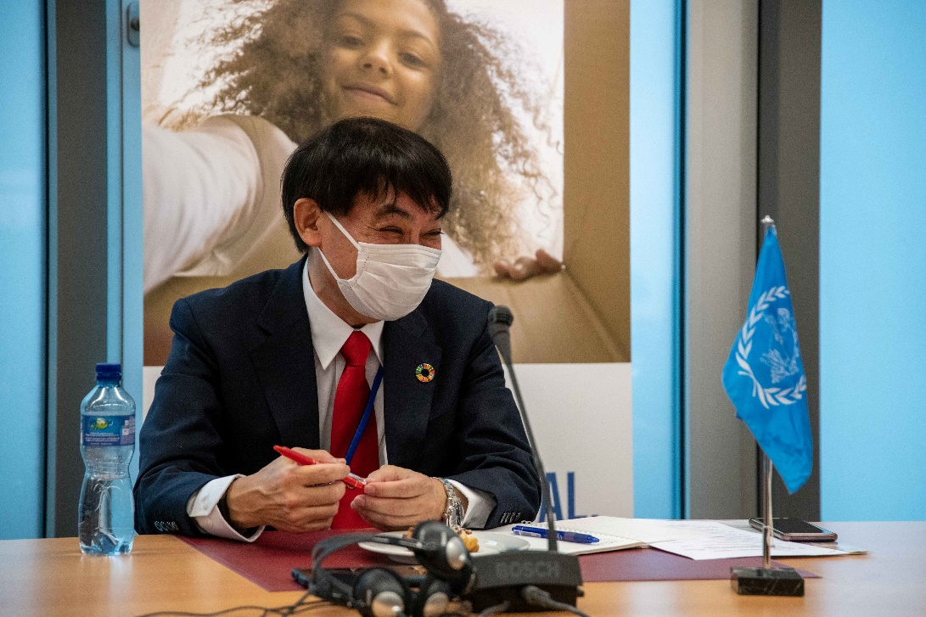
South-South and Triangular Cooperation concept
The use of appropriate technology and solutions works well, especially if there is a big constraint of resources. Southern countries used to complain about such solutions being thrust on them because they led to problems.
“Nothing for me without me” is the voice of the South in the development cooperation field. Within this framework, the UPU has developed its strategy for the South-South and Triangular Cooperation.
“The UPU is originally a technical organization that ensures that the technical, not political, matters are solved. Therefore, the role of the UPU is to react very fast and to assist the developing countries practically so that their needs are met,” – UPU Director General Masahiko Metoki, 5 January 2022

Slide 10
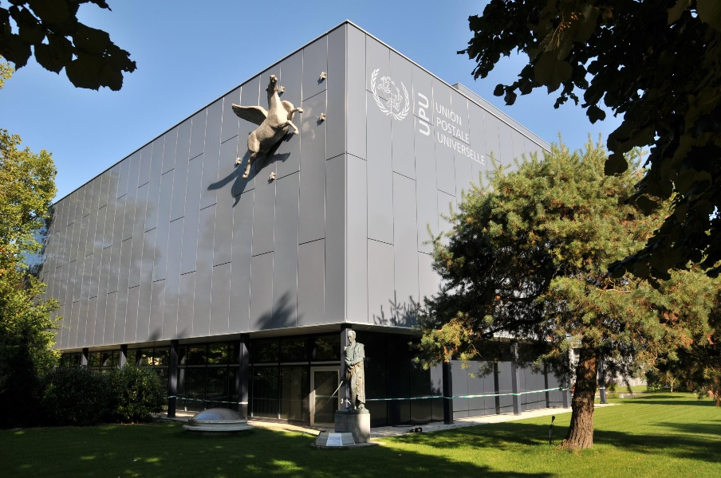
South-South and Triangular Cooperation concept
An important element of South-South and Triangular Cooperation is to train similar countries to ensure technical development. Only successful methods in a similar environment should be applied so that there is no need “to reinvent the wheel”.
When the UPU steps in South-South Cooperation, it becomes Triangular. We need to be proactively and innovatively involved.
UPU’s priority objectives:
To support national and regional development efforts;
To strengthen institutional and technical capacities;
To improve the exchange of experience and know-how among developing countries;
To respond to the specific challenges of developing countries;
To increase the impact of international cooperation and UPU’s effectiveness in the region.

Slide 11
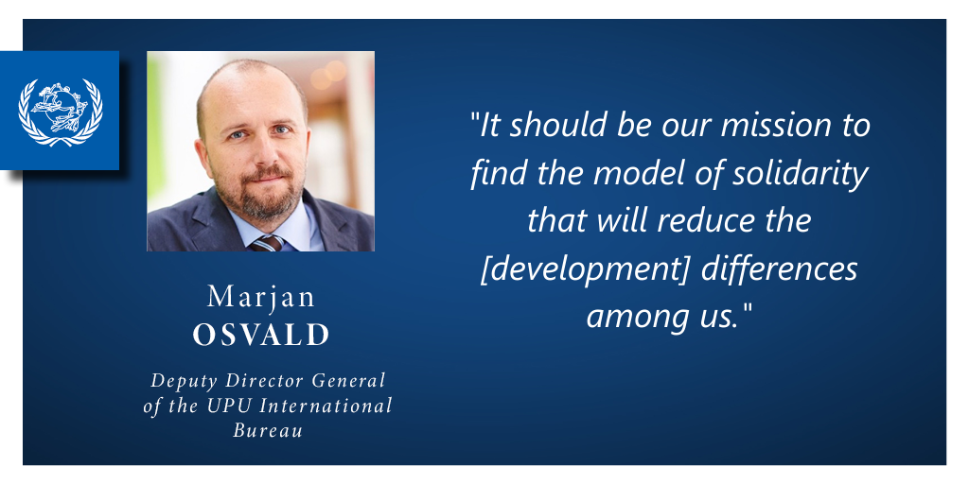
UPU’s commitment to South-South and Triangular Cooperation

Slide 12
Resource mobilization for South-South and Triangular Cooperation
South-South and Triangular Cooperation is an important tool for raising new resources – in cash and kind. We need to carry out projects in traditional and new ways by using the funds already available.
No resources should be wasted!
There are many ways to reduce project implementation costs by innovatively cooperating with the countries in the South and the North.
The resources of the DCs have increased and many of them are willing to share with the South. Countries in the North find the solutions and experiences of the South worth supporting and they are willing to implement the South-South and Triangular Cooperation model.
We need to link project outcomes with the regional and national priorities, and with the UN SDGs to get the support of the wider international community and the civil society.

Slide 13
What has been done?
In the previous cycle, the UPU implemented excellent projects under South-South and Triangular Cooperation:
COVID-19 Recovery Plan to supply IT equipment to 19 SIDS, LDCs, and LLDCs;
Operational Readiness for E-commerce (ORE) (8 week-long workshops: 4 for Asia and 4 for the Pacific);
training for postal officials from developing countries;
training equipment for the Asian-Pacific Postal College (APPC);
Interactive Online Training Program (IOTPs) at the APPC for developing countries: 422 participants, 8 IOTPs in 2020 and 17 IOTPs in 2021;
200 green computers, donated by a member country, to DOs in the Pacific (a contribution in-kind);
Strengthening the postal sector to fulfil its social obligation in 2019;
Postal infrastructure improvement for the enhanced e-commerce in 18 developing countries of the region (ongoing).
DCDEV.PAP was able to fully use the financial support from the donors to implement the projects.

Slide 14
South-South and Triangular Cooperation is our vision
The UPU DG issued a special appeal to all UPU members to assist the DOs financially: “It is important that the world community now come to the aid of DOs, particularly those in SIDS, LLDCs, and LDCs. It is essential to support these DOs in every possible way. This contribution may be in cash or in-kind.”
The DCDEV budget has shrunk. We need to find an innovative way for the further development of DO’s in our regions. South-South and Triangular Cooperation is our way.
We encourage all DCDEV teams to apply the South-South and Triangular Cooperation mechanism to develop their regions.
We offer to work together and implement interregional projects, e.g. training at the APPC for your member countries.
We’re happy to share our experience and best practices with you!

Slide 15
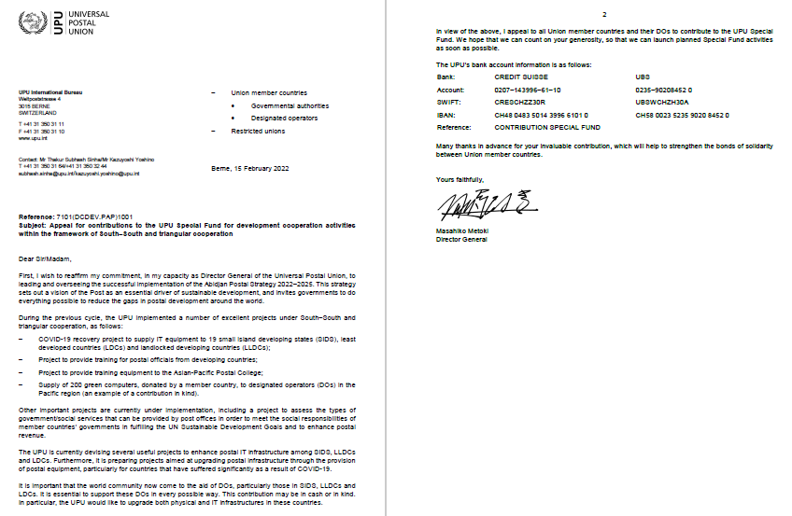
Appeal for contributions to the UPU Special Fund for development cooperation activities within the framework of South–South and Triangular Cooperation from the UPU Director General

Slide 16
Understanding and implementing the UN 2030 Agenda for Sustainable Development is our primary objective at the UPU

Slide 17
Thank you!
DCDEV.PAP

